Slide 1
CREATIVE EUROPE DESK SWEDEN
Elin Rosenström

Slide 2
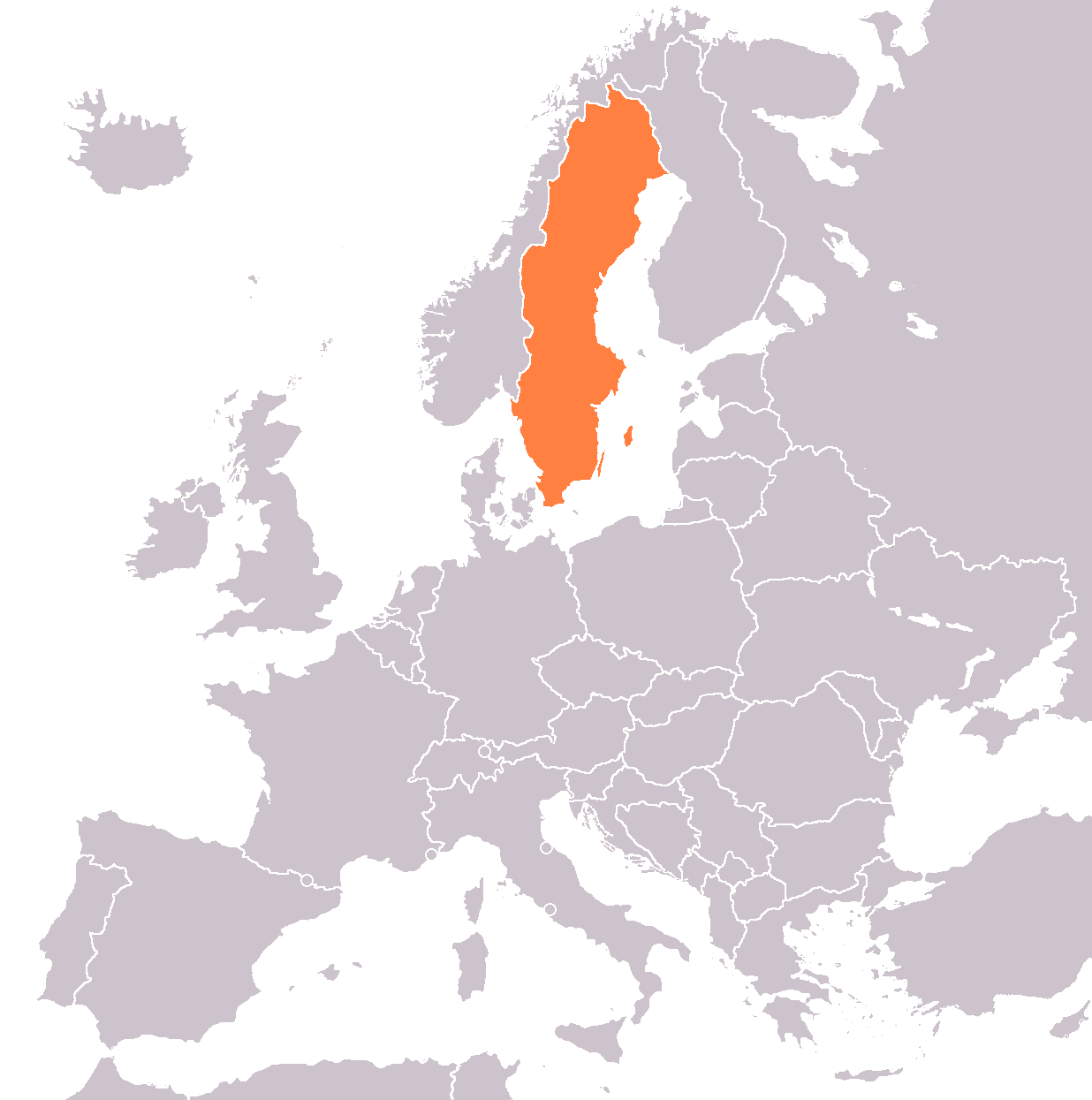
SWEDEN
Some basic facts:
Approx. 10 million inhabitants
Stockholm is the capital, Göteborg and Malmö second and third largest cities
Language: Swedish, common to speak English fluently
Currency: Swedish crown (SEK)

Slide 3
SWEDISH CULTURAL POLICY
The objectives for Swedish cultural policy are that:
Culture is to be a dynamic, challenging and independent force based on freedom of expression
Everyone shall have the opportunity to participate in cultural life
Creativity, diversity and artistic quality are to be integral parts of society’s development

Slide 4
SWEDISH CULTURAL POLICY
To achieve the objectives, Swedish cultural policy is for example to:
Promote international and intercultural exchange and cooperation
Promote opportunities for everyone to experience culture, participate in cultural activities and develop their creative abilities
Promote quality and artistic renewal
Promote culture for children and young people

Slide 5
FUNDING FOR CULTURE IN SWEDEN

Slide 6
FUNDING STRUCTURE: AN OVERVIEW
The culture sector is mainly financed by public funding (national, regional and local level), low percentage of private investments, sponsorship etc.
No cuts in the state budget for culture, stable situation for the Swedish arts and culture sector. Large budget for culture rise in 2018 (745 million Swedish crowns)
Several different funding agencies

Slide 7
SWEDISH ARTS COUNCIL
Public authority under the Swedish Ministry of Culture and Democracy
Principal task: to implement national cultural policy determined by the government and the parliament
Aim to promote development in the culture sector, based on the national cultural policy objectives
Activities for the development of the sector (including evaluations, analysis etc.)

Slide 8
SWEDISH ARTS COUNCIL
Main funder in Sweden, allocating annual subsidies of 1,8 billion Swedish crowns yearly
Allocates state funding to theatre, dance, music, literature, reading promotion, public libraries, cultural magazines, visual arts, museums and exhibitions, national minorities languages, specific missions and programmes
Reference groups – peer reviews – a total of 120 experts “arms length distance”

Slide 9
SUPPORT FOR INTERNATIONAL CULTURAL COOPERATION
Funding for international cooperation, exchange and internationalisation: working grants, project grants, touring, co-productions etc. Priority for co-financing of Creative Europe projects (the Swedish organisation is eligible to apply)
Grants for cultural export
International promotion of Swedish Performing Arts (international fairs; APAP, PAMS etc.)
Grants for international book publishers

Slide 10
SWEDISH LITERATURE EXCHANGE
Grants for publishers based outside of Sweden:
Translation grants
Project grants (inviting Swedish writers etc.)
Grants for arranging translation workshops/training
Grants for participation at the Göteborg Book Fair
Read more at www.kulturradet.se/en/swedishliterature lncludes contact details for publishers and literary agents in Sweden

Slide 11
SWEDISH ARTS GRANTS COMMITTEE (Konstnärsnämnden)
Support individual professional artists based in Sweden active in visual art, design, music, dance, theatre and film, promote international cultural exchange, support artists´ travels, projects and artistic work
International music programme and international dance programme
International residency programmes
IASPIS
Read more at www.konstnarsnamnden.se

Slide 12
IASPIS
The Swedish Arts Grants Committee's International Programme for Visual and Applied Artists
Supporting international exchange for artists in visual art, design, craft and architecture
Establishing international contacts between practitioners and professionals, such as curators and critics
Aim to increase contacts between Swedish artists and international institutions, artists and the general public

Slide 13
IASPIS
Support for international cultural exchange and expert visits of foreign curators, critics and other professionals active in visual arts and design to create and develop contacts with artists and curators in Sweden
Residencies in Sweden and abroad
Swedish artists can apply to invite international artists to Sweden to collaborate and to learn from their experiences and knowledge. The forms may vary:
seminars, workshops, or other joint artistic projects, grant to cover the international guests' costs of travel

Slide 14
OTHER SOURCES OF FUNDING
Performing Arts Agency (Statens musikverk) fund collaborative projects in the independent professional music sector www.musikverket.se
Swedish Institute (Svenska institutet) support exchange with other countries in the fields of culture, education, research and social life Creative Force Programme for cultural cooperation www.si.se
Swedish based organisations are eligible to apply

Slide 15
UMBRELLA ORGANISATIONS AND ASSOCIATIONS: PERFORMING ARTS
Scensverige (Swedish ITI) organisations and institutions in performing arts, promote international collaborations and exchanges. Represent Sweden in the International Theatre Institute Svensk Scenkonst (Swedish Performing Arts Association) organisation for theatre, music and dance, member of ISPA (International Society of Performing Arts)
Swedish Assitej organise theatre for children and young adults

Slide 16
UMBRELLA ORGANISATIONS AND ASSOCIATIONS: MUSIC
Musiksverige (Music Sweden)
Export Music Sweden (promote Swedish music in all genres abroad, arrange capacity building training and seminars for the music sector etc.)
Föreningen Sveriges Tonsättare (Swedish Society of Composers)
Svensk Live (part of the European Platform Live DMA)

Slide 17
UMBRELLA ORGANISATIONS AND ASSOCIATIONS: VISUAL ARTS AND LITERATURE
Visual arts: Konstnärernas Riksorganisation (Swedish Artists' National Organization) Riksförbundet Sveriges museer (Association of Swedish Museums)
Architecture: Sveriges arkitekter (Swedish Architects)
Design: Svensk form (Swedish Design Association)
Literature: Förläggareföreningen (Swedish Publishers Association)

Slide 18
SWEDISH CULTURE SECTOR
Broad and diversified sector
Solid infrastructure for arts and culture with support systems for arts professionals and arts organisations (national, regional, local public funding)
Developed organisational structure, including associations and trade unions

Slide 19
SWEDISH PARTICIPATION IN CREATIVE EUROPE − CULTURE
Large interest from Swedish organisations of different sizes to participate in international cultural cooperation on individual and organisational level, including participation in Creative Europe-projects
Notes:
Två delprogram:
Kultur ̶ alla kulturella och kreativa sektorer
MEDIA ̶ audiovisuella sektorn; film, tv och dataspel
Ett sektorsövergripande programområde, bl.a. ett nytt lånegarantiinstrument och stöd till gränsöverskridande policysamarbete

Slide 20
SOME EXAMPLES
European networks: Trans Europe Halles, Sweden, Arts Printing House, Lithuania
European platforms: Versopolis Poetinis Druskininku ruduo, Lithuania, Littfest, Sweden
Aerowaves Lietuvos sokio informacijos centras, Lithuania, Dansens Hus, Sweden
PARALLELL – Europen Photobased Platform Kauno Skyrius, Lithuania, Landskrona city council, Sweden

Slide 21
CONTACT DETAILS
Elin Rosenström Head of Creative Europe Desk Sweden
E-mail: elin.rosenstrom@kulturradet.se
Tel. + 46 8 519 264 15
www.kreativaeuropa.eu

