Slide 1
Kaunas Forum 2018
Thea Breivik, Arts Council Norway

Slide 2
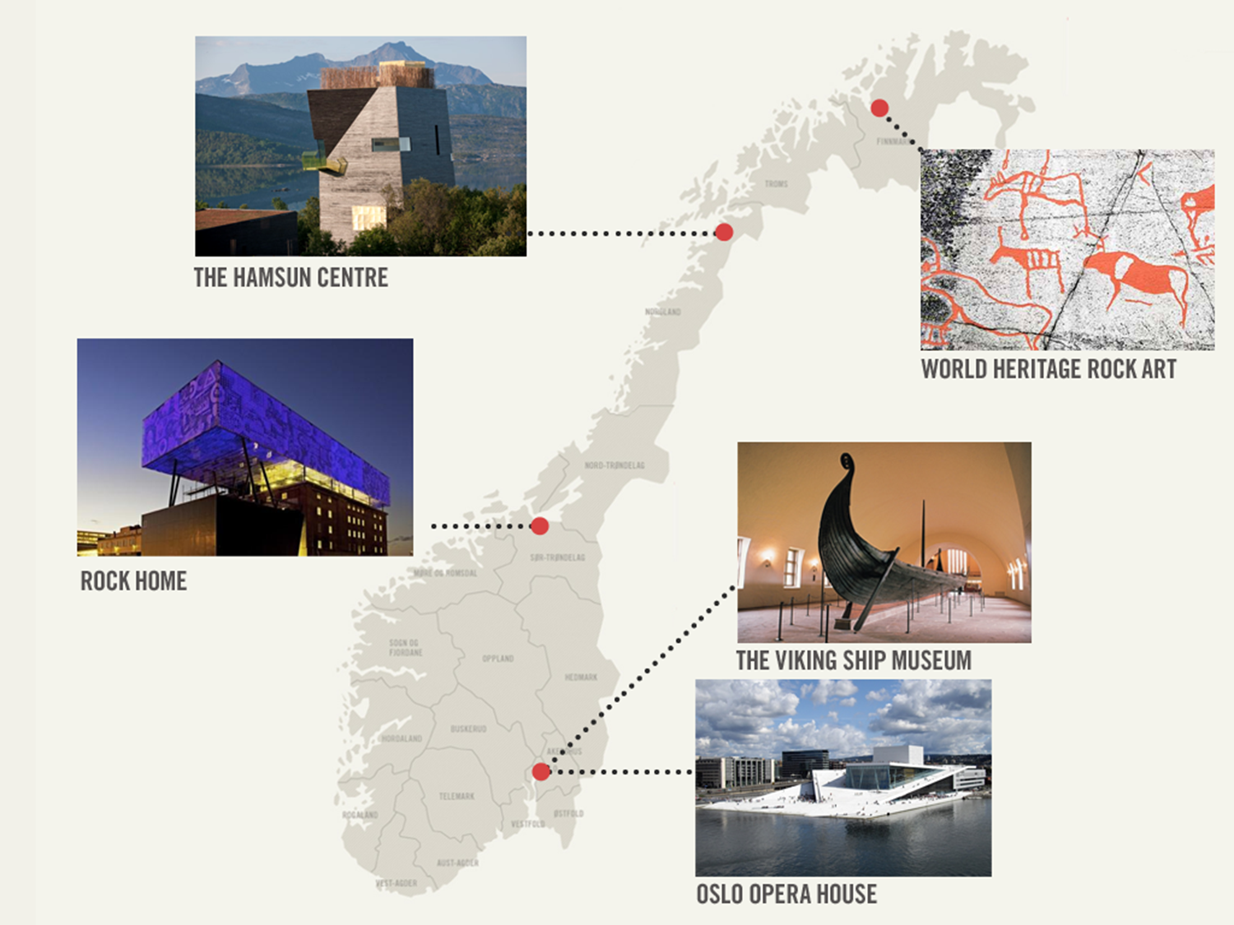
Notes:
Norway has a population of 5 million people, and a vast coasline. And there are great distances between the different parts of the country. The geography is a challenge for culture in Norway. This is a challenge in terms of reaching the audience, and for the citiziens to have access to professional art.
In our work with the EEA Grants we try to reach out as far as possible, to the whole cultural sector. We cooperate closely with others, like the Directorate for Cultural Heritage and other stakeholders to reach out.
The EEA grants will offer opportunities for cultural exchange in 7 countries to date. Ten relatively big-sixed European countries offer chances of collaboration with three very small, together totalling aroung 5,5 million inhabitants. Small nr. 1 Norway – Small nr 2. Iceland and even smaller 3: Liechtenstein
300 Norwegian cultural operators aleady involved in the EEA grants, in addition we have several cultural players from Iceland involved.

Slide 3
Main topics:
Norwegian cultural policy
Creative Europe in Norway
EEA grants - new period coming up

Slide 4
Arts Council Norway
The main governmental operator for the implementation of Norwegian cultural policy
Advisory body to the central government and public sector on cultural affairs
Arms length principle + peer review
Funding for a variety of projects and activities within the performing arts, visual arts, music, literature, archives, museums
also artists’ grants, the Audio and Visual Fund and
manage government initiatives in the museum sector
Notes:
10 oppnevnte rådsmedlemmer, 125 utvalgsmedlemmer i 25 ulike utvalg.
EEA Grants
Creative Europe desk
UNESCO
Norwegian-Icelandic programme
Nordic project on integration

Slide 5
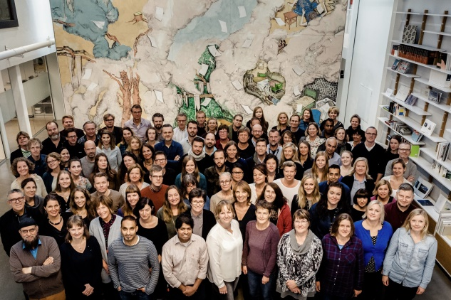
Notes:
The Arts Council Norway november 2015. Staff of 120 people.
The Arts Council Norway is:
The main governmental operator for the implementation of Norwegian cultural policy
Advisory body to the central government and public sector on cultural affairs
Financed by the Ministry of Culture
Arms length policy

Slide 6
«Taking part in Platform Shift + has given us new impulses and the possibility to explore what theatre for young people can be today».
Cecilie Lundsholt, Teatret Vårt
Platform Shift +. Photo: Arild Moen
Notes:
Norway is not an EU member
But through agreements we take fully part – pay
EVALUATION:

Slide 7
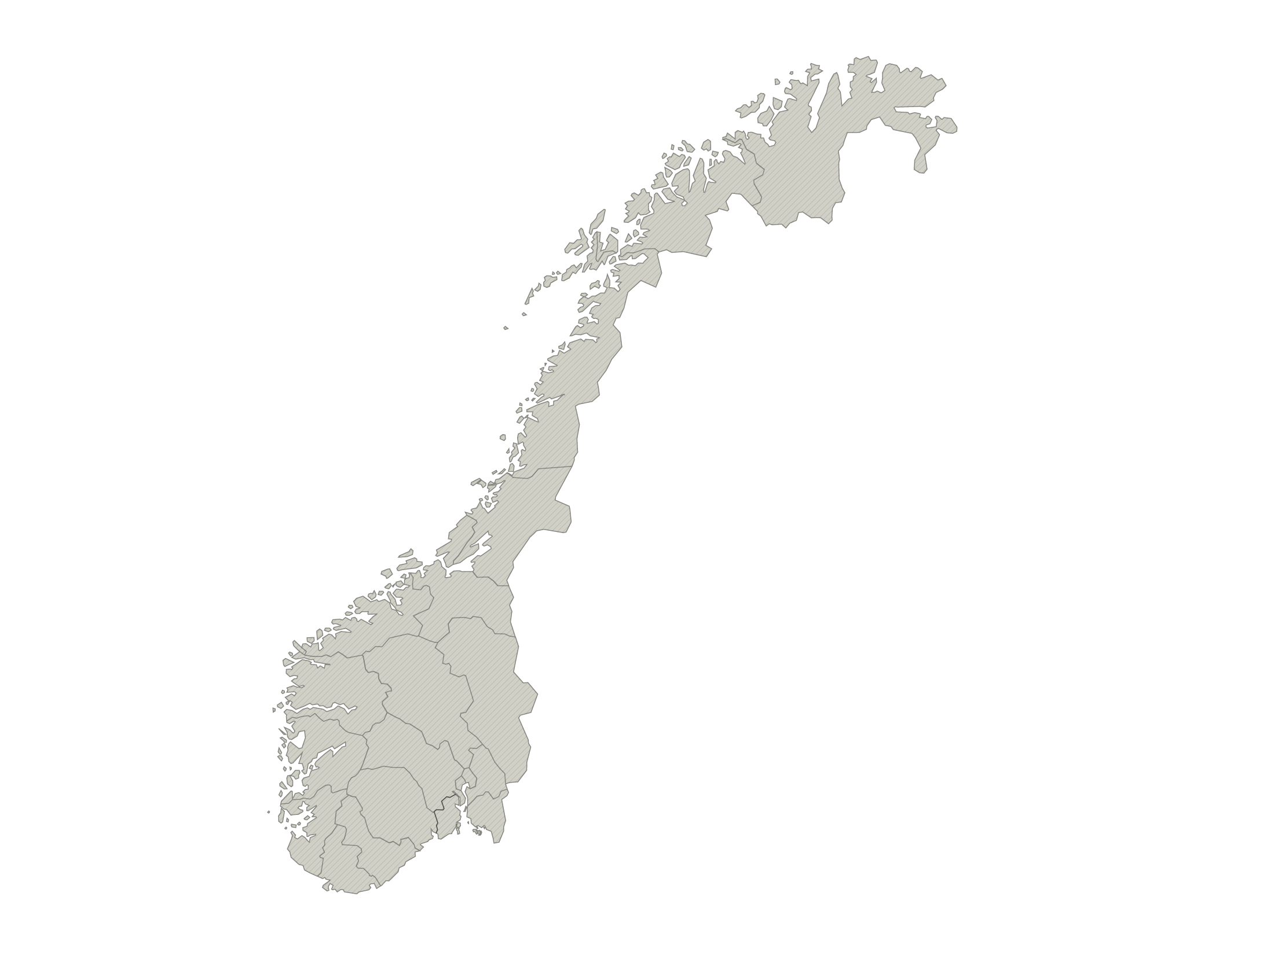
We Are Europe Insomnia Festival
http://www.kulturradet.no/internasjonalt/prosjektbank?categoryIds=1202657,1297034
Follow the Vikings Sør-Troms Museum
Changing Weathers, Hilde Methi
Power of Diversity Pikene På Broen AS
Follow the Vikings Museum Nord
Advancing Performing Arts Project - Performing Europe 2020 Bergen Internasjonale Teater Future DiverCities-Creativity in an Urban context, Bergen senter for elektronisk kunst Turn on Literature, Bergen Offentlige Bibliotek
Re-imagine Europe
Bergen Kunstforening
PLATFORM Shift + Teateret Vårt
I will be everything
Nordland teater
The people's smart Sculpture, Oslo Barnemuseum og Universitetet i Oslo
Moving Classics Network For New Music, Pinquins Ans
Blackboard Music Project, Rikskonsertene
Liveurope, Blå Literary Europe Live, Oslo Internasjonale Poesifestival
Renewable Futures, Høgskolen i Oslo og Akershus
MusXchange, Ungdomssymfonikerne
European Talent Exchange Program 3.0, Music Norway ULYSSES, Ultima Theatre European Engagement Network og PUSH, Norsk Scenekunstbruk Platform of European Acadmies, Westerdals ACT
Opera vision, Den norske opera og ballett
Follow the Vikings Karmøy Kommune
READ ON
Haugaland vgs
Big Bang - an Adventurous Music Project for Children, Stavanger konserthus European Light Expression network, I/O/LAB Rogaland senter for framtidskunst
IN SITU ACT Østfold Kulturutvikling
PLATFORM Shift + Universitetet i Agder
Exchange of international talent in Europe
Sørnorsk kompetansesenter for musikk
Bokbyen forlag
Notes:
Norske kulturaktører over hele landet deltar i Kreativt Europa prosjekter. Vi har god spredning fra nord til sør og innen ulike kunst- og kulturfelt.
Who takes part?
Some national institutions Opera
Regional art instit
Relatively good funding structures
Capital of culture – can apply every third year – in competion with

Slide 8
Platform Liveurope. From the venue BLÅ Photo: Stian Frøysang
Notes:
PARTNER SEARCH – we are there to help you!

Slide 9
New Period - EEA GRANTS
2014 – 2021 (2023)

Slide 10
What are EEA grants?
Iceland, Liechtenstein and Norway grants
Reducing economic and social disparities in Europe
Strengthening bilateral relations with 15 beneficiary countries in Northern, Central and Southern Europe

Slide 11
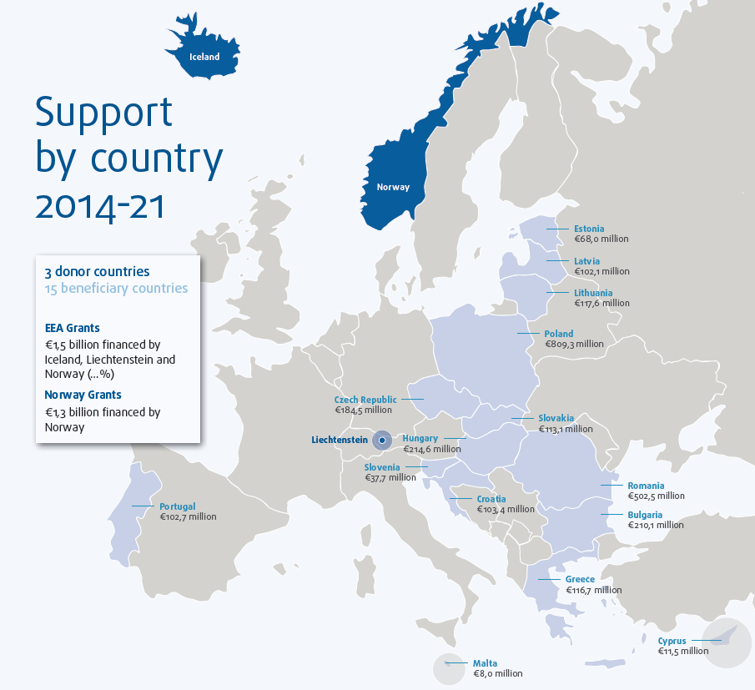
Notes:
2

Slide 12
5 priority sectors
Innovation, Research, Education and Competetiveness
Social Inclusion, Youjt Employment and Poverty Reduction
Environment, Energy, Climate Change and Low Carbon Economy
Culture, Civil Rights, Good Governance and Fundamental Rights and Freedoms
Justice and Home Affairs

Slide 13
Culture programmes in 8 countries
Bulgaria
Latvia
Czech Republic
Lithuania
Poland
Portugal
Rumania
Slovakia

Slide 14
The cultural programme
Cultural Entrepreneurship, Cultural Heritage and Cultural Cooperation
Objective: Social and economic development strengthened through cultural cooperation, cultural entreneurship and cultural heritage management
The Cultural and Creative sectors are important drivers of economic growth, job development and social inclusion
Cultural heritage – DPP is Norwegian Directorate of Cultural heritage

Slide 15
Bilateral funds
Cross sectorial – also culture
In addition to the programmes every country has a bilateral fund
2% of the total allocation in each country
Joint Committee is set up with representatives from both sides
Notes:
Focus: bilateral ambitions
cooperation between institutions and persons at administrative and political level
as well as in the private sector, academia and civil society. Other elements of bilateral
relations include trade and investment, cultural cooperation, as well as general
knowledge, understanding and public awareness about the other country and the ties
existing between them.
activities that have a clear
bilateral profile and serve the purpose of strengthening bilateral relations between the
Donor and Beneficiary States. As an example, in an event supported under the fund
for bilateral relations, having attendants from Donor State entities at the actual event
is not considered sufficient to define it as ‘bilateral’. The event must reflect the bilateral
ambition throughout the event programme, e.g. through a focus on exchanging
relevant experiences between the Donor and Beneficiary State. Both promoters and
partners shall be actively involved in planning and organising the activity.
The flexibility of funds for bilateral relations is ensured through a longer eligibility
period than for programmes and projects2, as well as by opening up for activities of
smaller scale that are subject to a simplified approval process.
JCBF has a direct role in allocating funds for bilateral relations to programmes of
bilateral interest, as well as identifying initiatives beyond the programmes. Through
the JCBF, the Donor and Beneficiary States will jointly establish bilateral ambitions,
identify priority areas for bilateral cooperation
Work Plan will be:
• Are there on-going initiatives or upcoming events of importance for bilateral
relations to build on?
• Are there areas of common bilateral interest highlighted in the MoU or identified
by the JCBF that should be prioritised?
• Are there areas of common interest at political level and European level which
are relevant for strengthening bilateral relations?
• Could initiatives be tied to major events in the Donor or Beneficiary State (state
visits, international chairmanships, EU Presidencies, European Capitals of
Culture, etc.)?
• How can the funds best be used to promote and facilitate partnership projects
under the programmes?
The ambitions and priorities might vary from

Slide 16
Arts Council Norways role
The Arts Council Norway cooperates with Programme Operators as a Donor Programme Partner*
Advise on programme development and implementation
Many of the challenges of the arts and culture sector are the same over Europe
A unique opportunity to collaborate directly with related entities in central and southern Europe.

Slide 17
Special concerns
Programmes have included special concerns which have focus on:
Cultural diversity
Minorities’ culture
Roma culture
Jewish heritage
Children and youth

Slide 18
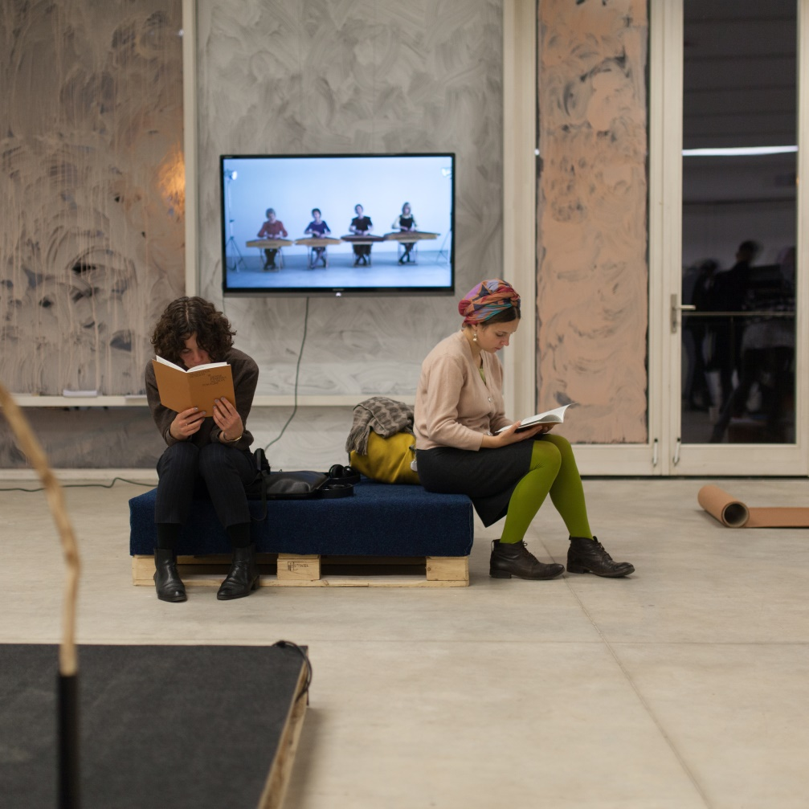
Cultural cooperation
Music
Performing Arts
Cultural Heritage
Visual Arts
Education
Literature
Creative place making
From Rupert, Lithuania in cooperation with National Academy of Art in Oslo and The Living Art Museum i Reykjavik: «Interdisciplinary Art Project Politics of Emotion: Art in the Expanded Sphere»
Notes:
Totalt var det Midler til prosjekter innenfor kunst- og kulturfeltet i 10 land (Bulgaria, Latvia, Litauen, Polen, Portugal, Romania, Slovakia, Spania, Tsjekkia, Ungarn)
300 prosjekter – da teller vi med alle initiativer, også studiebesøk, workshoper o.l.

Slide 19
Aura Dance Theatre, Kaunas– «Godos»
Panta Rei Danseteater
Notes:
Det var mange prosjekter i landene i Østersjøregionen – totalt 84 i Latvia, Polen og Litauen, som er de baltiske landene der Kulturrådet er samarbeidspartner. (Til sammen gikk ca. 14 millioner euro til disse landene.)
Panta Rei Danseteater fra Norge og Aura Danseteater i Kaunas skaper i fellesskap forestillingen GODOS hvor elementer fra norsk og litauisk folklore, tradisjoner, moderne musikk og dans inngår.

Slide 20
Factory Light festival – Bella Sky Way,Torun

Slide 21
How is this relevant to me?
Key to unlocking more funding!
A chance to promote your productions in Norway, Iceland or Liechtenstein
A way of reaching your communties within Norway
Do you have partners from Creative Europe that you want to work closer with?
EEA projects can develop into Creative Europe projects
NB! No double funding allowed - side projects can be a solution
Notes:
For non

Slide 22
Prepare for calls 2019!
Define: what are your needs – look to your strategy
Make a simple project proposal
Find out who do you want to play with
Contact possible partners - studytrip!
Check your resources – in kind needed?
Be well prepared when the calls come

Slide 23
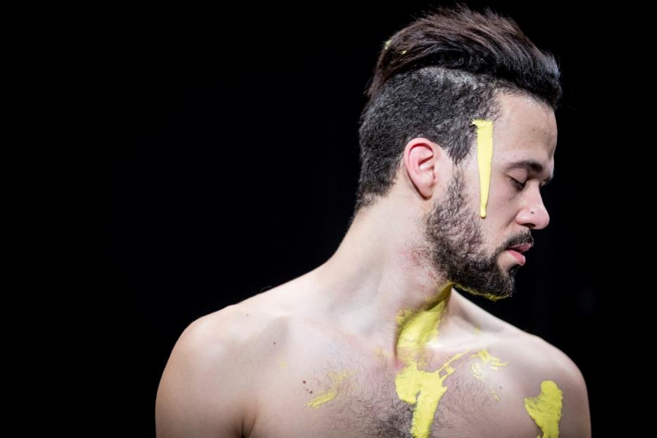
Implementation issues
Complicated administrative procedures
Reporting and documentation can be demanding
Reimbursement takes time
Public procurement necessary
Sniper’s Lake: Czech – Norwegian dance co-production. Photo: Vojtech Brtnicky

Slide 24
But…
… most issues are soved through good dialogue and good cooperation!
Norwegian and Portuguese students are creating operas in «Write a Science Opera»

Slide 25
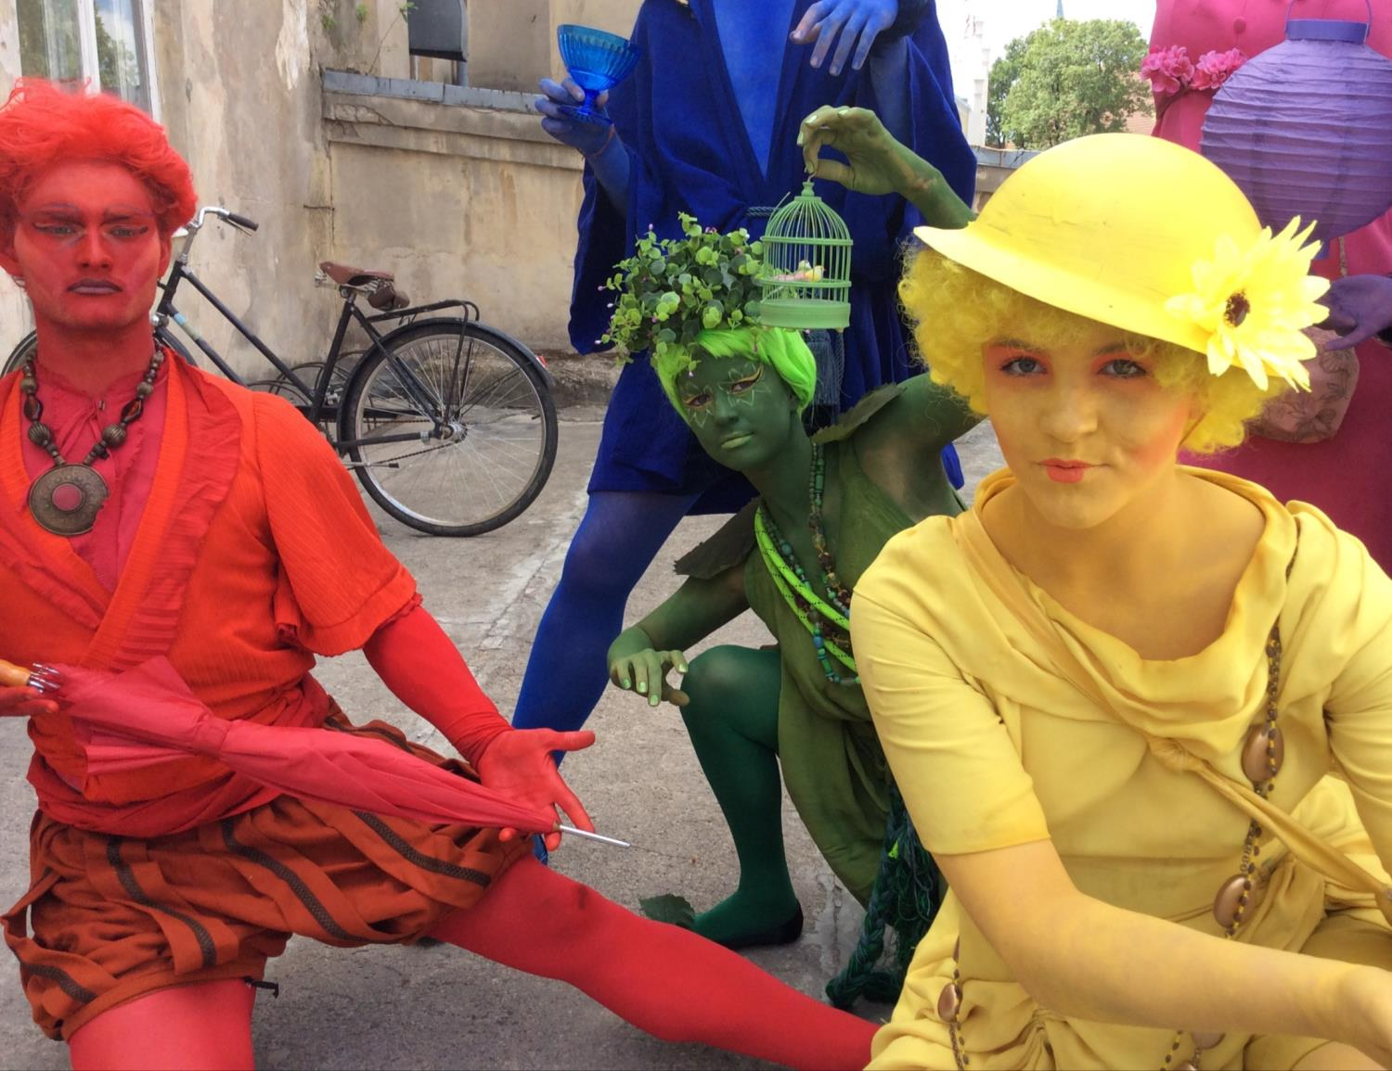
Key ingredients for for success?
Communication
Joint project development and planning
Involvement of partners in all stages
Trust
Common understanding of content and strategy
Common goal and vision
Agreement on budget
Long-term perspective
Drøbak (NO) and Kuldiga (LV) are friendship cities. Through EEA Grants they could deepen their cooperation

Slide 26
Arts Council Norway: www.kulturradet.no
Facebook: Kreativt Europa Kultur
EEA grants www.eeagrants.org
Facebook: EEA Grants Culture
Email: thea.breivik@kulturradet.no

