Slide 1
European Capital of Culture Forum Kaunas
Opportunities
for international collaboration and mobility
19th May, 2018

Slide 2
Relais Culture Europe

Slide 3
A French public service
for European common interest

Slide 4
A plateform for innovation and European cooperation in creative and cultural sectors

Slide 5
A new mission :
Horizon 2020
Research and innovation
for cultural and creative sectors

Slide 6
Relais Culture Europe
is Creative Europe Desk for France
Culture & MEDIA

Slide 7
#Pépinière
#LabEurope
#Conversations

Slide 8
#Pépinière
To understand Creative Europe’s funding opportunities
Workshops
Online sessions
Networking activities
…

Slide 9
#LabEurope
To create new dynamics in regions and encourage European cooperation
Workshops
Information sessions
Online ressources
…

Slide 10
#Conversations
To debate and share European experiences
Annual event in Paris
Online sessions
Networking activities
…

Slide 11
Next #Conversations
5th & 6th September Paris – Anis Gras
Day off: 7th September

Slide 12
Creative Europe
Projects

Slide 13
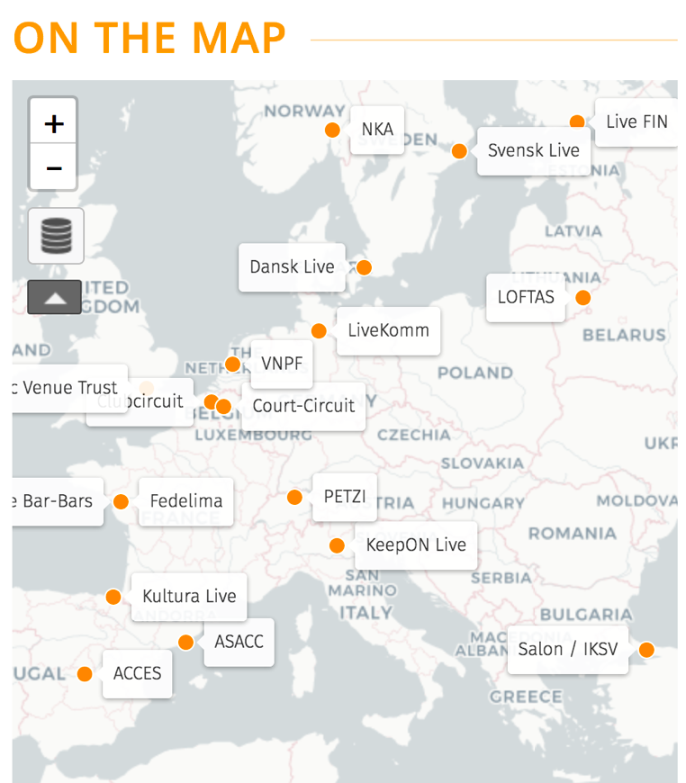
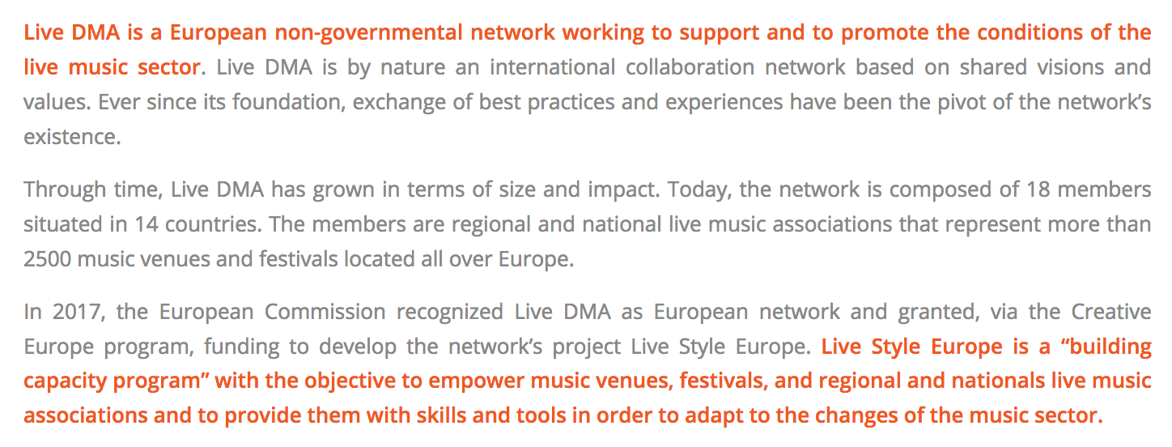
More information: www.live-dma.eu

Slide 14
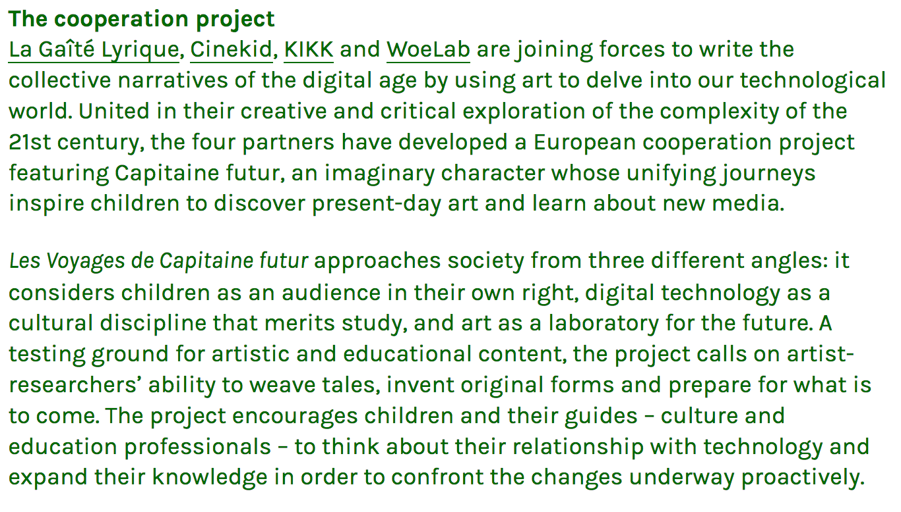
More information: http://capitainefutur.voyage/

Slide 15
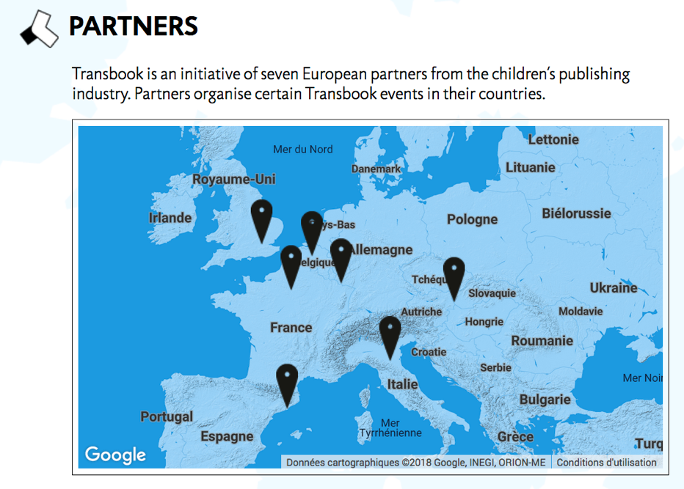
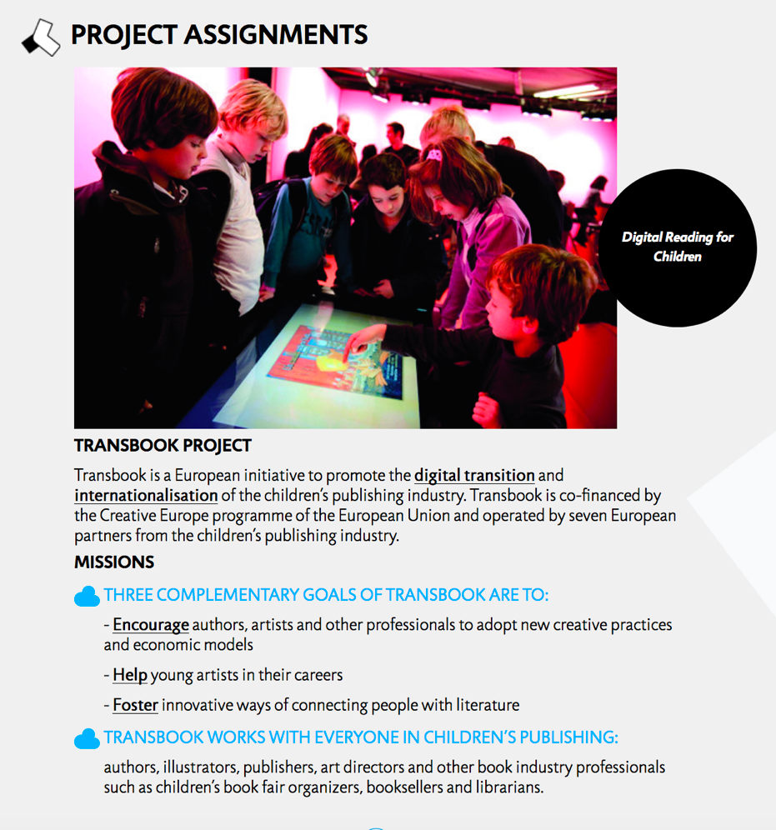
More information: http://transbook.org/en

Slide 16
Supports / opportunities

Slide 17
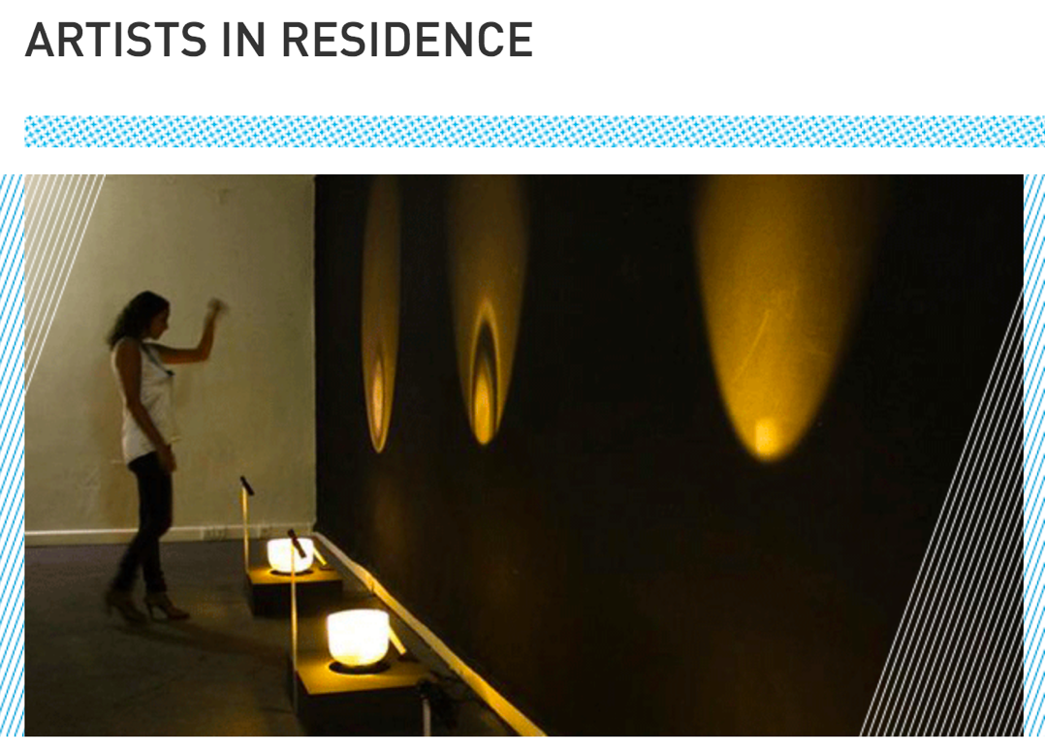
For more information: www.institutfrancais.com/en/artists-residence

Slide 18
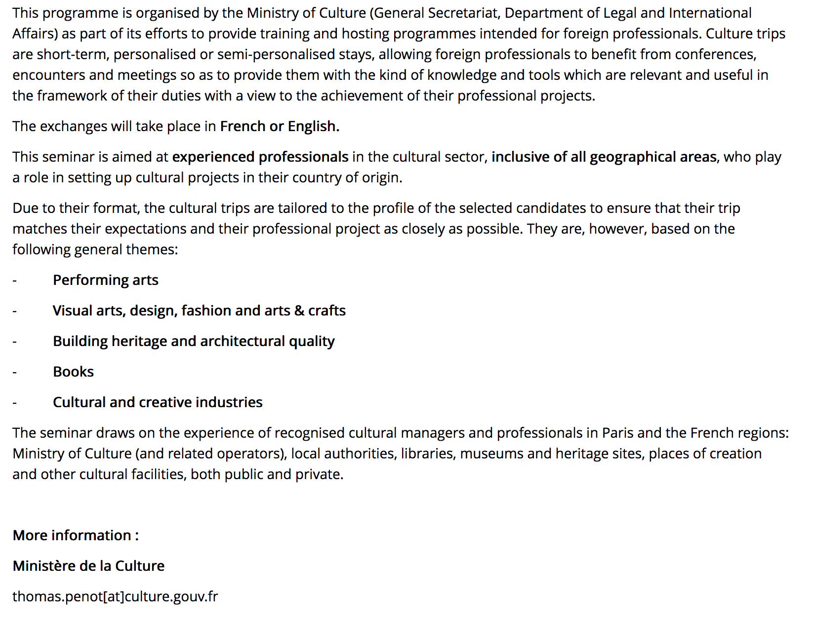
For more information:
www.culture.gouv.fr/Aides-demarches/Appels-a-projets/Appel-a-candidatures-francophones-et-anglophones-Sejour-Culture-date-limite-22-septembre-2017

Slide 19
For more information:
www.onda.fr/en/soutiens-financiers/promoting-cooperation-between-operators/

Slide 20
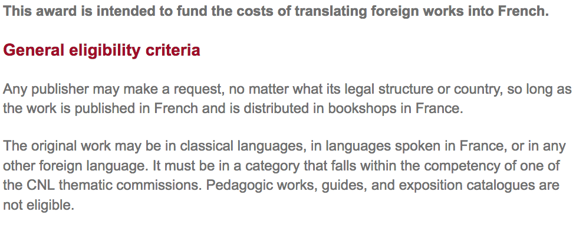
For more information: www.centrenationaldulivre.fr/en/editeur/aide_a_la_traduction/aide_pour_la_traduction_en_francais_d_ouvrages_etrangers/

Slide 21
Some ressources
French Ministry of Culture
www.culture.gouv.fr/
Institut Français
www.institutfrancais.com/fr
CNC (Cinema - audiovisual)
www.cnc.fr/web/fr
CNL (Literature - books)
www.centrenationaldulivre.fr/

Slide 22
Contact
Mathilde Vasseur
mathilde.vasseur@relais-culture-europe.eu

Slide 23
More information about Relais Culture Europe
www.relais-culture-europe.eu
www.facebook.com/RelaisCultureEurope/
twitter.com/RCE_infos

