Slide 1
Czech Republic Creative Europe Desk - Culture Eva Zakova & Magdalena Müllerová

Slide 2
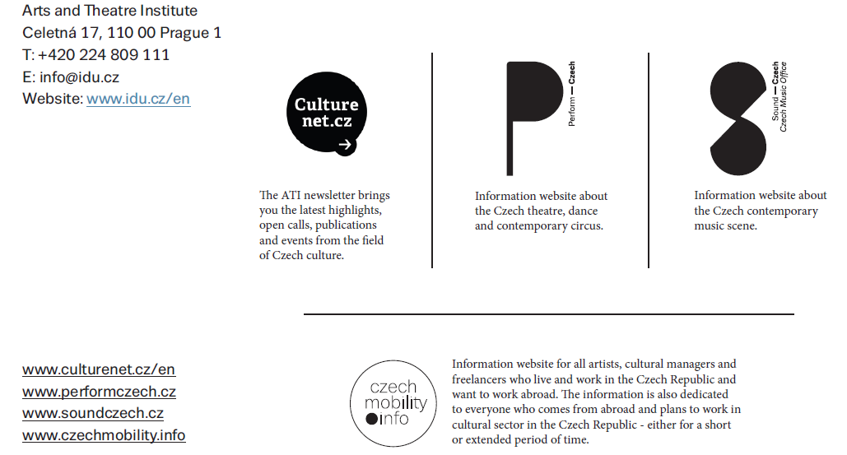
Art and Theatre Institute, Prague
Notes:
Sídlíme v IDU
IDU se věnuje exportu umění a kultury

Slide 3
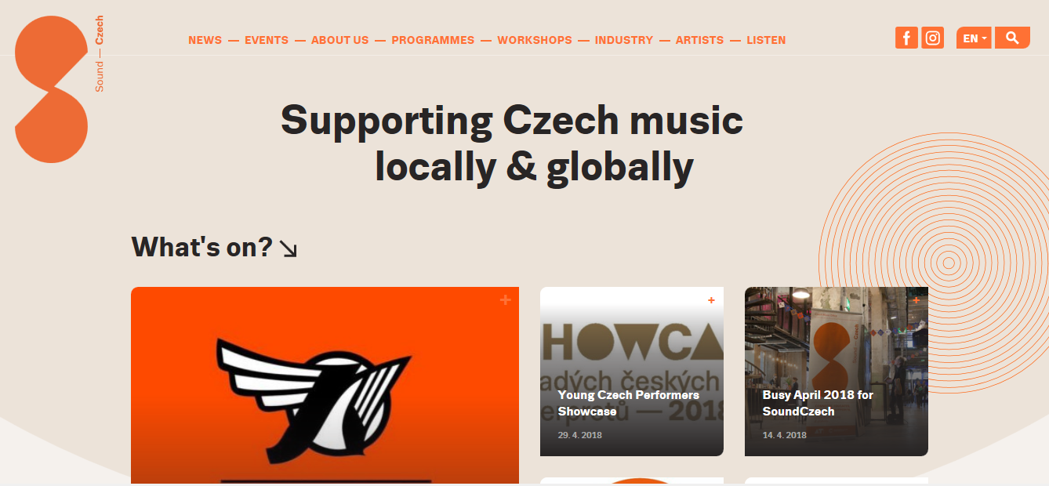
SoundCzech.cz

Slide 4
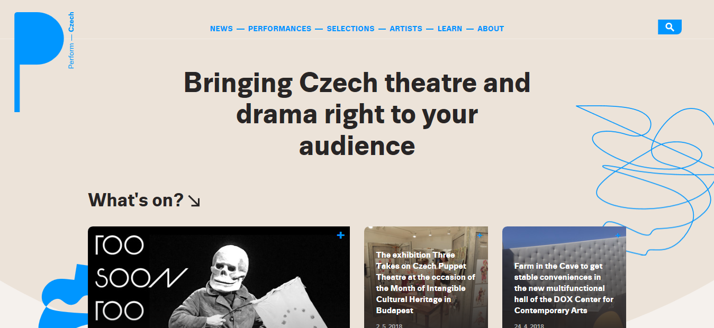
PerformCzech.cz

Slide 5
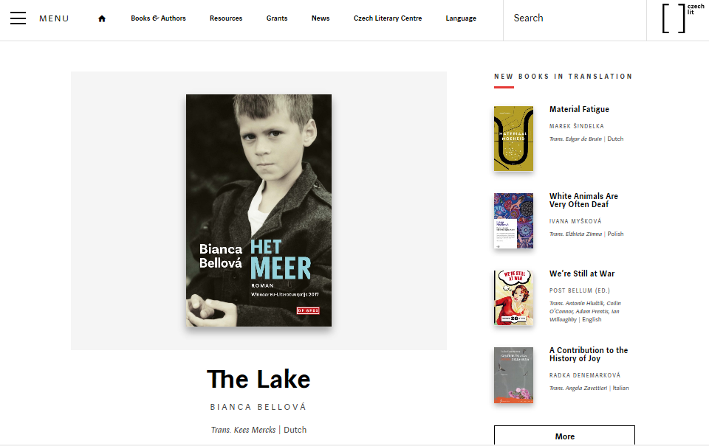
Czechlit.cz

Slide 6
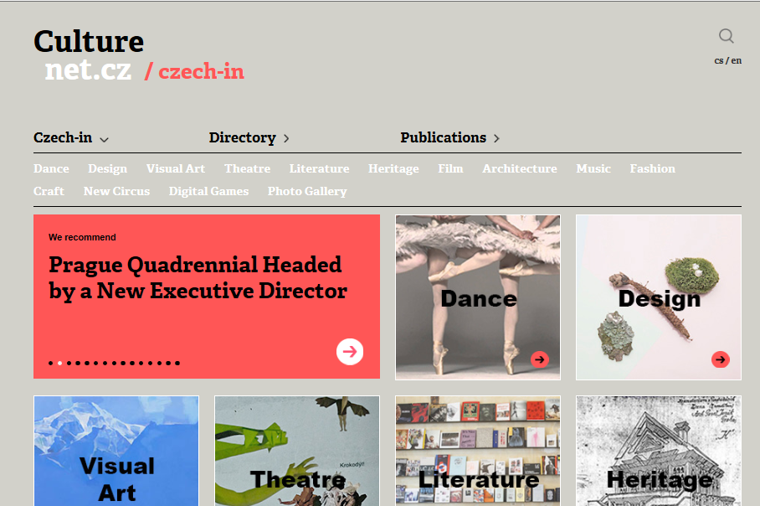
Culturenet.cz

Slide 7
Czechmobility.info

Slide 8
FIRST STEP
Go European & network
Arts Take Part - Active Participation for Creative Europe
CIRCOSTRADA
The Network of European Museum Organisations
AEC - Strenghtening Music in Society
Factories of the Imagination: Investing in Cultural Changemakers
ADCE Network - Empowering the European design and creative communication industry
ENGAGE - Empowering today's audiences through challenging theatre
EJN EUROPE JAZZ NETWORK
ENCATC
Upgrade – Connect – Reach out, Raising Awareness for Collective Singing in Europe
Act for Culture in Europe
ECSA network
EDN21: strengthen-impact-imagine
European Industrial Heritage 2020
EFA RISE 2: The rise of the community
European Music Council
IMZ - International Music + Media Centre
Performing Arts in (a world in) Transition
Sharing Heritage - Sharing Values
Live Style Europe
FRH Connect
EUNIC- Crossroads for Culture
European Storytelling Network
JOINING VOICES – Early music in Europe
JMI CONNECT
Eurozine - Network of European Cultural Journals
European Network of Cultural Centres - the next generation
Connecting Architects in Europe

Slide 9
Tips & Tricks
Trust matters – know your partners well
Cooperation is (give space to your partners)
Be Creative, but…
Follow our missions – be (nenechte se /
Do not go beyond your capacities (org. And fin.)
Do not overwhelm

Slide 10
THANK YOU!
Magdalena Müllerová E magdalena.mullerova@kreativnievropa.cz
Eva Žáková E eva.zakova@kreativnievropa.cz
www.kreativnievropa.cz
facebook.com/kreativnievropa

