Slide 1


Slovenia in the CREATIVE EUROPE EU Programme
Mateja Lazar, ECOC Forum, Kaunas, 17 May 2018

Slide 2

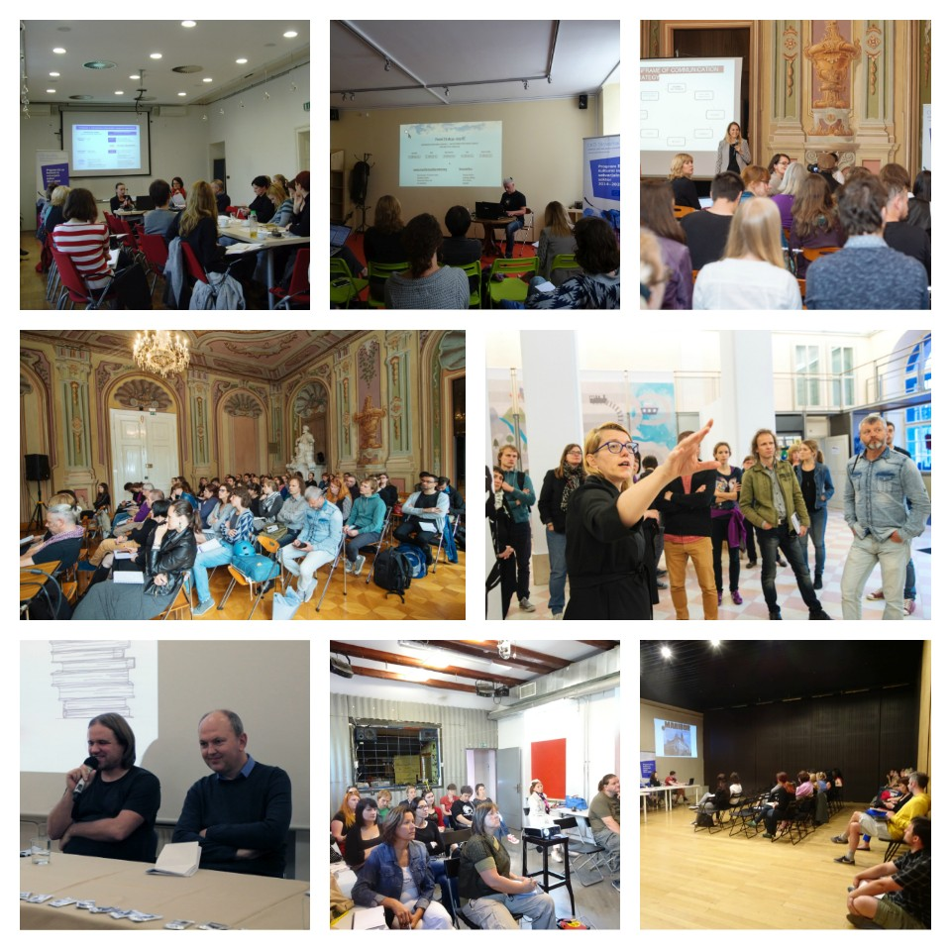
Motovila Institute
Centre for the Promotion of Cooperation in the CCSs
we inform + advise + train + facilitate + connect + promote + research … for CCSs
2014–2020:
Notes:
Impressions from various events: for ex. „What‘s the Story of Your Project“ – event on communication strategies for the CCSs with Anastasiya Nurzhynska, UA (2016).
CORE ACTIVITIES:
Promoting the CE programme & particularly the supported projects and initiatives
Facilitating international cooperation by providing:
information & technical support to CE applicants
facilitating our users in searching internatinonal project partners
organising networking events in order to stimulate exchange of best practices and know-how
… and training events to provide new skills for the CCSs
(3) Signposting to other relevant international opportunities and financial mechanisms relevant for the CCSs
(4) Acting as a mediator or „interpreter“ between the decision-makers and the sector (by providing information on the sectors‘ needs hindering the international cooperation)

Slide 3
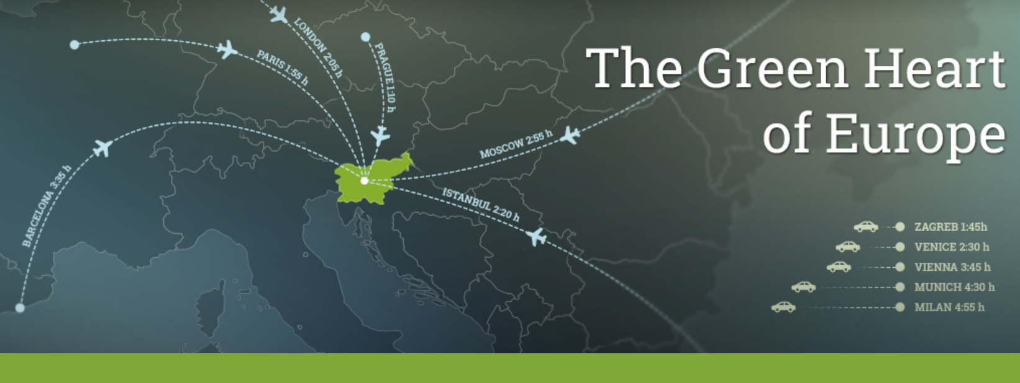

Population: 2 millions
Capital city: Ljubljana (population: ca. 300,000)
Administrative division: 212 municipalities (out of them 11 „urban“)
Independent since 1991 > EU member since 2004 > EURO area since 2007
Notes:
LJ-Kaunas → DISTANCE by car: nearly 1500 km

Slide 4
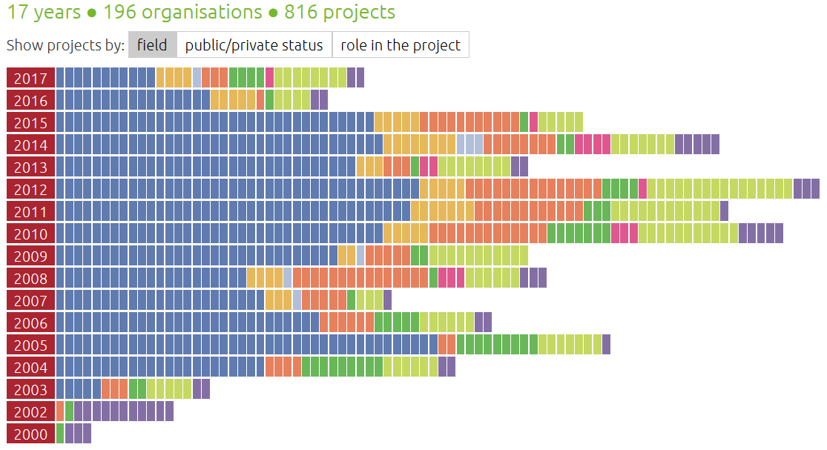

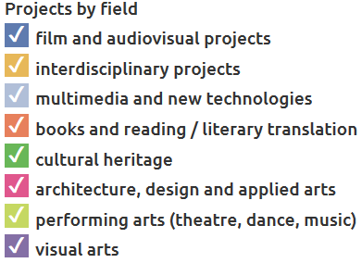
Infographics available on-line in English!
Notes:
Project „Culture!“ → joint data for both sub-programmes, i.e. Culture & MEDIA
… Online database/Infographics on the EU funding for culture, film & AV media raised by Slovenian organizations from 2002 onwards
… showing all EU supported SLO organisations by the SECTOR (field) / by the legal status (public vs. private/NGO) / by the ROLE in the project (leader vs. partners)
… in cooperation with the national culture.si webportal of Slovene cultural organisations in English. It offers information on Slovene cultural producers, venues, festivals and support services, all in one place.

Slide 5
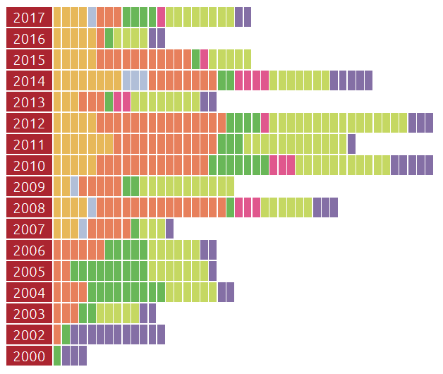
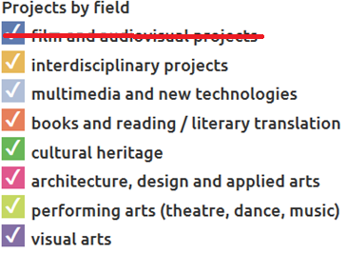
Only CULTURE projects supported by:
Culture 2000 (2002-2006)
Culture (2007-2013)
Creative Europe – Culture (2014 - )
Notes:
Slovene organisations have participated in the EU culture programmes since 2002 and are nowadays very successful also as lead partners especially in the Culture subprogramme.
After the economic/financial crisis (with severe cuts to the national culture budget) a considerable growth of submitted/supported projects!
Not sufficient financial support for international cooperation on the national level obviously provided additional motivation.

Slide 6
EU FundinG for CCS?
4 observations from Slovenia
(1) Increase of participation demonstrates:
→ successful EU fundraising by the Slovenian cultural producers
BUT ALSO:
→ new international partnerships interwoven in their management
→ new experiences & competences gained (they have professionalized)
international visibility & recognition
(2) Matching funds by the Ministry of Culture has stimulated organisations to apply for the EU funding.
(3) Visible international events (e.g. ECOC, PEU …) stimulate the interest for cult. cooperation & partnerships.

Slide 7
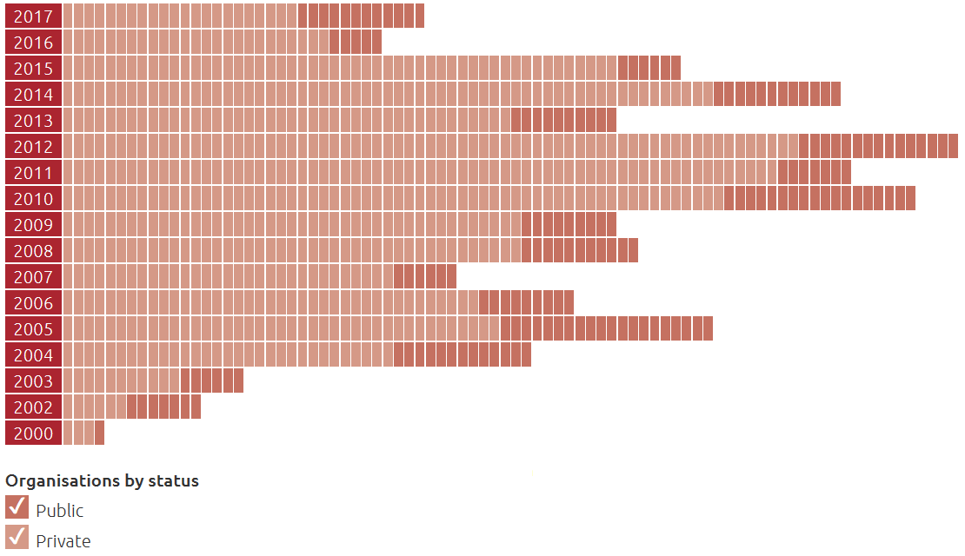
SLOVENIA case: public vs. NGO/private
Legal status of supported organisations
(4) Private organisations (NGO) are agile,
public institutions
still to catch up.
Notes:
NGOs (Culture) & SMEs (MEDIA) represent the major part of the supported organisations – for Culture it‘s ca. 80 % of all sucessfull applicants.
The biggest challenge: how to secure the co-financing share (i.e. 40-50% of the project budget) while the CCSs is facing severe shortage of co-funding sources at national level, especially in the case of under-financed NGO sector, which usually does not have regularly employed staff (but free-lance artists working on the basis contract fees).
Positive recent changes:
additional budget for the CE co-financing mechanism implemented by the Ministry of Culture foreseen (currently the annual budget available is only ca. 100.000 €; average support per beneficiary low: 1.000-4.000 €);
a new co-financing scheme for NGO to be launched soon by the Ministry of Public Administration (i.e. project match-funding for NGOs supported by various EU programmes – also Creative Europe);
a new mechanism for the book sector to be established in 2019 by the Slovenian Book Agency (co-financing EU project preparatory phase / cooperation with partners submitting applications to CE, H2000 and EFC; average support per project: 3.000 € with ca. 30 grants envisaged)

Slide 8
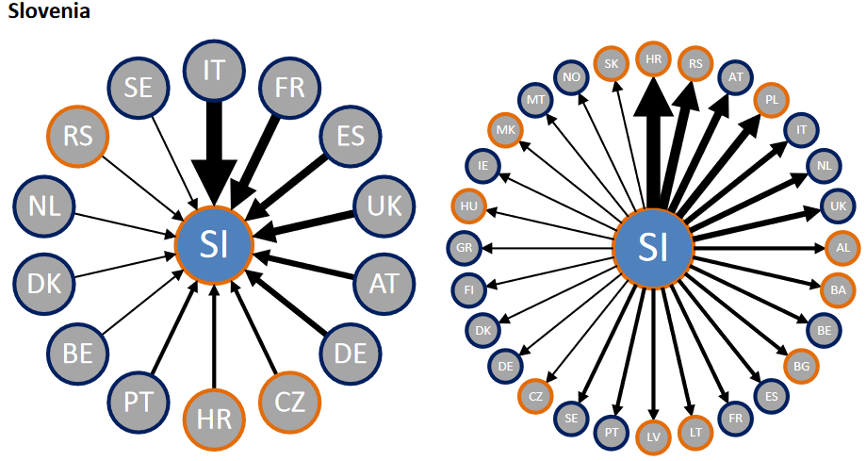
„the geography of cultural networking“
(by The Budapest Observatory)
COOP + PLATF 2014-2016
SLO organisations invited
38 times as partners
SLO project leaders established
60 partnership bonds in 28 countries
Notes:
Let‘s have a look at visual representation of this international cultural networking … for 3 years (2014-17).
The infographic with these wheels have been designed by the BO (i.e. Budapest Observatory = Regional Observatory on Culture in East-Central Europe) explaining that:
„Slovenia is the incontestable east-central European champion in the CE programme. Its operators were selected 38 times – in the region only much bigger Poland (2 mio vs. 60 mio inhabitants) could collect more. But the real achievement is the 60 partnership bonds that Slovenian project leaders have established in the past three years in 28 countries.“

Slide 9
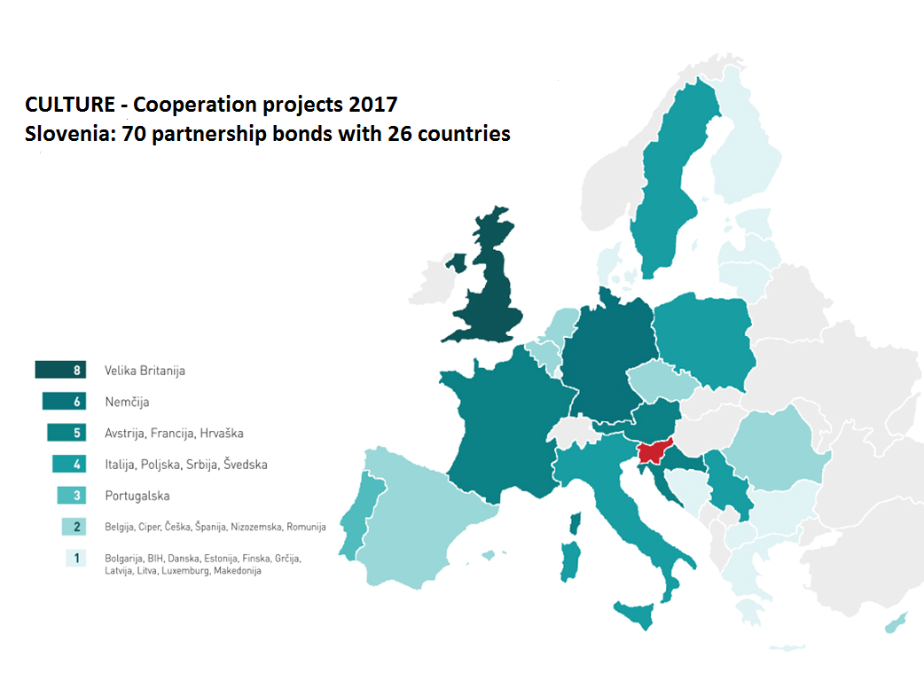
„the geography
of cultural
networking“
Notes:
Using more up-to-date data, a visual representation of this international cultural networking can be as presented above.
This picture presents the number of partnerships established just within one call (within coop. projects 2017): 17 Slovenian organisations connected with 70 partners from 26 different countries.
It gives the impression of how intense and diverse and therefore important international cooperation is for the Slovene CCSs (and for the country in general!).
(Total EU support for 7 Slovene leaders and 10 partners within this call, participating in 16 supported projects: 1,2 mio EUR)

Slide 10
… and 3 examples
Versopolis (European platfrom)
Future Architecture (European platfrom)
Our Little Library (Cooperation project)

Slide 11
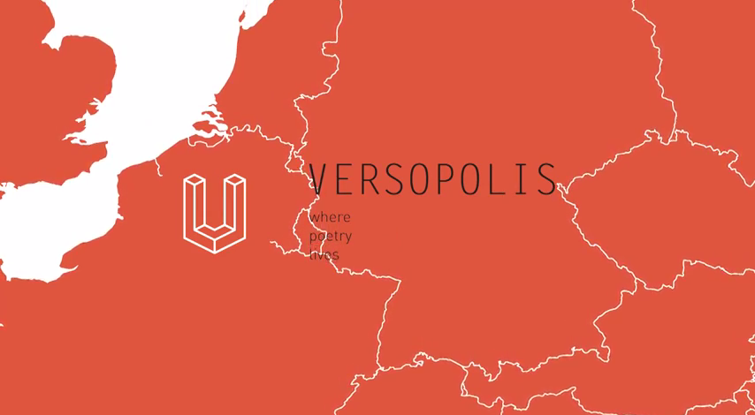
BELETRINA Publishing house (coordinator)
Field: literature > poetry
Call: CE > Culture > European platforms 2014 & 2017
EU grant: ca. 450.000 EUR per year
Duration: 2014–2017 & 2017-2021
Notes:
Versopolis is a European poetry platform creating opportunities for the emerging European poets to establish themselves internationally.
Main goals of the platform, united under its motto ‘where poetry lives’, are encouraging mobility of emerging artists from different European countries, increasing accessibility to poetry, and delivering quality literature to all poetry lovers.
The mission of the platform participants is to spread awareness of poetry as far and wide as possible, and involve all generations in participating, in reading and writing it.
VIDEO: https://www.youtube.com/watch?v=w_iNP_61D_k
Question „Why poetry matters?“ answered by poets and poetry lovers explaining why they love poetry and why other should as well.

Slide 12
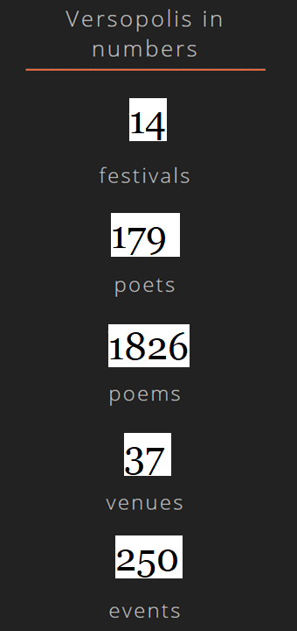
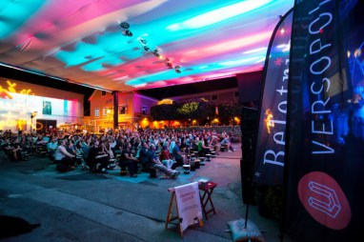

VERSOPOLIS – Where Poetry Lives
European poetry platform that creates new opportunities for emerging European poets
LE PRINTEMPS DES POÈTES, FR
HAUSACHER LESELENZ, DE
ARS POETICA, SK
LITTFEST, SE
CITY CULTURE INSTITUTE, PL
LEDBURY POETRY FESTIVAL, UK
STRUGA POETRY EVENINGS, MK
FELIX POETRY FESTIVAL, BE
LITERATURE & WINE FESTIVAL, AT
GENOA INTERNATIONAL POETRY FESTIVAL, IT
GORANOVO PROLJEČE (GORAN’S SPRING), HR
PUBLISHERS' FORUM NGO, UA
POETINIS DRUSKININKŲ RUDUO / DRUSKININKAI POETIC FALL, LT
DAYS OF POETRY AND WINE, SI

Slide 13
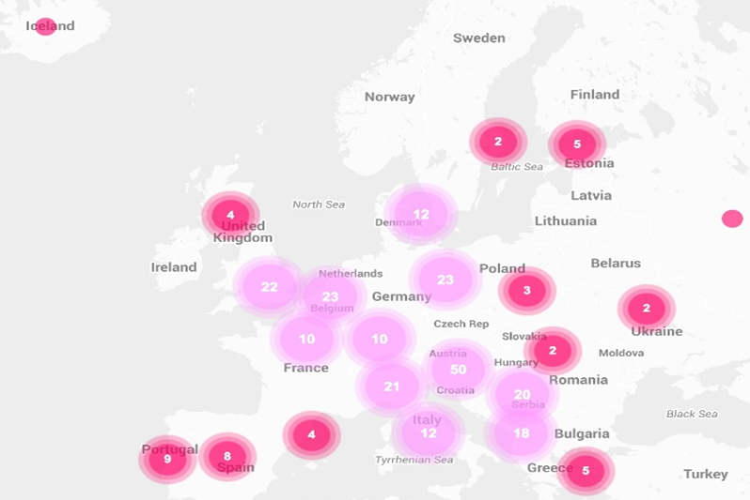
Future Architecture: 17 architecture museums, festivals & producers from 15 different cities/COUNTRIES across Europe
The platform builds on the social mission of European architecture as a fundamental cultural force that has the potential to improve our quality of life.
W: futurearchitectureplatform.org
MAO – Museum of Architecture & Design, Ljubljana (coord.)
Field: architecture & design
Call: European platforms 2015 & 2017
EU grant: 500.000 EUR/year
Duration: 2015–17 & 2017–21
Notes:
Future Architecture (FA) is a European platform of architecture museums, festivals and producers, bringing ideas on the future of cities and architecture closer to the wider public.
The Future Architecture platform wants to introduce and celebrate innovation, experimentation and the ideas of a generation that will design the architecture and build Europe’s cities in the years to come. It will promote European innovation, architecture, culture, knowledge and social capital through a single common platform.
The platform connects emerging talents of various professions, enabling them to present their ideas for the future of cities and architecture.
During the first two years of its operation (2015-2017), the platform presented 628 ideas by 1016 emerging creators and offered over 100 events where more than 200 emerging architects, urbanists, curators, critics and others, mostly young experts from all over Europe and beyond participated.
Currently (in its 2nd edition), FA brings together 17 organisations from 15 countries, from different fields: architecture, design, visual arts, film, publishing.
Goals:
Think Future. Highlighting the emerging generation of talents in various disciplines and explore and share their ideas about the future of cities and architecture.
Exchange. Partners will create a pan-European programme, tour emerging creators and present their ideas at exhibitions, conferences, lectures and workshops, in books and on the web.
Raise awareness. The platform will make complex issues of architecture comprehensible to everyone, and promote a more sustainable living environment.
Build commitment. A FA European Quality label will recognize organizers who work with aspiring emerging talents and show their commitment to the platform objectives.

Slide 14

OUR LITTLE LIBRARY (2017-2019)
LET’S MEET CHILDREN’S AUTHORS & ILLUSTRATORS
KUD Sodobnost Int., Ljubljana
Partners: publishing houses Ezop S. C. (PL), Ibis grafika (HR), Liels un mazs (LV), Nieko rimto (LT), OÜ Päike ja Pilv (EE)
AIMS:
promoting reading culture among school children in an inventive & amusing way
promoting new European children’s authors & illustrators who are well known at home but not beyond national borders
bringing works of SI, PL, HR, LV, EE & LT best authors & illustrators to a wider European market
Notes:
The goal: promoting 21 European children’s authors and illustrators who are well known at home but not necessarily in other European countries.
Each publishing house will participate with selected children's books, presenting writers and illustrators in all six languages. The chosen works will be included in the Activity book printed in partners‘ languages and distributed free of charge in order to involve a wider readership and school children to participate in the reading of high quality books that will increase their knowledge of other European countries and cultures.
Different promotional and creative activities by partners will include presentations at Book Fairs, authors‘ touring to all partners‘ countries, touring exhibition of illustrated suitcases...
The final International conference discussing challenges of the publishing industry will conclude the project.

Slide 15
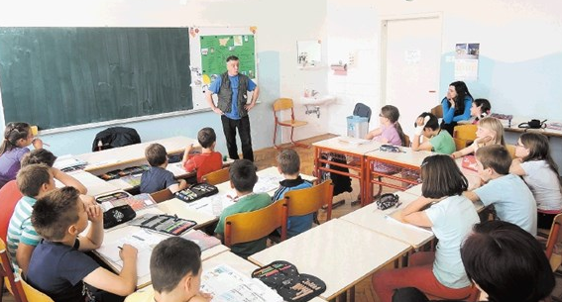

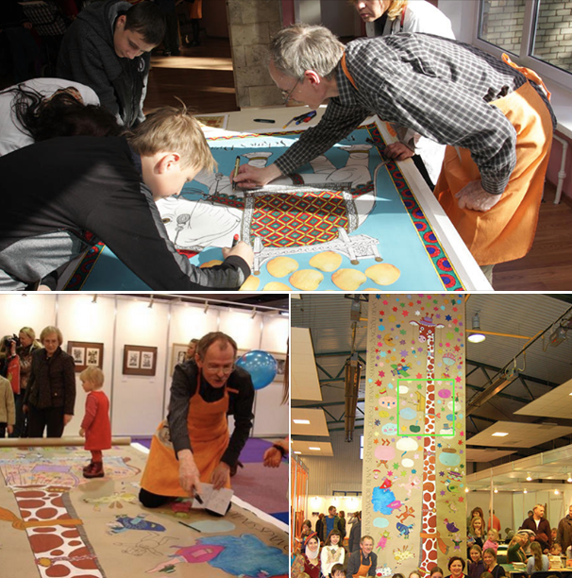
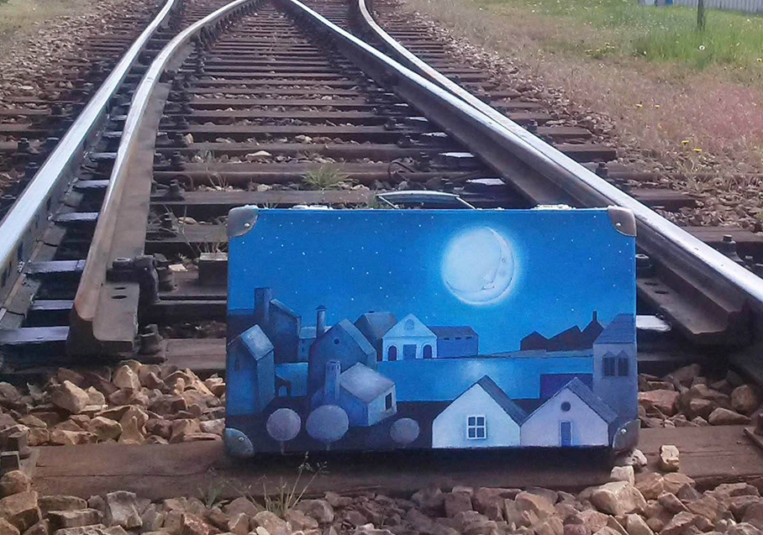
OUR LITTLE LIBRARY
Notes:
ACTIVITIES:
presenting 10 authors (writers & illustrators) in all 3 languages
creative workshops for children run by a hosted author
activity books for children (distributed free of charge)
travelling exhibition of illustrated suitcases accompanied by illustrators
international seminar dedicated to the publishing industry

Slide 16


Looking for partners?
Contact us!
MOTOVILA, Centre for the Promotion of Cooperation in the Cultural & Creative Sectors
E: info@ced-slovenia.eu
W: ced-slovenia.eu / FB: cedslovenia
Visit Culture.si
www.culture.si

