Slide 1
CREATIVE EUROPE DESK CROATIA opportunities for international collaboration and mobility
Morana Bigač, creative Europe desk – culture office
18 May 2018 | Kaunas, Lithuania

Slide 2
Ministry of Culture of the Republic of Croatia
The mission of the Ministry of Culture of Republic of Croatia is to ensure the normative, organizational, financial, material and other conditions for the development of cultural and artistic creativity; the protection and preservation of cultural heritage in the Republic of Croatia; presentation and promotion of Croatian culture in Europe and the world and support of various international cultural cooperation.
Open call for financial support of international cultural cooperation
Support for residency programme
Support for Croatian participants in selected Creative Europe projects

Slide 3
support for International Cultural cooperation
Strengthening and developing international cultural cooperation
Funding for international cooperation, mobitiliy and exchange
Promotion of Croatian culture
Funding for cultural export and internationalization

Slide 4
support for Creative Europe selected projects
- Decision by Minstar of Culture (2007 -)
- Culture programme (2007 – 2013) & Creative Europe (2014 – 2020)
Culture sub-programme
- for all categories in Culture sub-programme
Cooperation programs, Literary translations, Platforms and Networks
- co-funding: 30% - 60% (depend on status of Croatian partner)
- 103 projects | 58 organizations

Slide 5
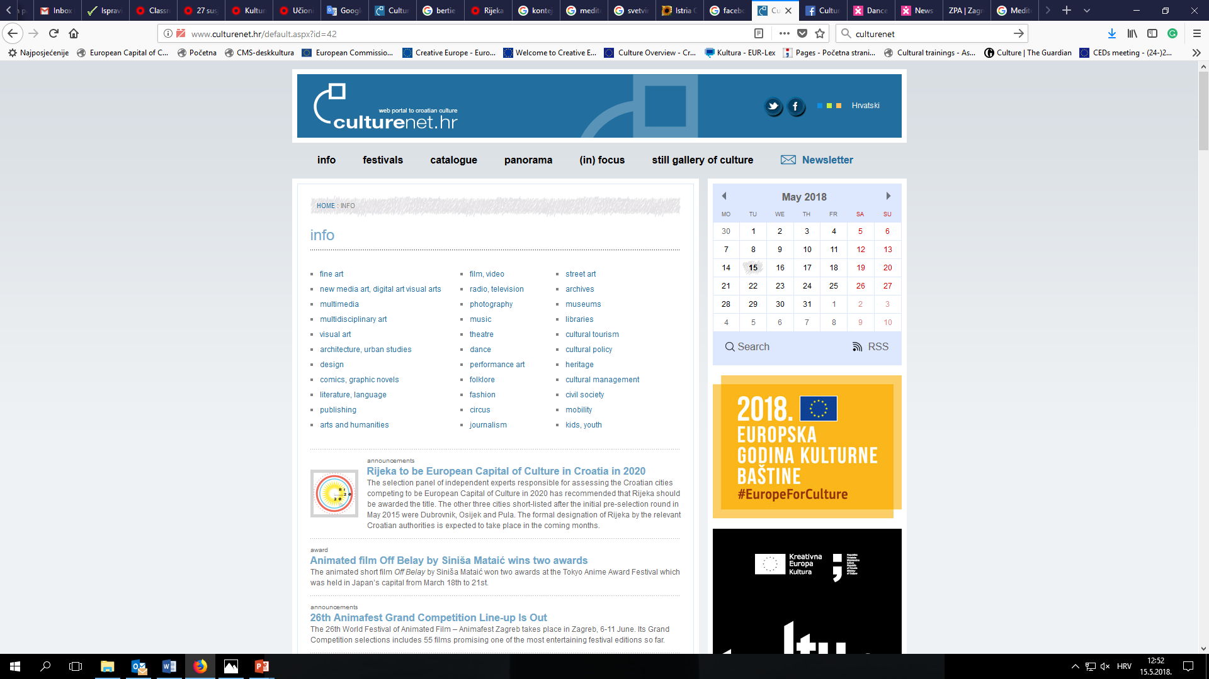
culturenet.hr
web portal to Croatian Culture
- General information on main organizations and
events
- Contacts
- Open calls
- Partner search
https://www.facebook.com/culturenet.croatia/

Slide 6
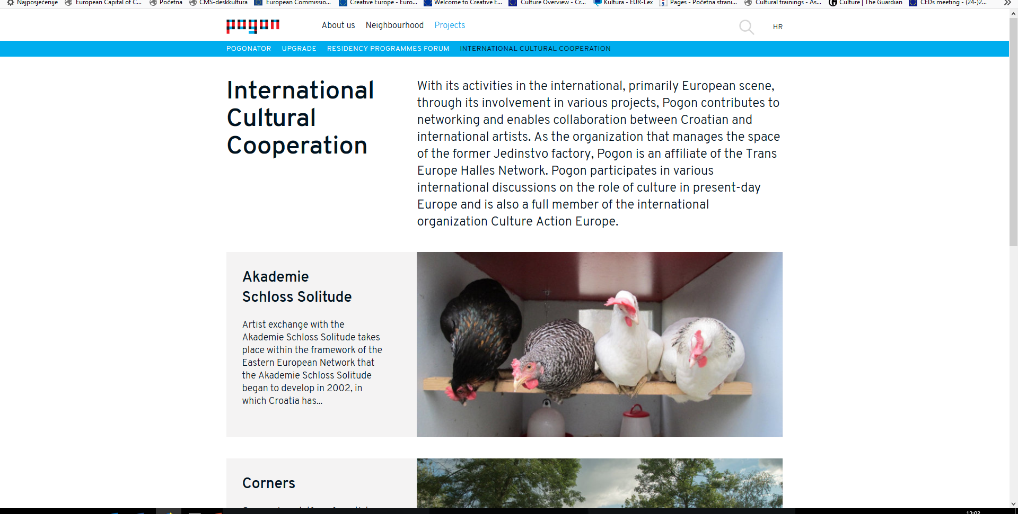
residency programs
POGON Zagreb center for independent culture and youth
(partnership with Akademie Schloss Solitude)
https://www.pogon.hr/en

Slide 7
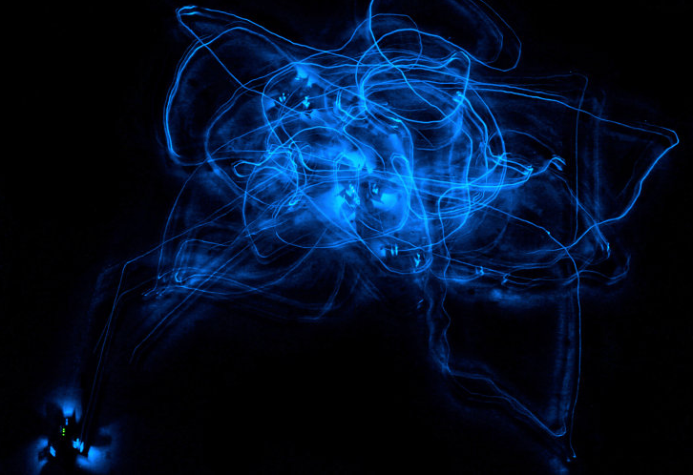
KONTEJNER | bureau of contemporary art praxis
(member of the European Media Art Platform)
www.kontejner.org

Slide 8
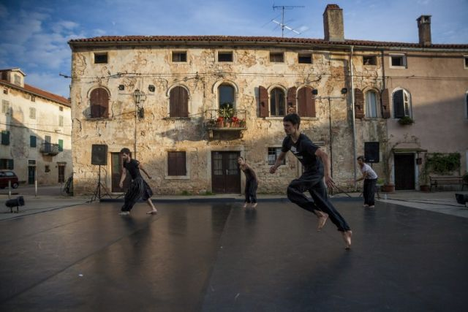
Zagreb Dance Company | Mediterranean Dance Center
Dance&non-verbal theatre festival San Vincenti, Istria
http://www.svetvincenatfestival.com/en/

Slide 9
Magic Carpets Platform (LAB852 d.o.o.) LAB 852 strive for learning and developing new methods and models of audience development, which can be experimented within the local context and used to create the platform for broader international visibility of emerging artists.
My Travelling Heart: Paulina Almeida
Schools Without Walls: Maj Horn
https://www.lab852.com/

Slide 10
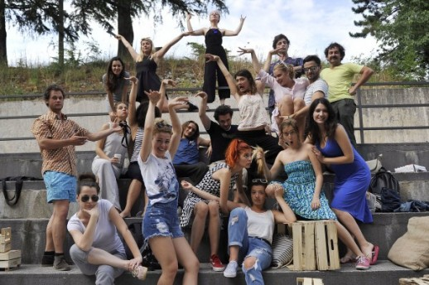
Rijeka – European Capital of Culture 2020
http://rijeka2020.eu/
7 interdependent and continuous programming streams – Flagships:
27 Neighborhoods'
Dopolavoro
Brick House
Sweet & Salt
Seasons of Power
Kitchen
Coast Lines

Slide 11
27 neighborhoods'
European partners: European Capitals of Culture 2018 (Leeuwarden, Valleta), 2019 (Matera, Plovdiv), 2020 (Ireland), 2021 (Romania, Greece), Agenda 21 for culture, UCLG – network of cities, local and regional governments, Intercultural cities – European Council, EUNIC – European network of national cultural institutions.
27 Neighborhoods' provides multiple opportunities for establishing exchange programs spanning the entire European Union, thus creating and informal cultural activity network between neighborhoods'

Slide 12
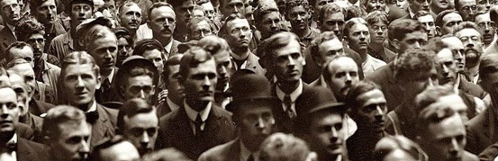
Cultural diplomacy programme
networking and partnership development on the European level
- mobility for experts in arts and culture
- cultural and creative industries and other sectors connected to culture – through international events co-organized and hosted in Rijeka
- promotions abroad
Classroom
an integrated learning programme for culture sector capacity building and strengthening the local community
ACTIVITIES: workshops, summer schools, mentorships, establishing lifelong education programs, study visits, work training, seminars, conferences, assemblies and meetings.
THEMES: space and technology; management and leadership; audience and community development and meetings; invariant and technique; management and leadership; audience and community building

Slide 13
DESK KREATIVNE EUROPE
MINISTARSTVO KULTURE
RUNJANINOVA 2
10 000 ZAGREB
01/ 4866 285 Anera STOPFER
01/ 4866 312 Morana BIGAČ
ced@min-kulture.hr
www.deskkultura.hr
THANK YOU!

