Slide 1
CREATIVE EUROPE DESK
LATVIA
Liene Upeniece
19/05/2018, Kaunas

Slide 2
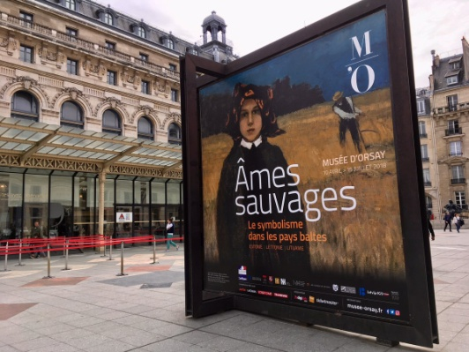
Culture in Latvia 2018
Centenary of the Republic of Latvia
Cultural projects:
Cultural School Bag;
National Encyclopaedia;
16 new feature films;
XXVI Latvian Nationwide Song and XVI Dance Celebration.
International cultural events:
Exhibition ‘’Wild Souls, Symbolism in the Baltic States’’;
Participation in London Book Fair.
You can find Centenary events on the digital platform http://lv100.lv/en/

Slide 3
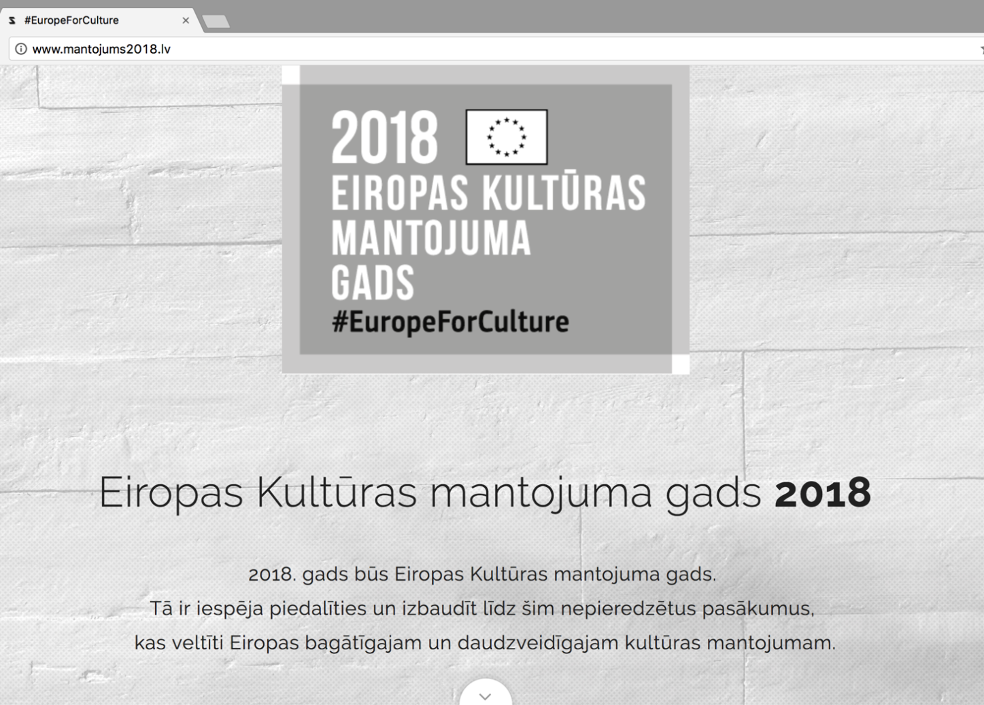
Culture in Latvia 2018
European Year of Cultural Heritage
Events in Latvia can be found at http://mantojums2018.lv/

Slide 4
Creative Europe desk in Latvia
Sub-programme ‘Culture’ is ensured by the Ministry of Culture.
Contact information: Liene Upeniece, liene.upeniece@km.gov.lv, +371 67330229
Sub-programme ‘Media’ is ensured by the National Film Centre.
Contact information: Lelda Ozola, lelda.ozola@nkc.gov.lv, +371 67358857
More information: https://www.km.gov.lv/en/funds-and-eu-policy/creative-europe

Slide 5
Latvia supported by Creative Europe ‘Culture’
Period 2014-2017
35 projects supported:
27 as a member; 8 as a coordinator.
Projects by sectors:
cross-sectoral: 9
Litterature/books: 8
Performing arts/festivals: 5
Visual/applied arts: 7
Music: 5
Fashion: 1
Projects by action:
Literary translation projects: 6
Platforms: 5
Networks – none
Cooperation projects small scale: 10
Cooperation projects large scale: 14

Slide 6
Latvian organisations supported by Creative Europe ‘Culture’
Period 2014-2017
Literature publishing house ‘Liels un mazs’;
Publishing house ‘Mansards’;
Janis Roze publishing house;
Publishing house ‘Jumava’;
Ltd. ‘Lasitava’;
Latvian Publishers Association;
Rezekne Municipality (Organization)/ Luznava Manor (Venue);
Liepaja Municipality institution „Culture Department“;
Latvian Academy of Culture;
Riga Technical University;
Art Academy of Latvia;
Riga Porcelain Museum;
Latvian Centre for Contemporary Art;
KIM? Contemporary Art Center;
Latvian National Opera and Ballet;
Riga EarlyMusic Centre;
Baltic Fashion Federation;
‘Riga2014’ foundation;
ISSP- platform for photography;
Dirty Deal Teatro (SAVIENOJUMS);
RIXC, The Center for New Media Culture;
Sound Forest;
New Theatre Institute of Latvia .

Slide 7
Most active cultural operators
New Theatre Institute of Latvia
Sound Forest- association for adventurous music and related arts
RIXC- center for new media culture, art gallery and artist collective
Notes:
Performing arts
Music
New media, art

Slide 8
Most active cultural operators
New Theatre Institute of Latvia
Known for festival Homo Novus
Large scale cooperation projects:
DNA Departures and arrivals (2014);
Project leader: Performing Arts Research and Training Studios vzw (BE)
Imagine 2020- Art, ecology&possible futures (2015);
Project leader: Kaaitheater vzw (BE)
Urban Heat (2015)
Project leader : London International Festival of Theatre Limited (UK)
European platform:
Magic carpets (2017)
Project leader: VIESOJI ISTAIGA KAUNO BIENALE (LT)

Slide 9
Most active cultural operators
Sound Forest- association for adventurous music and related arts
European platform:
SHAPE – sound, heterogenos Art and Performance in Europe (2014 and 2017)
Project leader: Meetfactory OPS (CZ)

Slide 10
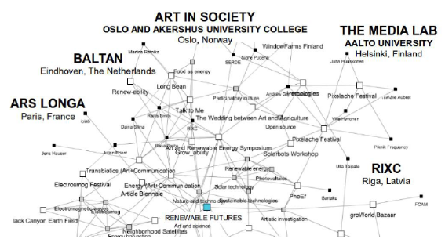
Most active cultural operators
RIXC- center for new media culture, art gallery and artist collective
Small scale cooperation project:
Changing Weathers (2014)
Project leader: Zavod Projekt Atol (SI)
Renewable Futures (2015)
Project leader: RIXC (Latvia)
Large Scale coopertion project:
Risk change (2016)
Project leader: KULTURNO IZOBRAZEVALNO DRUSTVO KIBLA (SI)
European platform:
EMAP- European media art platform (2017)
Project leader: Werkleitz Gesellschaft e.V. (DE)

Slide 11
Main local supporters of the projects
The State Culture Capital Foundation;
Rīga City Council’s Education, Culture and Sports Department;
Ministry of Culture (co-financement offered twice a year)
Society Integration Foundation;
Norwegian Financial Mechanism in Latvia;
Danish cultural institute;
British council;
Goethe institute Riga;

Slide 12
State insitutions of cultural field in Latvia
Latvian National Centre for Culture;
The State Culture Capital Foundation;
National Film Center of Latvia;
Centre for Culture Information Systems;
Investment and Development Agency of Latvia.
Notes:
In Latvia the Ministry of Culture, the Ministry of Economy and the Ministry of Education and Science as well as institutions subordinated to these ministries are responsible for the development of creative industries.
Latvian National Centre for Culture – responsible for cultural and creative industries education;
The State Culture Capital Foundation- Aims to promote a balanced development of creativity in all fields of art and preservation of the cultural heritage.
The foundation raises, accumulates, administers and allocates resources for the implementation of culture projects and life-long grants for culture and art workers for their life achievements in development of culture and art.
National Film Center of Latvia The National Film Center of Latvia is a state institution subordinated to the Minister of Culture, and its goal is to implement the state cultural policy in the film industry.
Centre for Culture Information Systems The mission of the for Culture Information Systems of the Ministry of Culture is to assist memory institutions – archives, libraries and museums to preserve and make accessible the cultural heritage for the generations to come by way of applying the most advanced IT solutions
Investment and Development Agency of Latvia
The profile of LIAA services is very wide – from information on how to start business, different state support programs and opportunities to attract funding, including entrepreneurial support for those wishing to start export operations and looking for cooperation abroad.

Slide 13
Programmes or initiatives supporting cultural field and international cooperation
Nordic-Baltic Mobility Programme in the field of Culture
For contacts in Latvia : The Nordic Council of Ministers’ Office in Latvia
The Latvian Writers Union
More at: http://latvianliterature.lv/en/grants or http://rakstnieciba.lv/en/grants/
The ISSP Riga Residency programme
Curated by ISSP
Notes:
Nordic-Baltic Mobility Programme in the field of Culture supports long- and short-term network building, artists’ residencies and mobility of professional art and culture practitioners in all artistic fields.
The main goal is to create a platform for an innovative, dynamic Nordic-Baltic art and culture life.
The Latvian Writers’ Union administers a number of grant programs that focus on the promotion of Latvian literature and publishing abroad.
The Latvian Writers’ Union (LRS) administers two grant programmes for foreign publishers. Two separate competitions - one for English and one for non-English publications.
The Latvian Writers’ Union (LRS) is offering financial support for translators who wish to translate Latvian literary works into any foreign language.
ISSP residency programme - Aimed at a diverse range of photographers and artists using the medium of photography, primarily based in the Nordic - Baltic region.
During stays of up to two months, the residency programme provides the opportunity for concentrated work on a project informed by interaction with the city and its residents.
Curated by ISSP - a platform for contemporary photography, based in Riga, but acting internationally.
Who can apply? Photographers and artists working with photography, primarily from the Nordic – Baltic region

Slide 14
Thank you for attention!
Liene Upeniece
Creative Europe Sub-programme Culture
Ministry of Culture
Latvia

