Slide 1
The value(s) of cultural networks
Yohann Floch
∞ International Cultural Consultant [capacity building & strategic development]
∞ Director of the International Resource Office [IRO @ TEH, Skåne, Sweden]
∞ Programme Coordinator [RESA & ILN @ Dansehallerne, Copenhagen, Denmark]
∞ President of FACE [Fresh Arts Coalition Europe]
∞ Board member of OTM [On the Move]

Slide 2

A cyclical, integrated chain of processes
For a good ecology of the arts & culture:
Education
Creation
Production
Diffusion
Documentation
+
Each step has to be equally supported and nourished by the others: between each step there must be adequate connections.
Exchanges with publics
Exchanges at international level
Access to Culture Platform
“Creativity & creation working group”
Structured dialogue with EU institutions

Slide 3
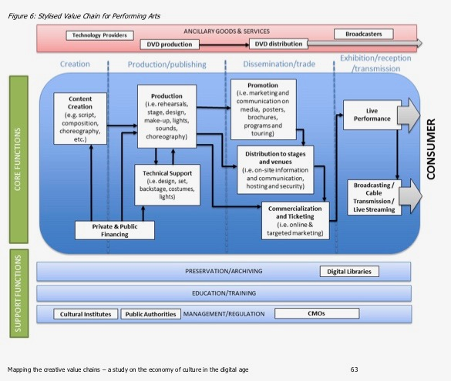
International dimension of the value chain
Mapping the Creative Value Chains, A study on the economy of culture in the digital age
By European Commission (IDEA-KEA-SMITH)

Slide 4
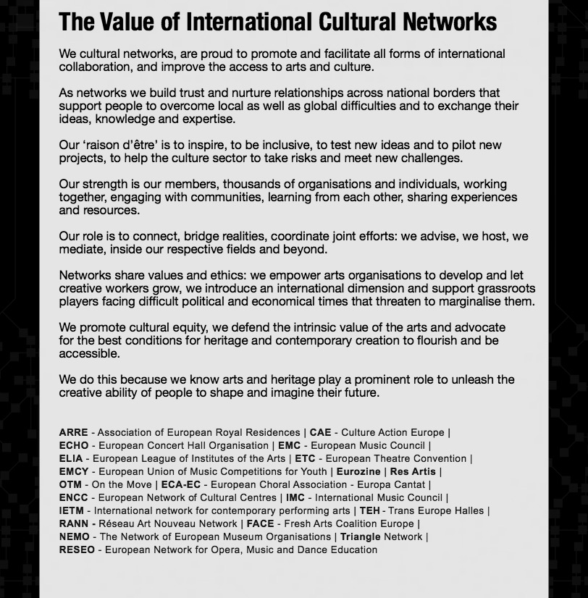
Notes:
Précis et réalisables… tenir comptes des forces, utiliser des outils (SWOP analysis, etc.)
Travail de groupe / réflexions multiples et considérations

Slide 5
(in)formal European networks
Focus on the formal cultural networks:
Network of organisations (independent workers included sometimes): professional relations, group of people who are interrelated to help each other (organisational, project, financing)
Relationships are formed within a legal structure (e.g. membership of an association) and / or by contract (e.g. consortium)
Network of networks: professional representation
Sectoral or thematic networks
Project-network: co-imagined, co-produced, co-financed action(s)

Slide 10

FACE-Fresh Arts Coalition Europe
International network of arts organisations that supports contemporary cross-disciplinary art forms and facilitates international collaboration. It covers fresh and ground-breaking practices such as live art, immersive or participatory projects, site-specific arts, contemporary circus, and physical and visual theatre.
International dimension: Europe dialoguing with other continents
Experimenting new initiatives (e.g. co-spectatorship programme to develop audiences or artistic residencies in
farms, etc.)
(R)evolution: constant reflection on relevance

Slide 11

OTM-On the Move
Cultural mobility information network active in Europe and worldwide. Born as a website in 2002 and as an initiative of IETM – now a dynamic network of 43 member-organisations
Members:
  Networks & federations (covering only in EU more than 1,350 member organisations)
  Information platforms or organisations (active at European, international or local level)
  Anchor organisations (connected to a certain context and/or issue)
  Funders of cultural mobility
  Research institutes
  Types of mobility opportunities:
  Events – Projects
  Co-productions / collaboration
  Touring / export
  Participation in meetings, conferences, networks’ events
  Artists/ curators’ residencies
  Go and see grants
  Incubator programmes
  Job/ Job shadowing / training
  Hybrid formats

Slide 12
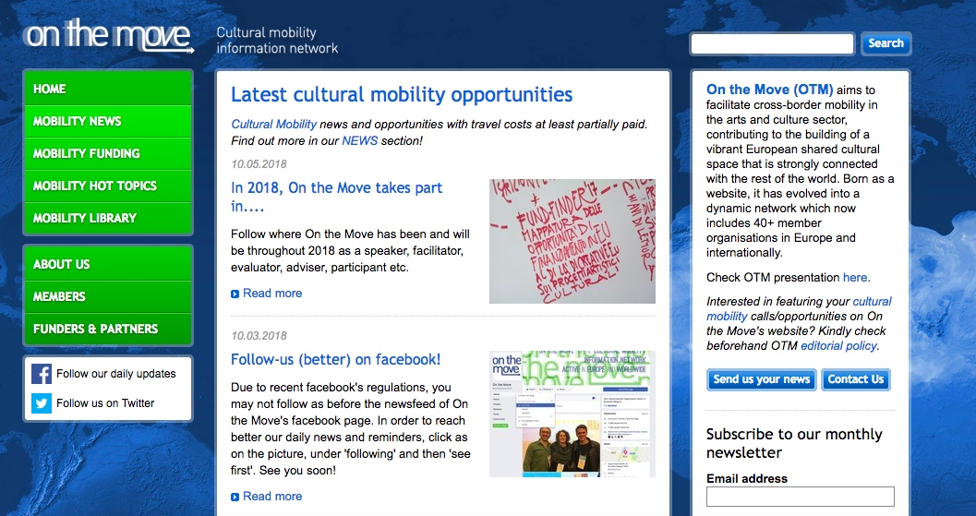

Slide 13
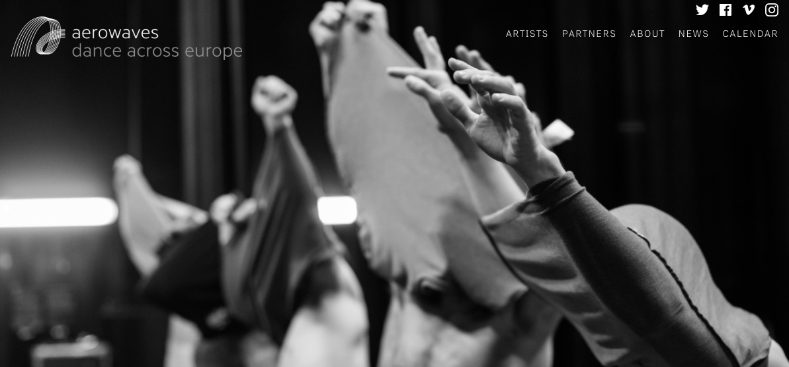
Plate-forme: AEROWAVES
Aerowaves is a hub for dance discovery in Europe. We identify the most promising new work by emerging dance artists and then promote it through cross-border performances. Aerowaves' network of 45 partners in 33 countries enables these younger choreographers to bring brand new dance to brand new audiences.

Slide 14
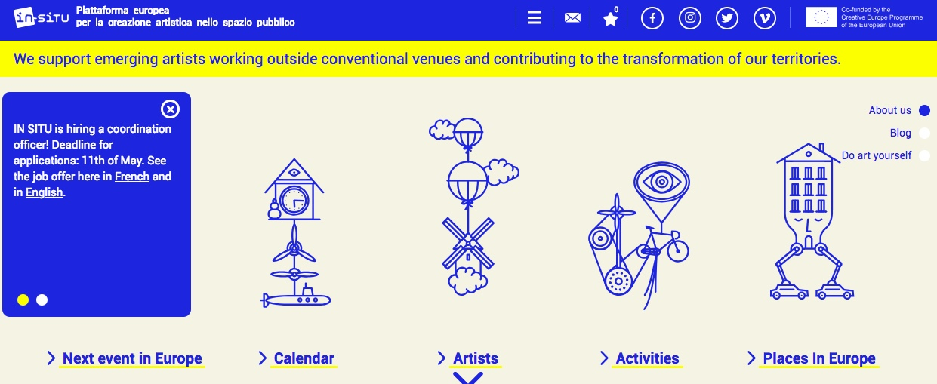
Plate-forme: IN SITU
IN SITU is the European platform for artistic creation in public space. Since 2003, it has supported more than 200 artists working outside conventional venues and contributing to the transformation of our territories. IN SITU is led by Lieux publics - European and national center for artistic creation in public space (France), and brings together 20 partners from 12 countries

