Slide 1
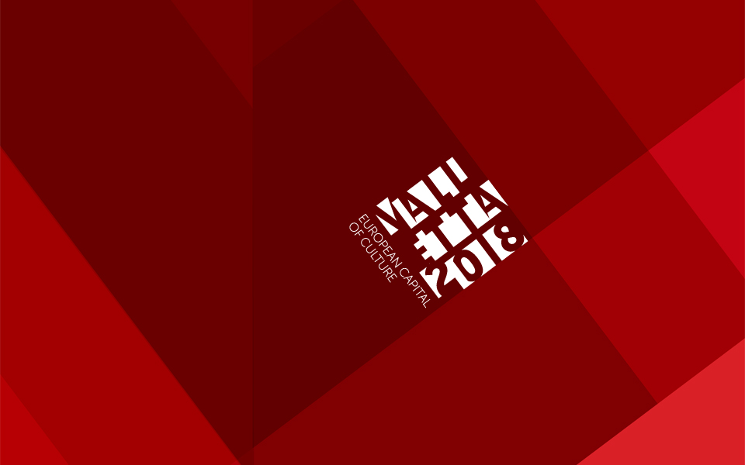

Slide 2
The community bridge between heritage and legacy
Dr. Victor Jacono
Valletta 2018 Foundation

Slide 3
Definitions
Community: a group of people with “something” in common, e.g. residence, but not only
Culture: implicit/explicit knowledge (that/how) and beliefs informing daily and extra-daily living
Art: any discipline value that can portray, interpret, challenge, and create culture
Creativity: our ability to make “things” new
Heritage: what we inherit, material or immaterial
Legacy: what we leave behind, material or immaterial

Slide 4
Bridge builders
Knowingly or unknowingly, we are are all cultural bridges linking heritage and legacy. Culture is renewed through us, our memory and our vision.
Active bridge builders
Passive bridge builders
Mindful bridge builders?
ECoC can be seen as an opportunity to engineer cultural bridges between heritage and legacy. The question is HOW this happens?

Slide 5
Mindful of complexity
From microscopic to macroscopic levels, everyone and everything is connected.
A small, local intervention, however precise, can have unexpected, widespread consequences.
Democratic values prompt empowerment through more active and mindful participation.

Slide 6
Examples from Valletta 2018
Opening week leading to 20th Jan 2018
https://valletta2018.org/cultural-programme/valletta-2018-opening/
Community strand
https://valletta2018.org/pt/community/

Slide 7
Opening fringe activities
A week of activities leading to the official opening on 20th Jan 2018
A more intimate encounter with the public, stimulating different degrees of participation among community members

Slide 8
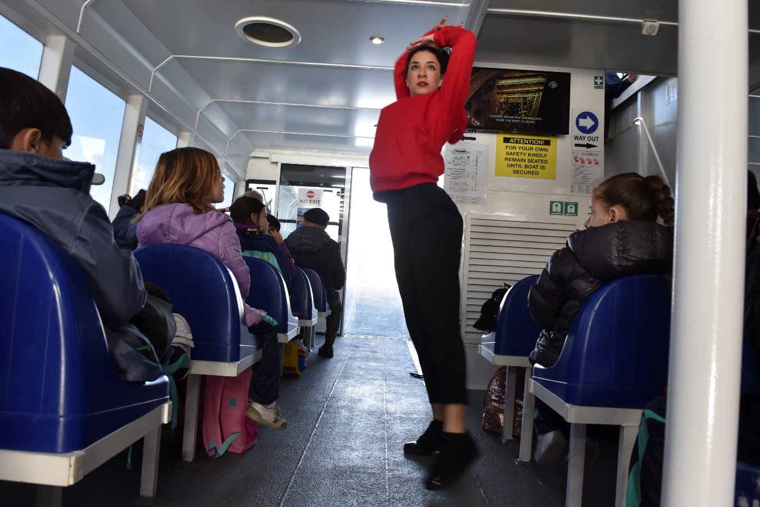
Lanċja ġejja
Kinetic Dance Academy – dance and music on the ferries

Slide 9
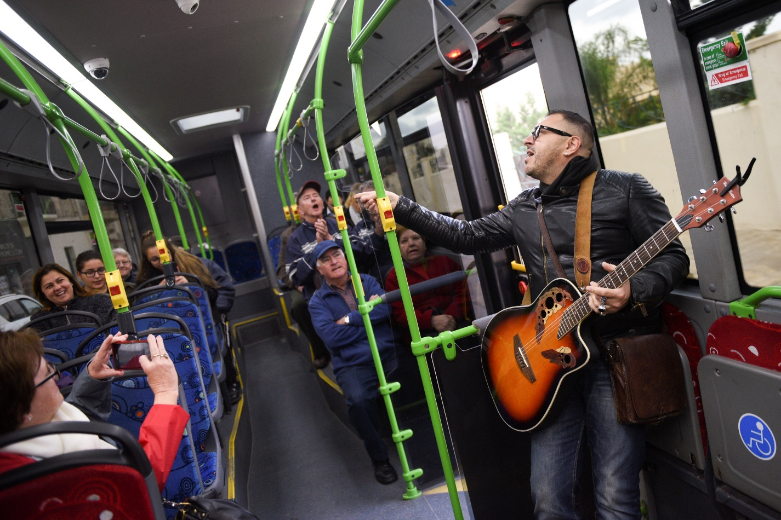
Tal-Lino
Ozzy Lino, the human juke box on route buses

Slide 10
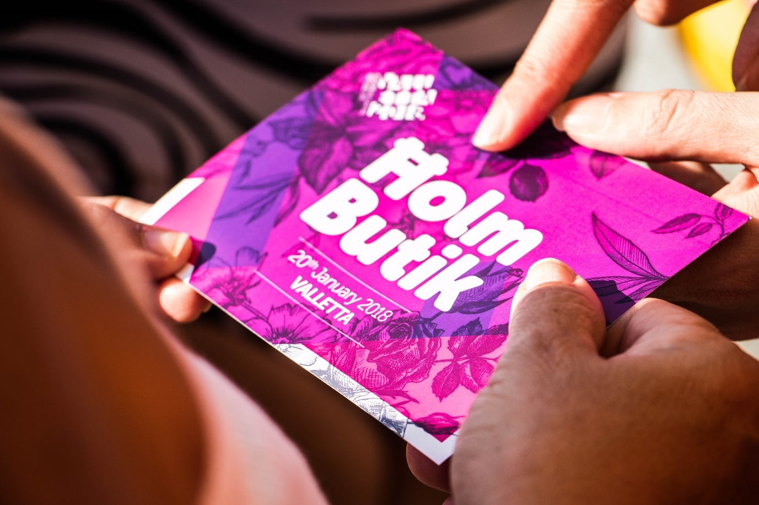
Ħolm Butik
Cynthia Debono (Move) & Victor Jacono – performing people’s dreams

Slide 11
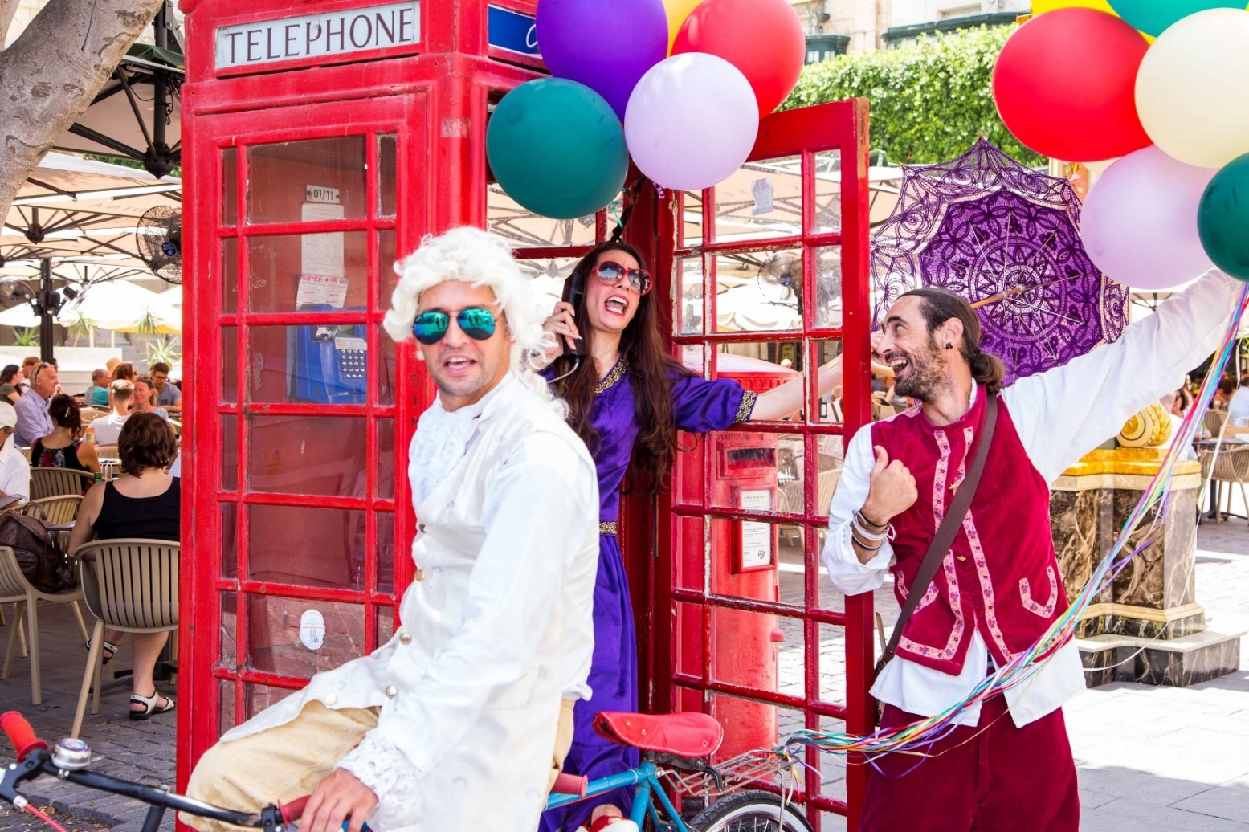
Ronald Briffa – Lee-N Abela – Andy Catania
Actors ready to go dream catching

Slide 12
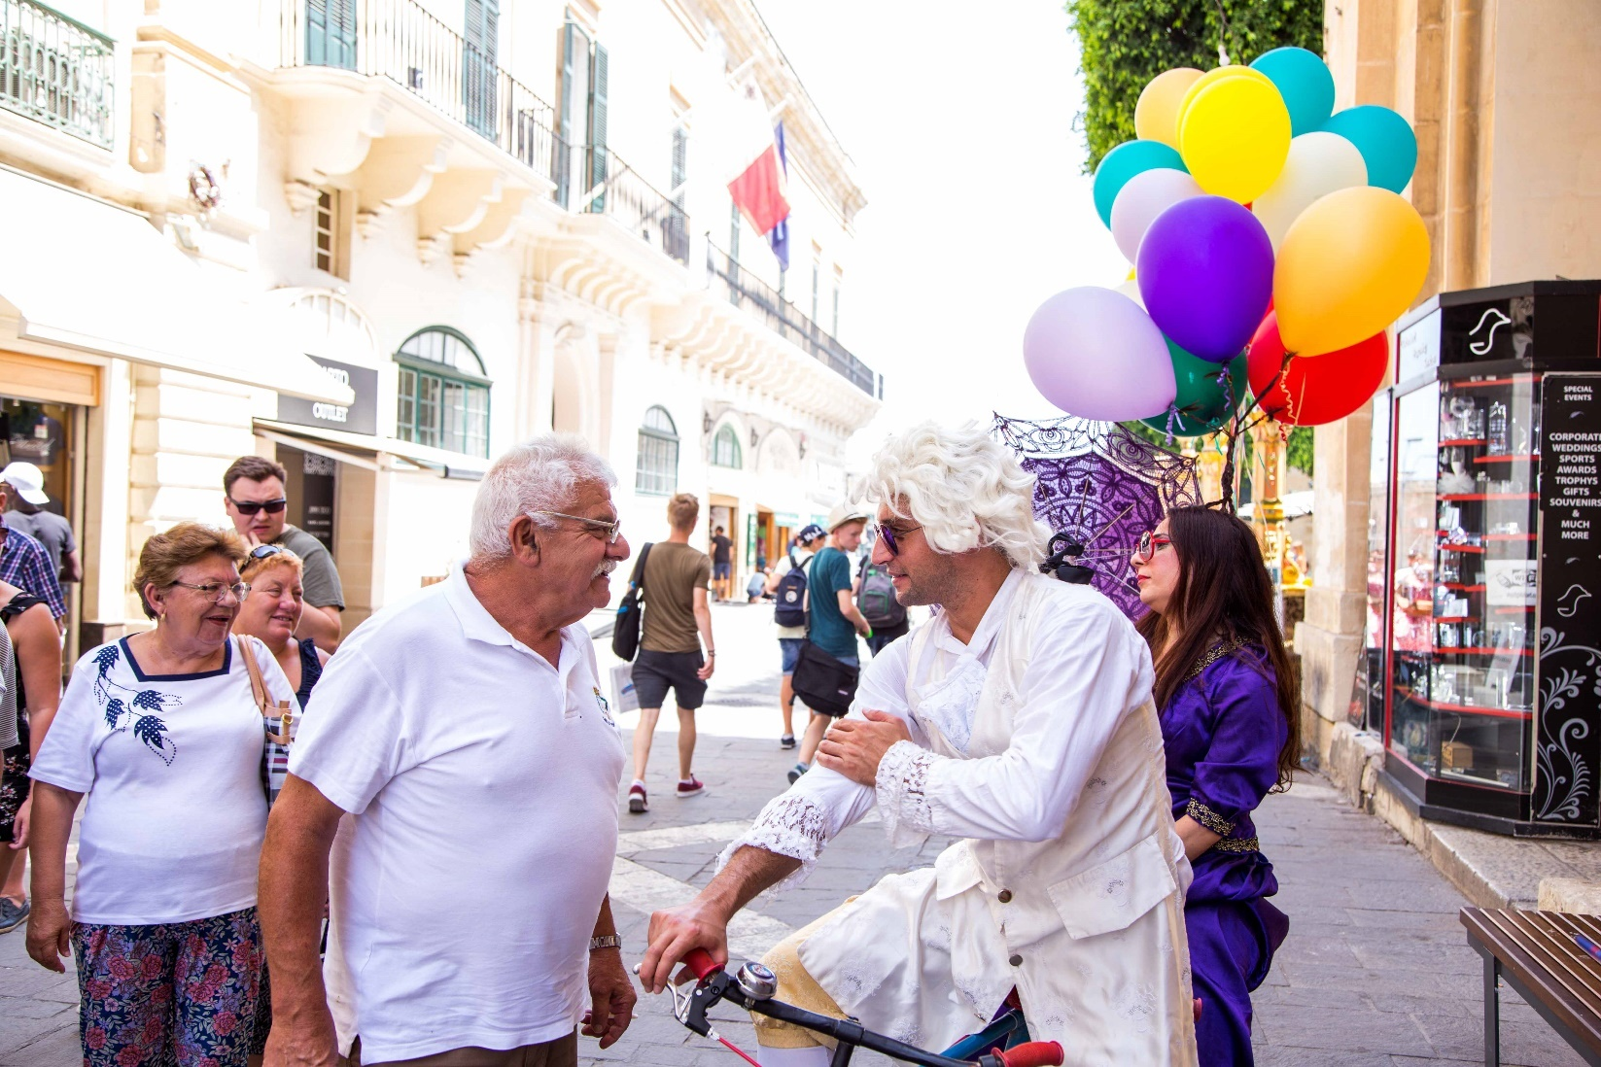

Slide 13
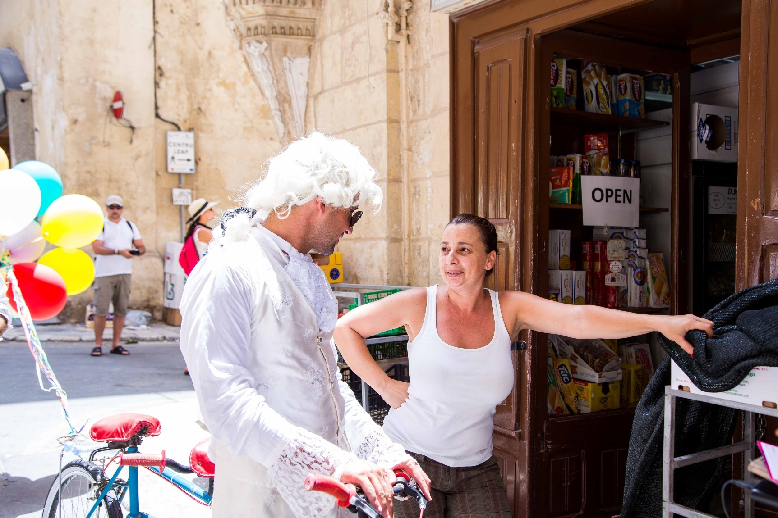

Slide 14
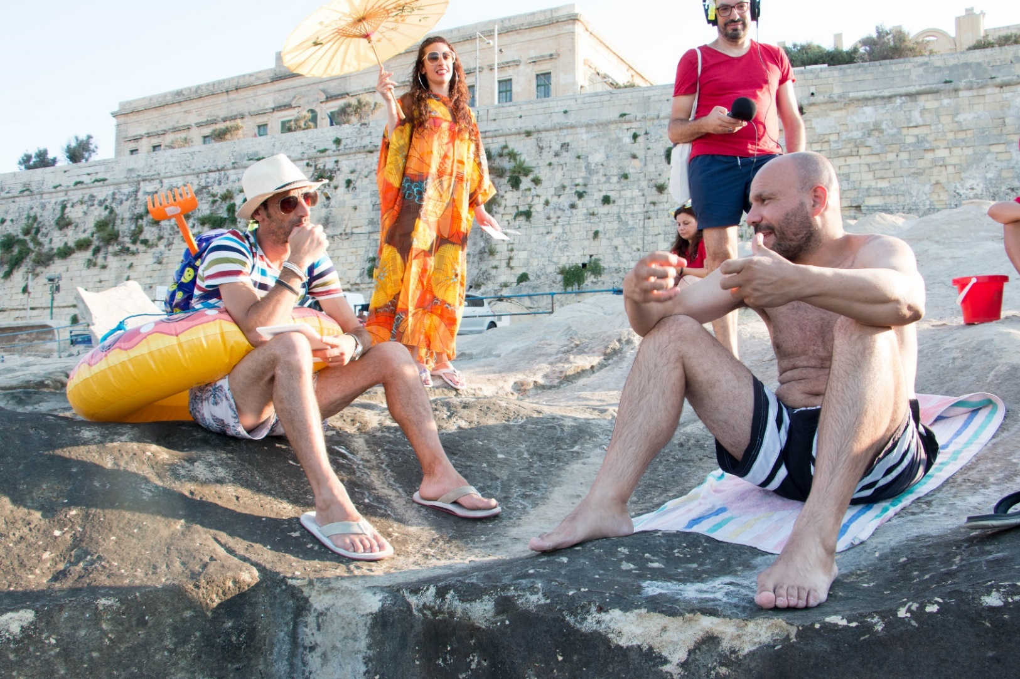

Slide 15
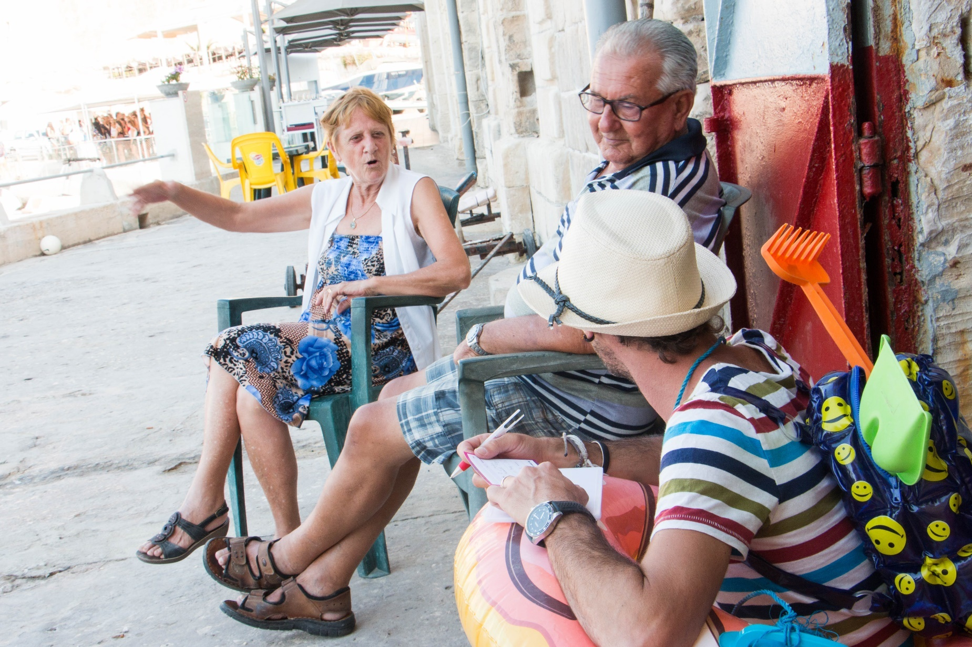

Slide 16
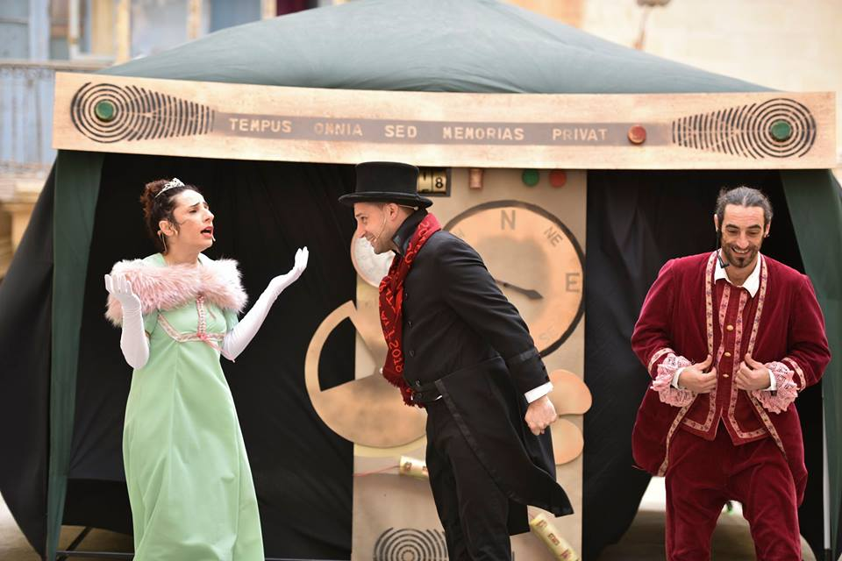
The dreams of Ninu, a poor servant, wishing to marry Bella, the spoilt countess who lost her dreams as a child, conflict with the ambitions of Aldo, a resourceful merchant seeking to augment his wealth.

Slide 17
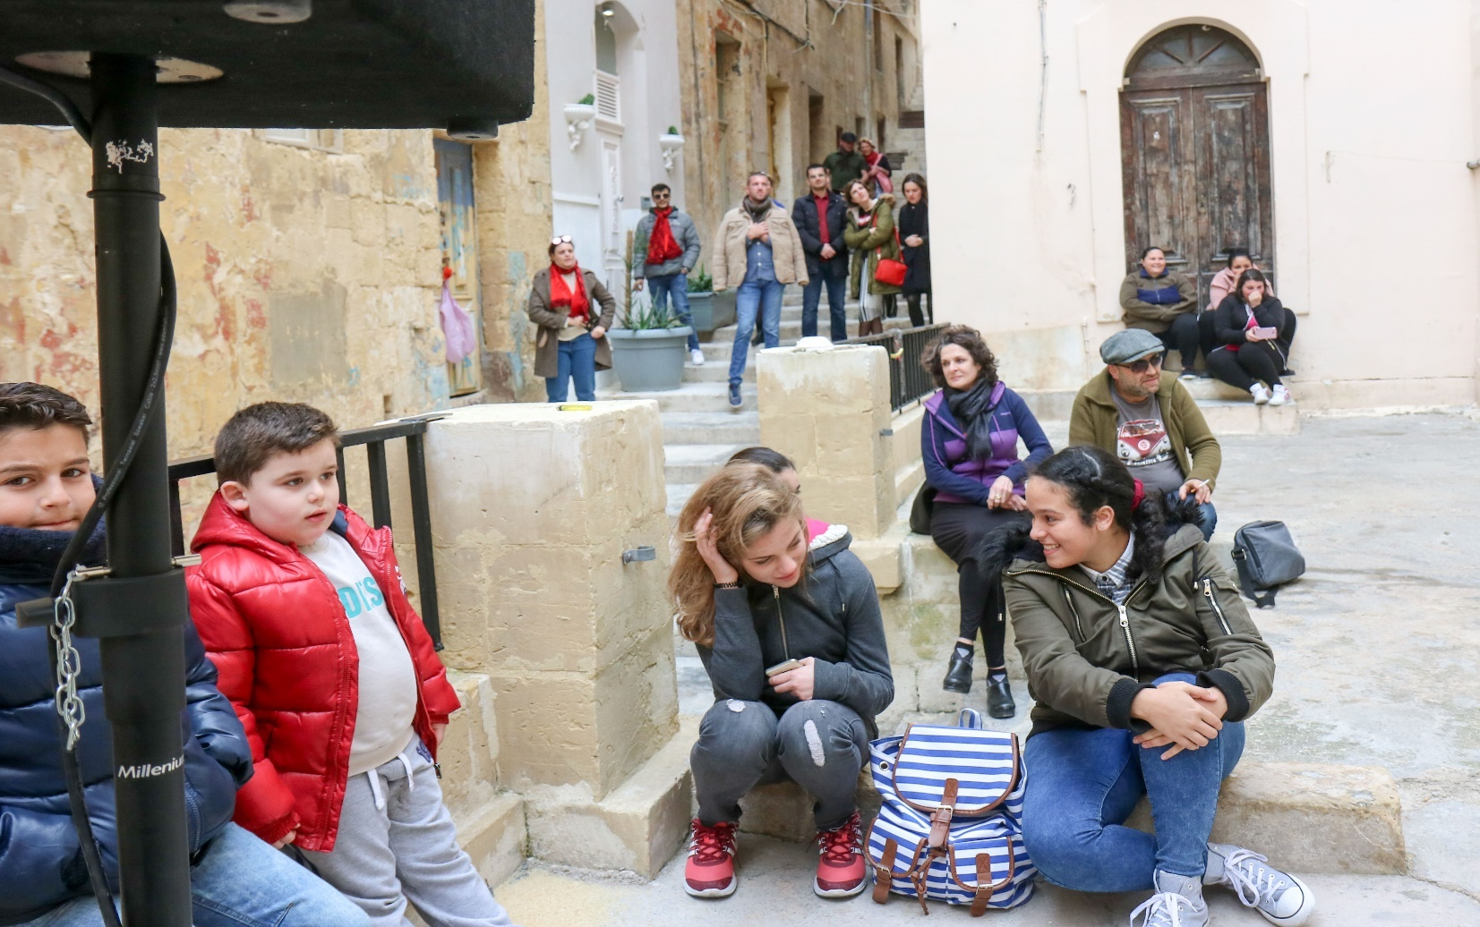
Performing the residents’ dreams in their living spaces

Slide 18
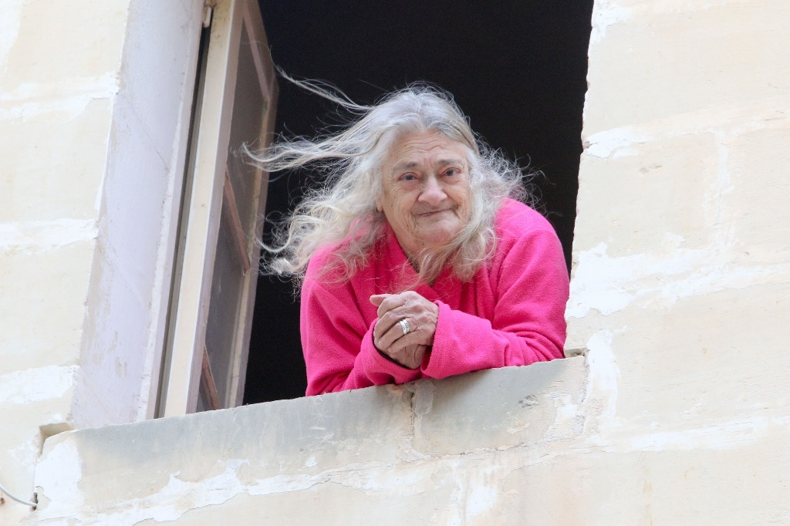
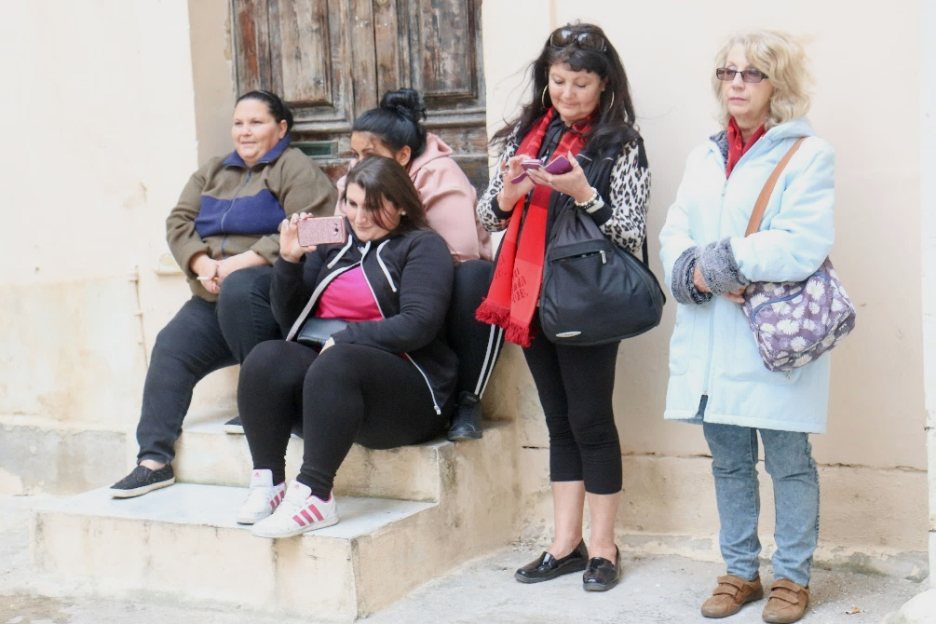

Slide 19
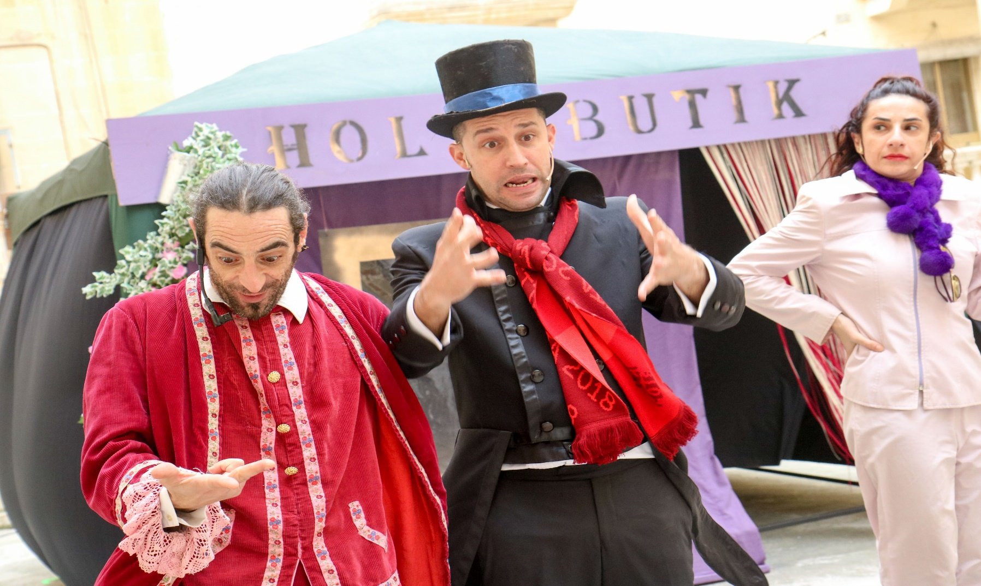

Slide 20
Il-Festa l-Kbira
The village festa is a defining cultural element in Malta, fusing sacred and profane customs, and keeping artistic traditions alive.
Valletta’s four patron saints:
St. Paul, St. Dominic, St. Augustine, Madonna of the Carmelo
Two band clubs: King’s Own, La Vallette
Different communities celebrating their festas together for the first time on 6th and 7th April 2018.

Slide 21
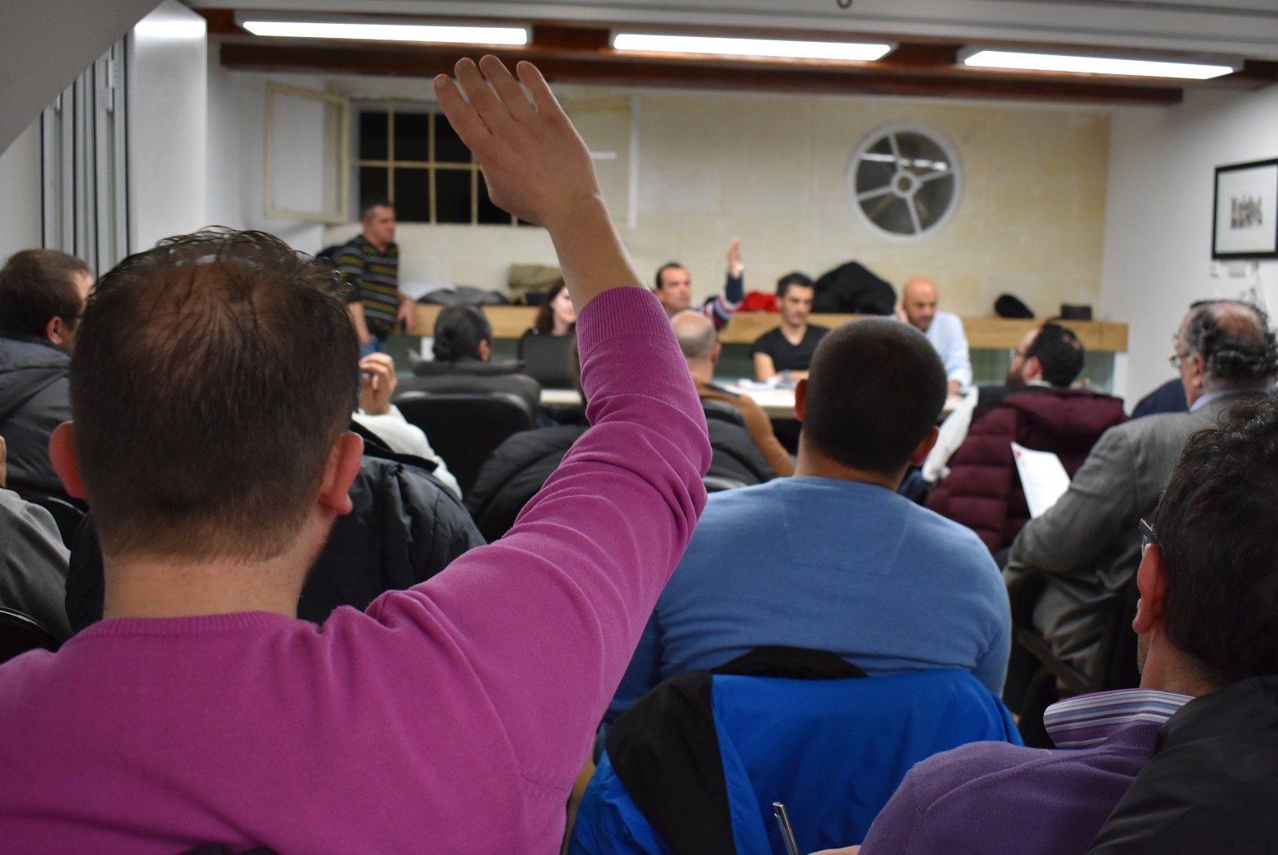
Communities involved in preparatory discussions and planning.

Slide 22
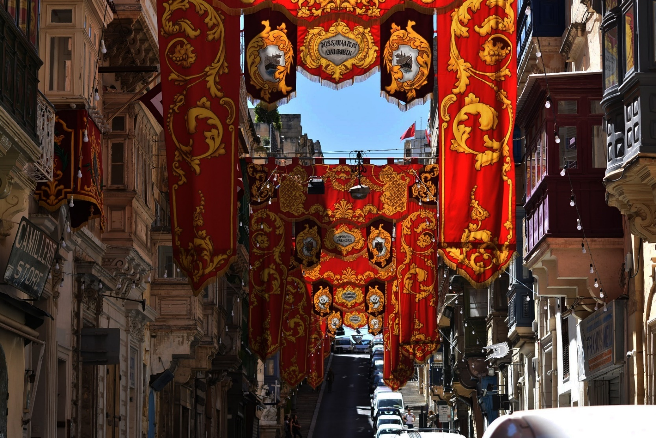
Setting up the colourful street decorations

Slide 23
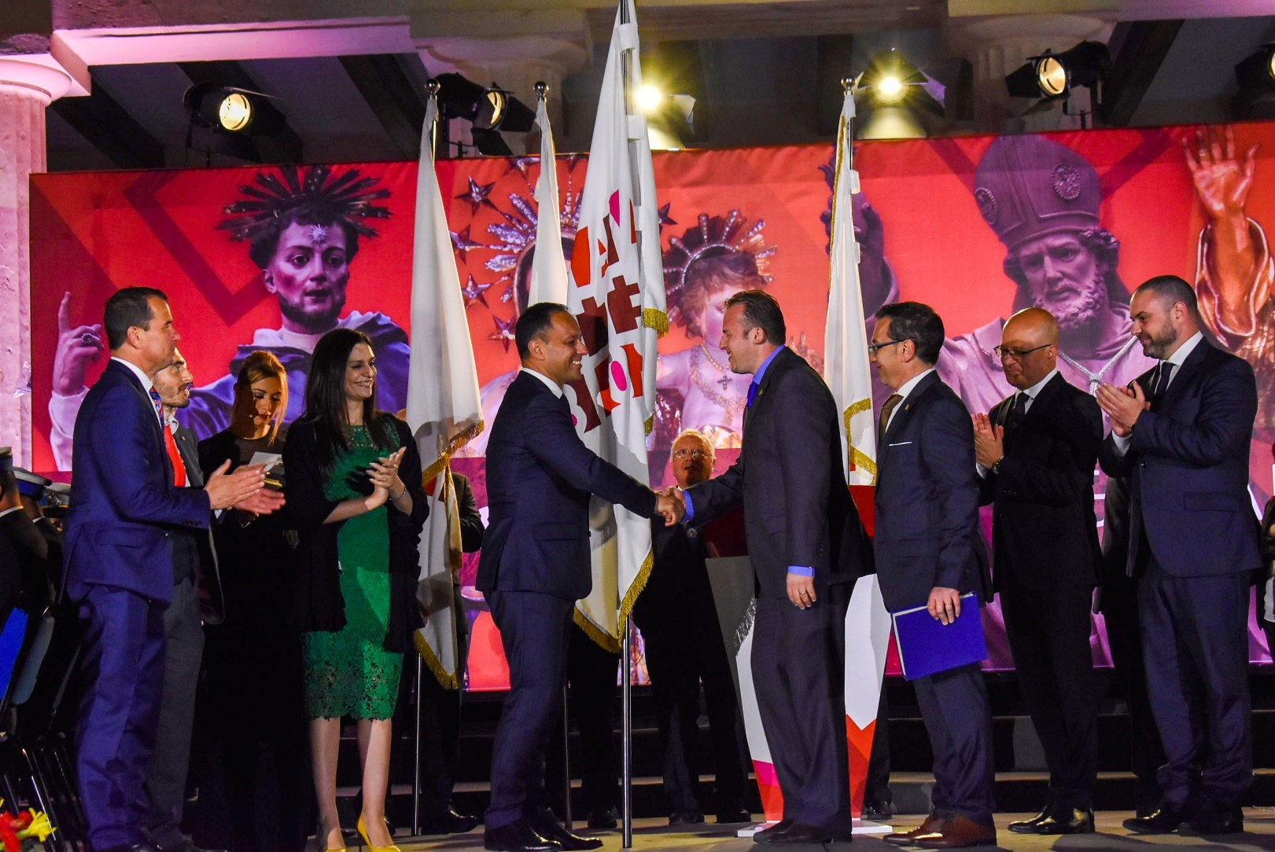
Deserved recognition for cultural contribution

Slide 24
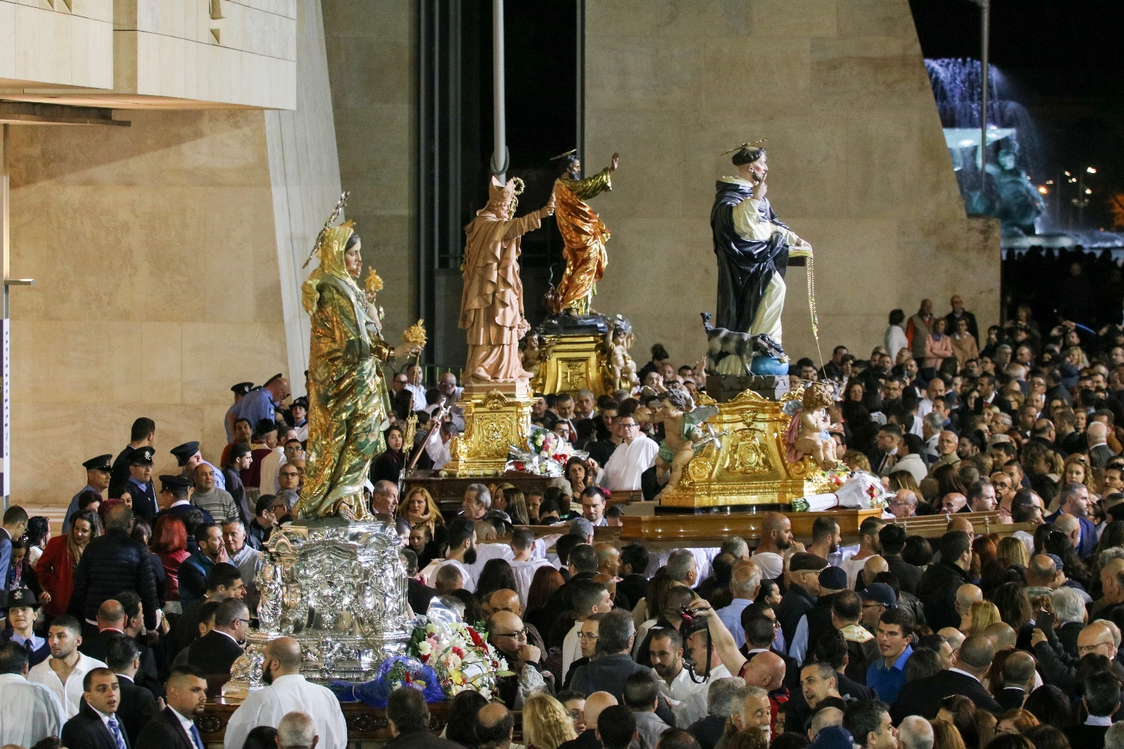
The four statues in front of Parliament

Slide 25
Ġewwa Barra
A community arts project conducted by Victor Jacono with Valletta residents
Empowering creative and responsible participation vis-à-vis ongoing changes in the capital city
Engaging residents’ cultures to express the needs and dreams that shape their experience of Valletta as a lived space

Slide 26
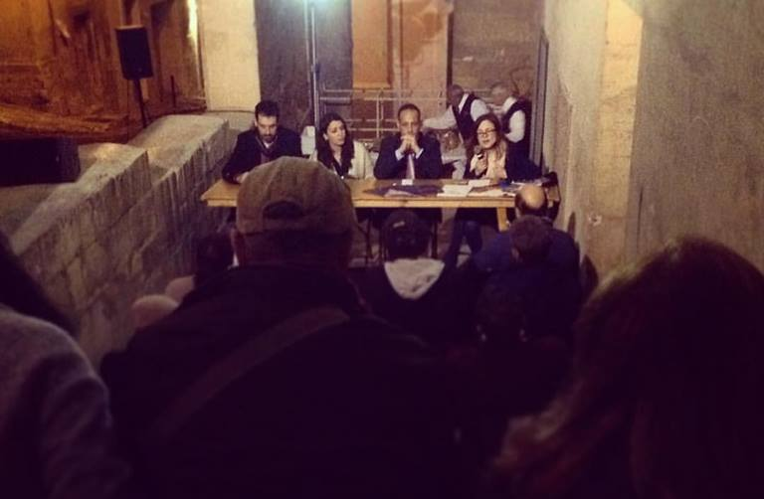
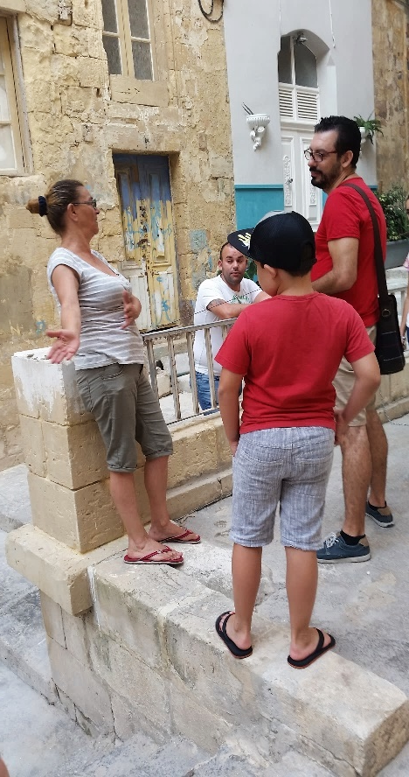
Moving from formal, collective meetings to more informal and intimate encounters with the community.

Slide 27
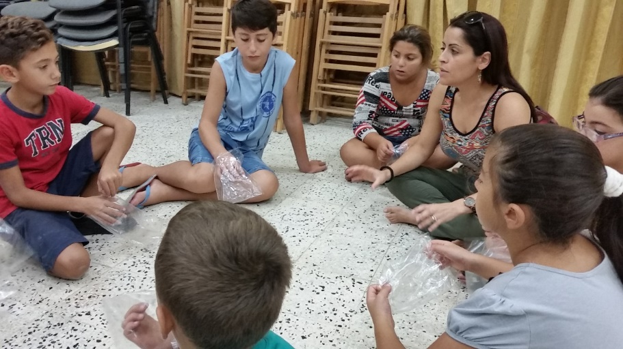
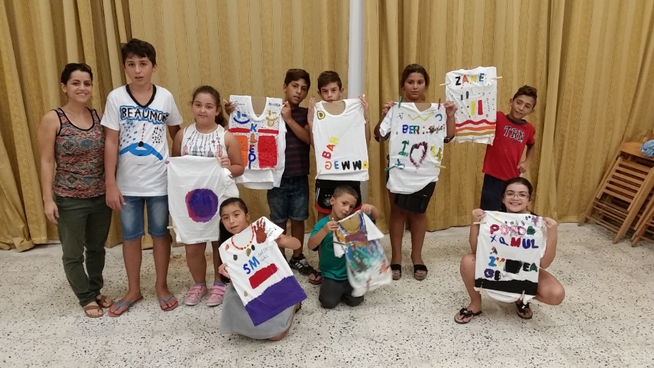
To narrate, celebrate,
play, and care …
By means of
Informal meetings
Creative workshops
Artistic projects

Slide 28
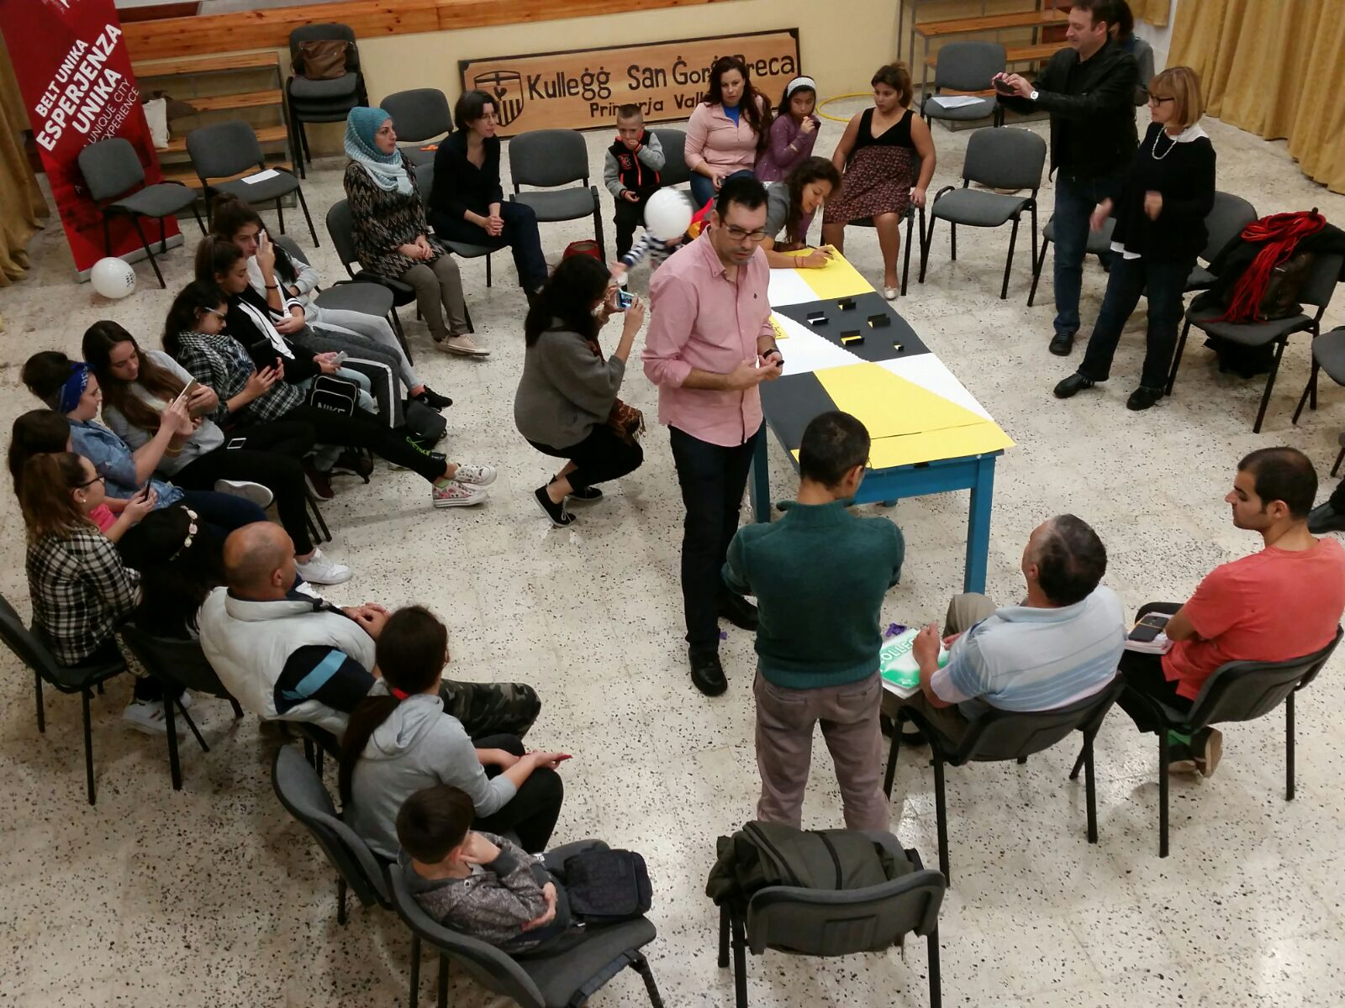
With architects Maria Cerreta & Fabio Lancio to discuss the regeneration of community spaces

Slide 29
Bringing all the stakeholders together
Valletta 2018 Foundation
Maria Cerreta, Franco Lancio, Colla
Diju Balli Residents
Grand Harbour Regeneration Corporation
Valletta Local Council
Claude Mangion & Ivan Busuttil
Arc Studio Ltd.

Slide 30
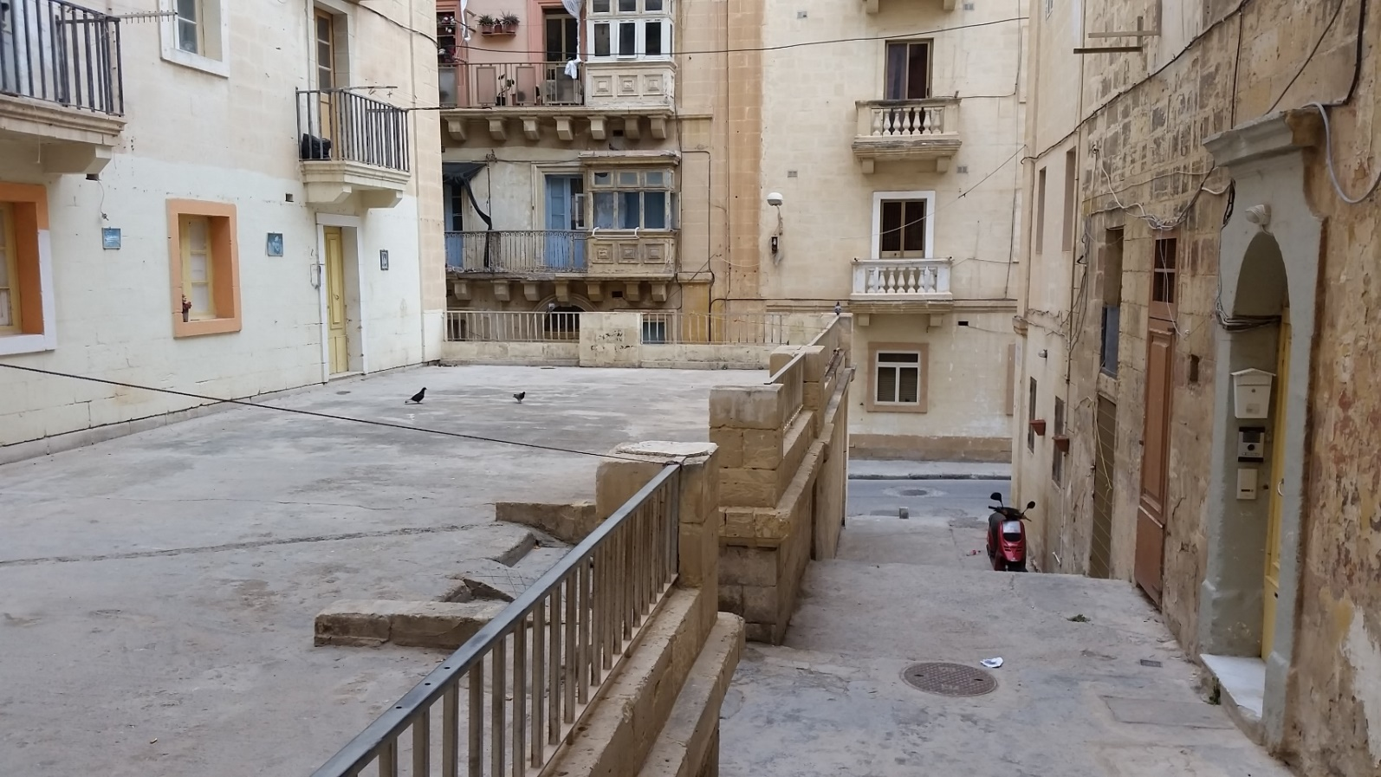
To change this …

Slide 31
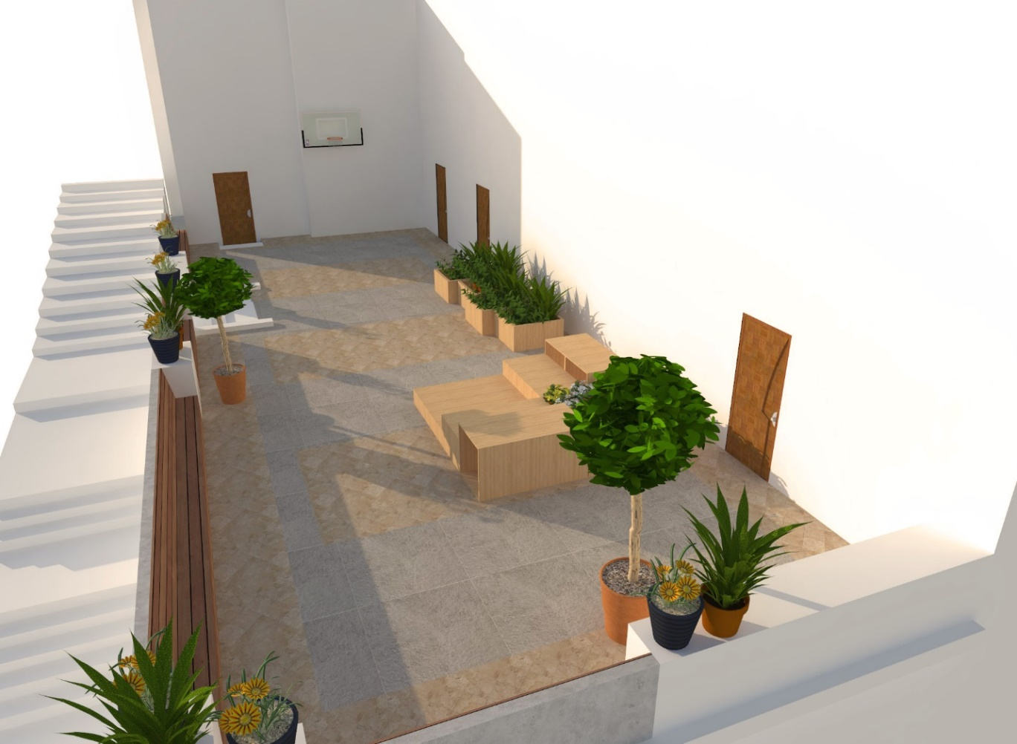
… into this.

Slide 32
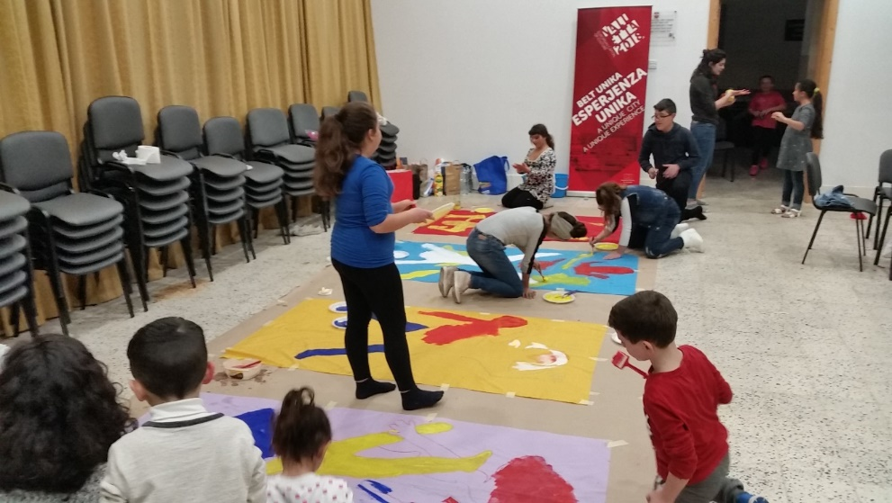
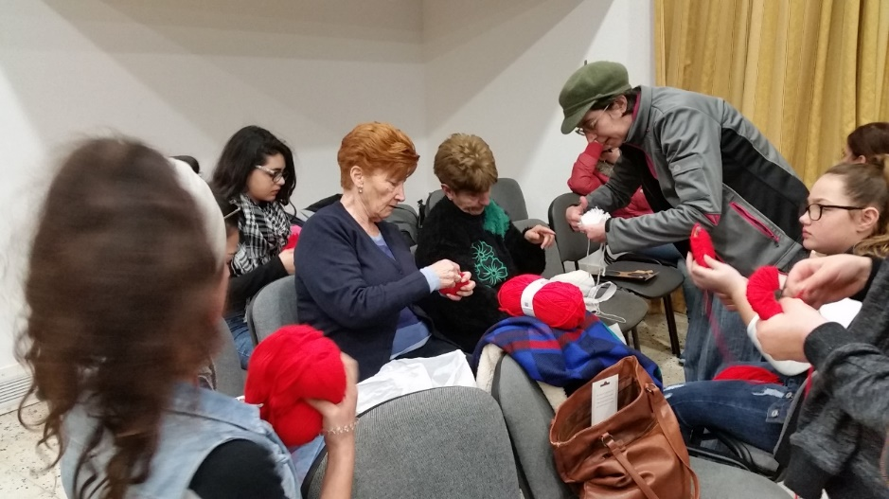
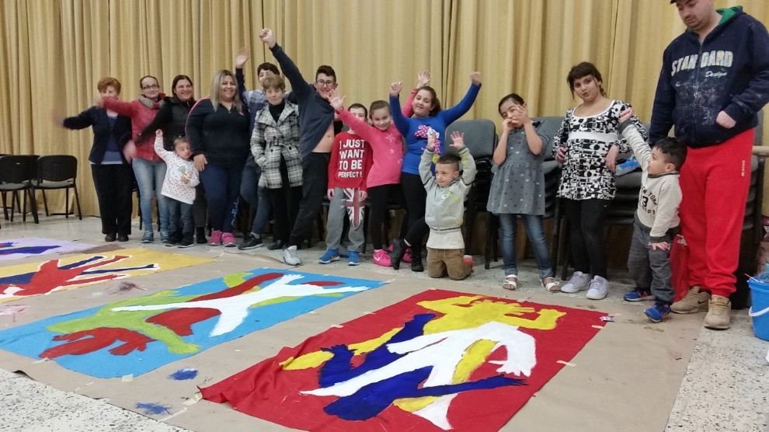
Preparing to take Carnival down to the neighbourhood

Slide 33
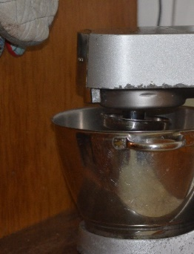
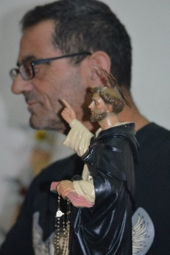
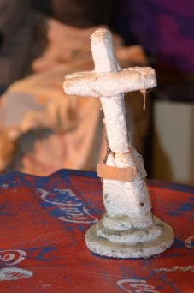
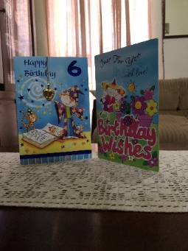
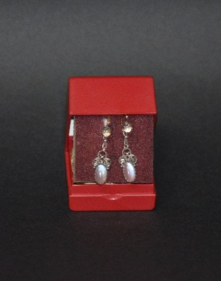
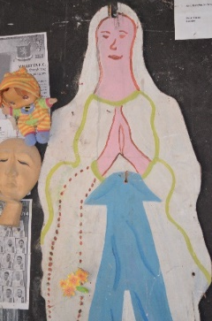
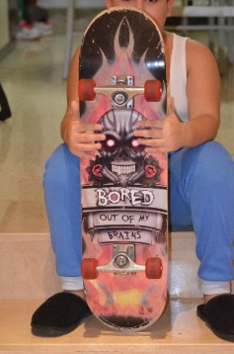
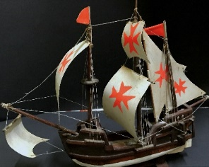
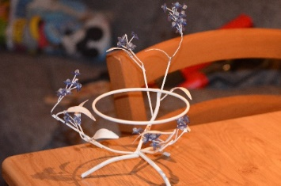
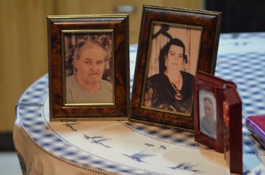
Pictures and stories
Steps Street amateur photographer Osea Tabone taking pictures of objects especially chosen by the Diju Balli residents …
inspiring stories by Maltese writer Jean Paul Borg

Slide 34
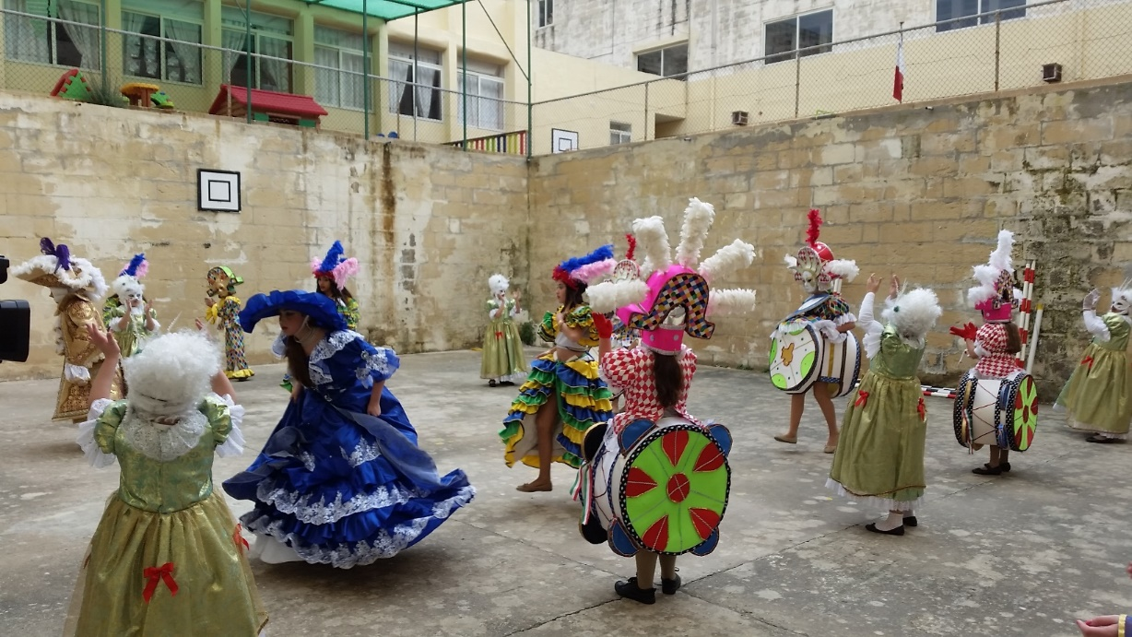
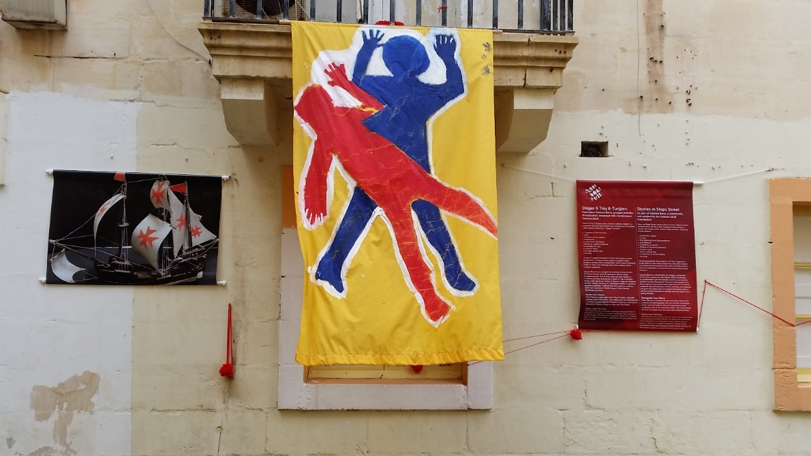
To celebrate ...
and narrate.

Slide 35
Now towards the Ħasla!
Ħasla – double meaning in Maltese: cleansing and telling-off, catharsis and condemnation
A theatre performance involving residents from across the city neighbourhoods
Artists as facilitators to help the residents create and present their performance on life in the capital city
Taking a video documentation of the whole process

Slide 36
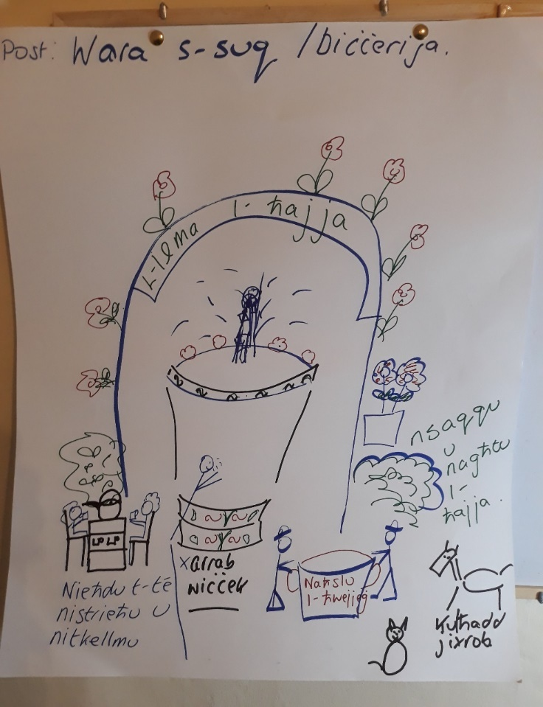
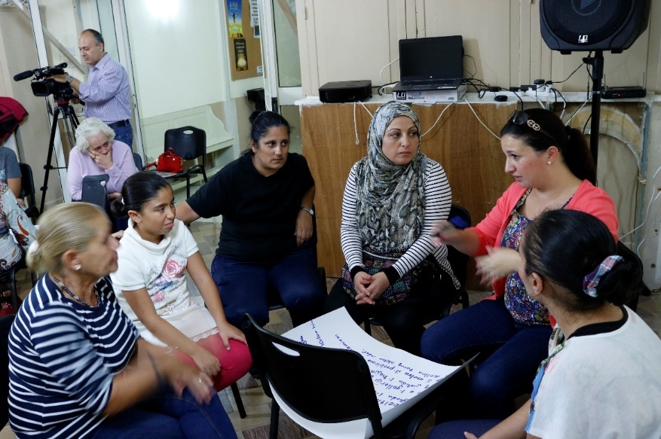
Creative workshops
Workshop on fountains and the use of water at differenti times of the day with
Kaldon Mercieca

Slide 37
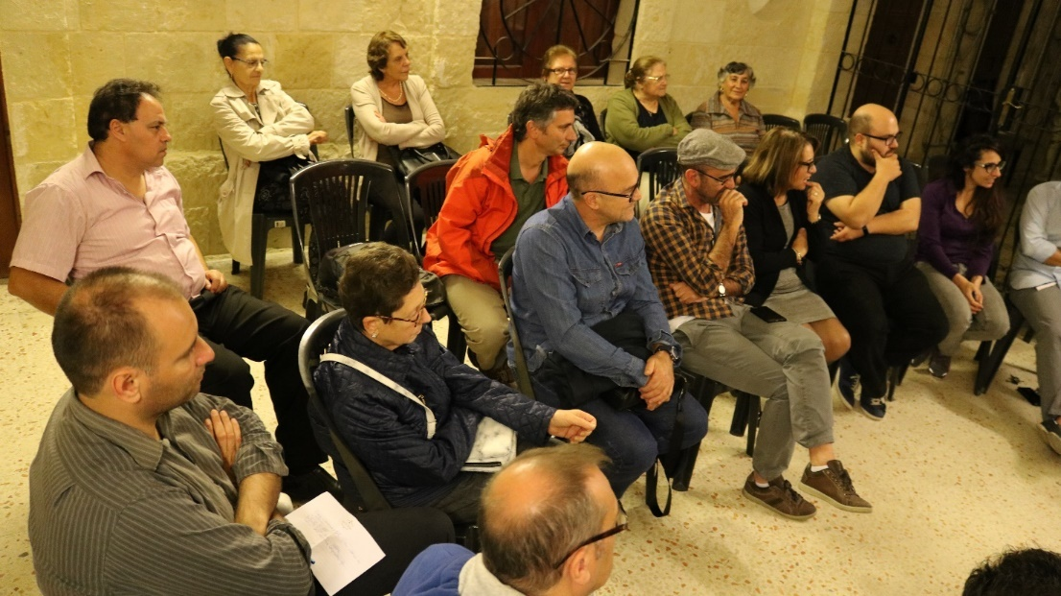
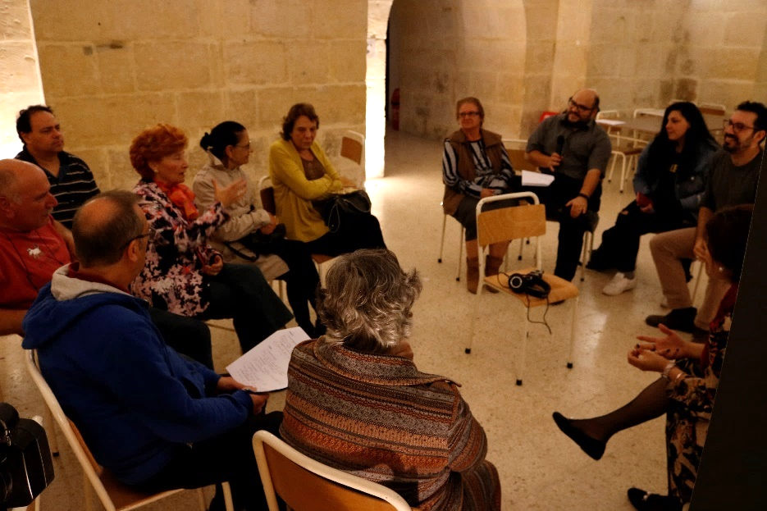
More creative workshops

Slide 38
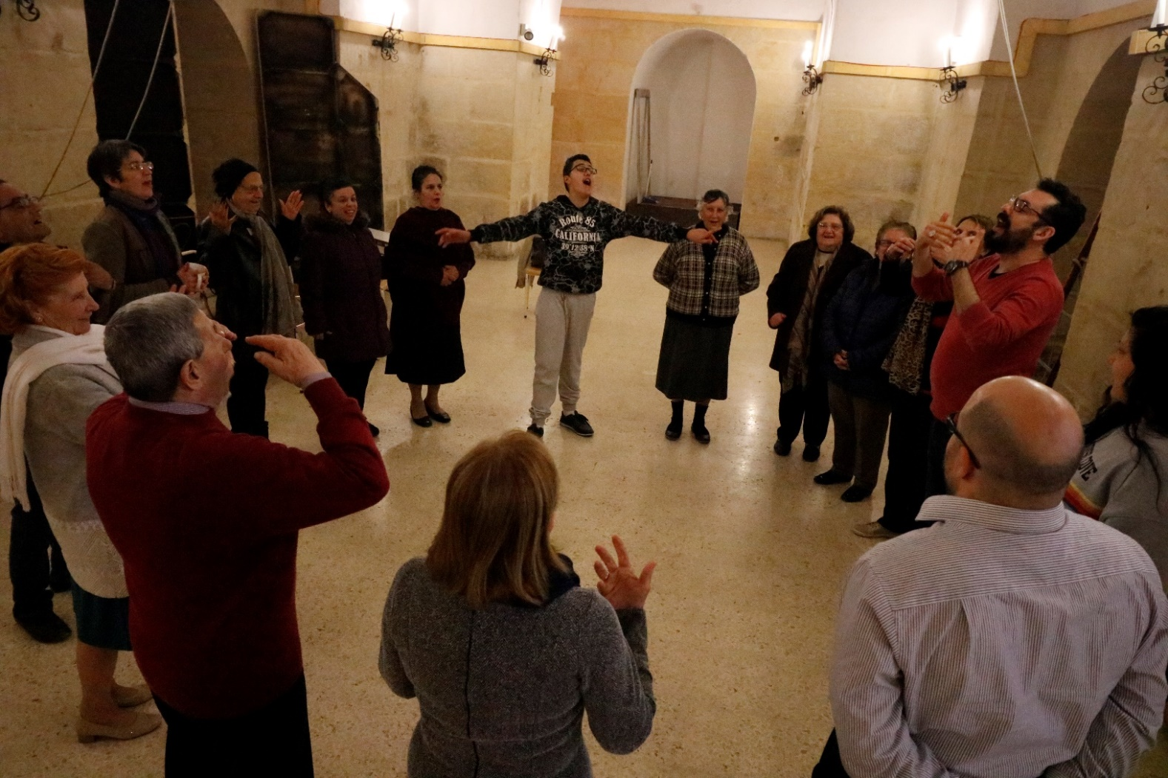
Making ready for the performance on 26th August 2018

Slide 39
Challenges to creative civic participation
The greatest challenge is change
We are more inclined to preserve the status-quo
Changing the culture of civic participation
Changing decision making models
Changing the residents’ mindset on authority and representation

Slide 40
A bottom-up & top-down process
The residents are experienced, but not necessarily experts.
Complexity: we are all connected, we are all affected.
Building a heritage-legacy bridge that is socially healthy requires enhanced democratic processes, through mindful civic participation.

Slide 41
Mutual empowerment
The arts can serve processes of empowerment. They can give communities the stimuli and awareness necessary to provide decision makers with both insight and support.
Living together and adapting to change is complex, and will not go away.
ECoC is an opportunity to experiment creative and socially-sensitive approaches towards engineering the heritage-legacy bridge together.

Slide 42
Thank you!

Slide 43
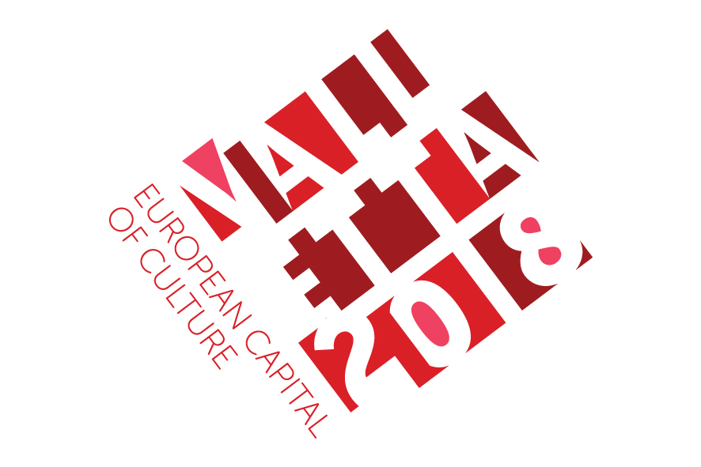
www.facebook.com/valletta2018 www.twitter.com/valletta_2018 www.instagram.com/valletta_2018

