Slide 1
DANSEMA dance theater
WWW.DANSEMA.LT

Slide 2
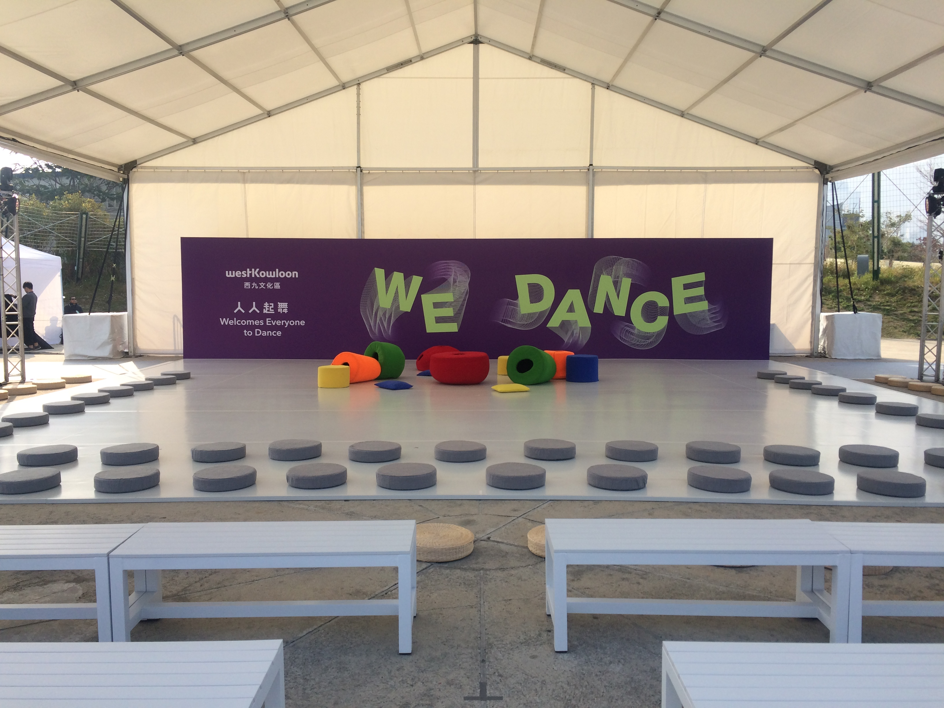

Slide 3
"Dansema" Dance Theater is a non-governmental organization producing dance performances for young audience.
It was the first professional theater which by the initiative of the famous Lithuanian choreographer Birute Baneviciute started to create dance performances for young audience in Lithuania. Since it was established in 2007 theater successfully has been touring in Lithuania and abroad (Europe, Asia, USA). "Dansema" also organizes seminars for dancers, choreographers and dance teachers, implements educational dance projects with children. Theater performances have been nominated and awarded by Lithuanian Ministry of Culture as the best children performances of the year 2012 and 2015.
Since 2014 Dansema focuses on developing dance productions for babies under 3 years.
Theater is a member of the international networks ASSITEJ and IPAY.

Slide 4
EDUCATION PROJECTS
Early dance for babies
Professionals and children on the stage
Seminars for professionals and parents

Slide 6
Dansema Dance Theatre performances are more than just fun for babies and small children, taking up most of their time in the first years of their life. By playing, they explore and learn about themselves and the surrounding world: to sit and crawl, climb and jump, grasp and drop, catch and kick, smile and frown, share and…

Slide 7
Everywhere we perform, the kids don't want to leave the stage space afterwards.' Why? 'Because we understand each other

Slide 8
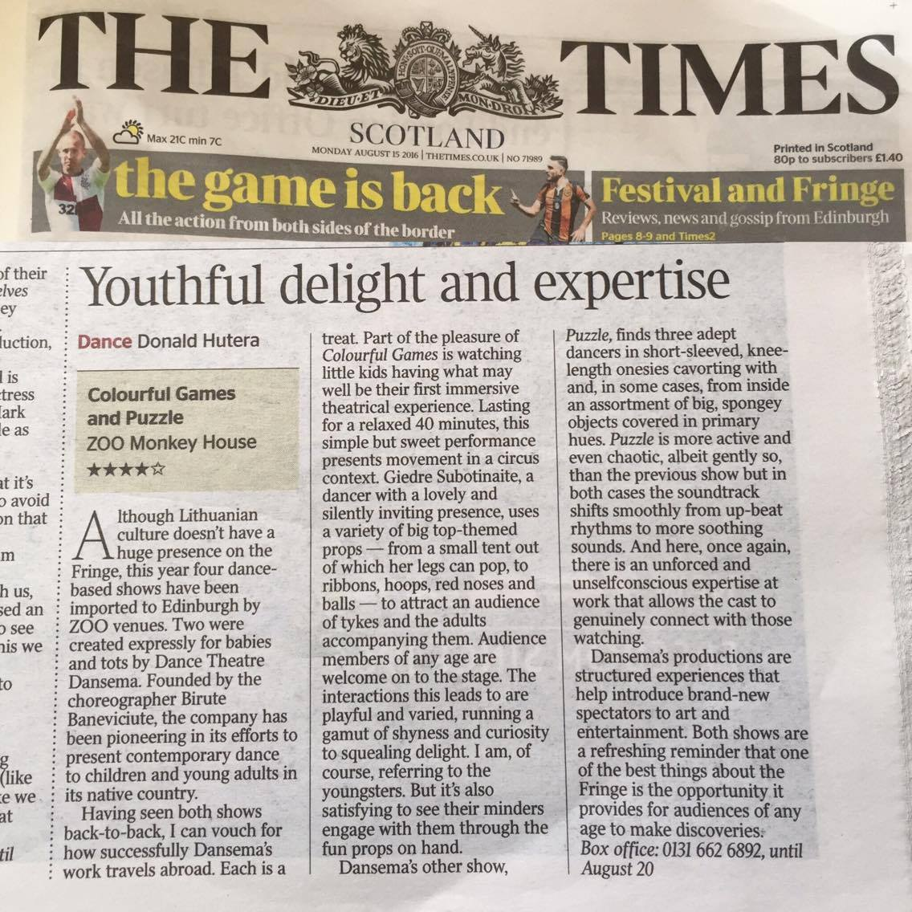

Slide 9
Why important to create, support and present performances for babies and toddlers?
high quality artistic experience for the early age
exploring and learning process for babies and parents
non-verbal communication skills development
Education of the future audience (habits, taste and ….)

