Slide 1
Teamwork for the Future of Liverpool 2008
Lewis Biggs
[Title]
[Name]
[Date]
European Capital of Culture Forum
Kaunas May 18-19 2018
With thanks to Liverpool City Council Press Office and Marketing team

Slide 2
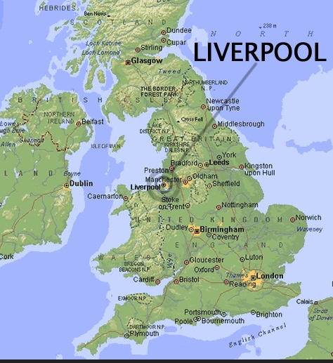
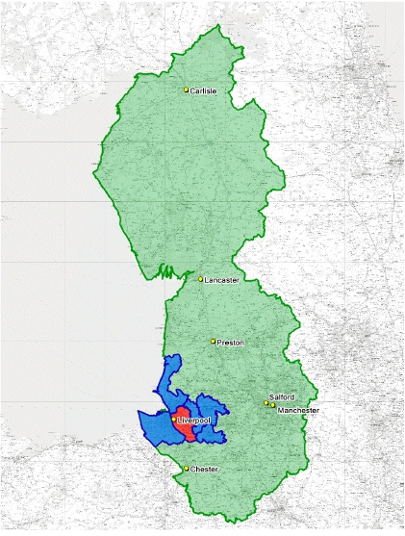
[Title]
[Name]
[Date]
Notes:
The Estuary of the River Mersey – the quickest sea route to Ireland and the New World - West coast of Europe
The Five Boroughs of Merseyside – set within the Northwest Region of England.

Slide 3
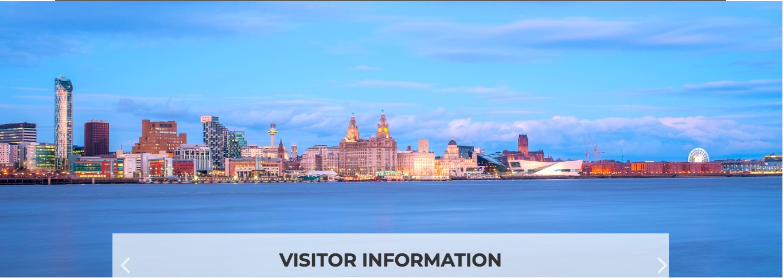
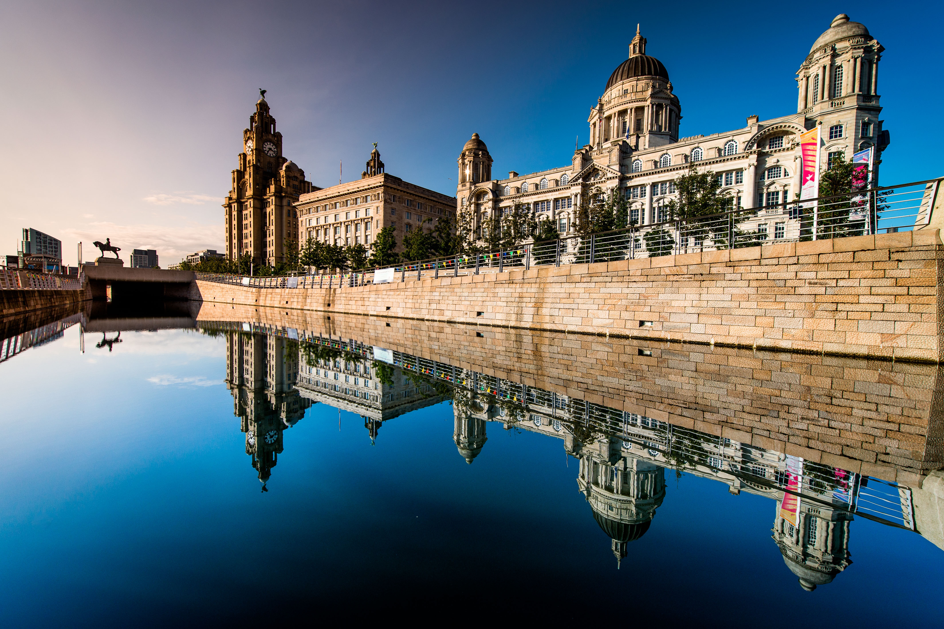
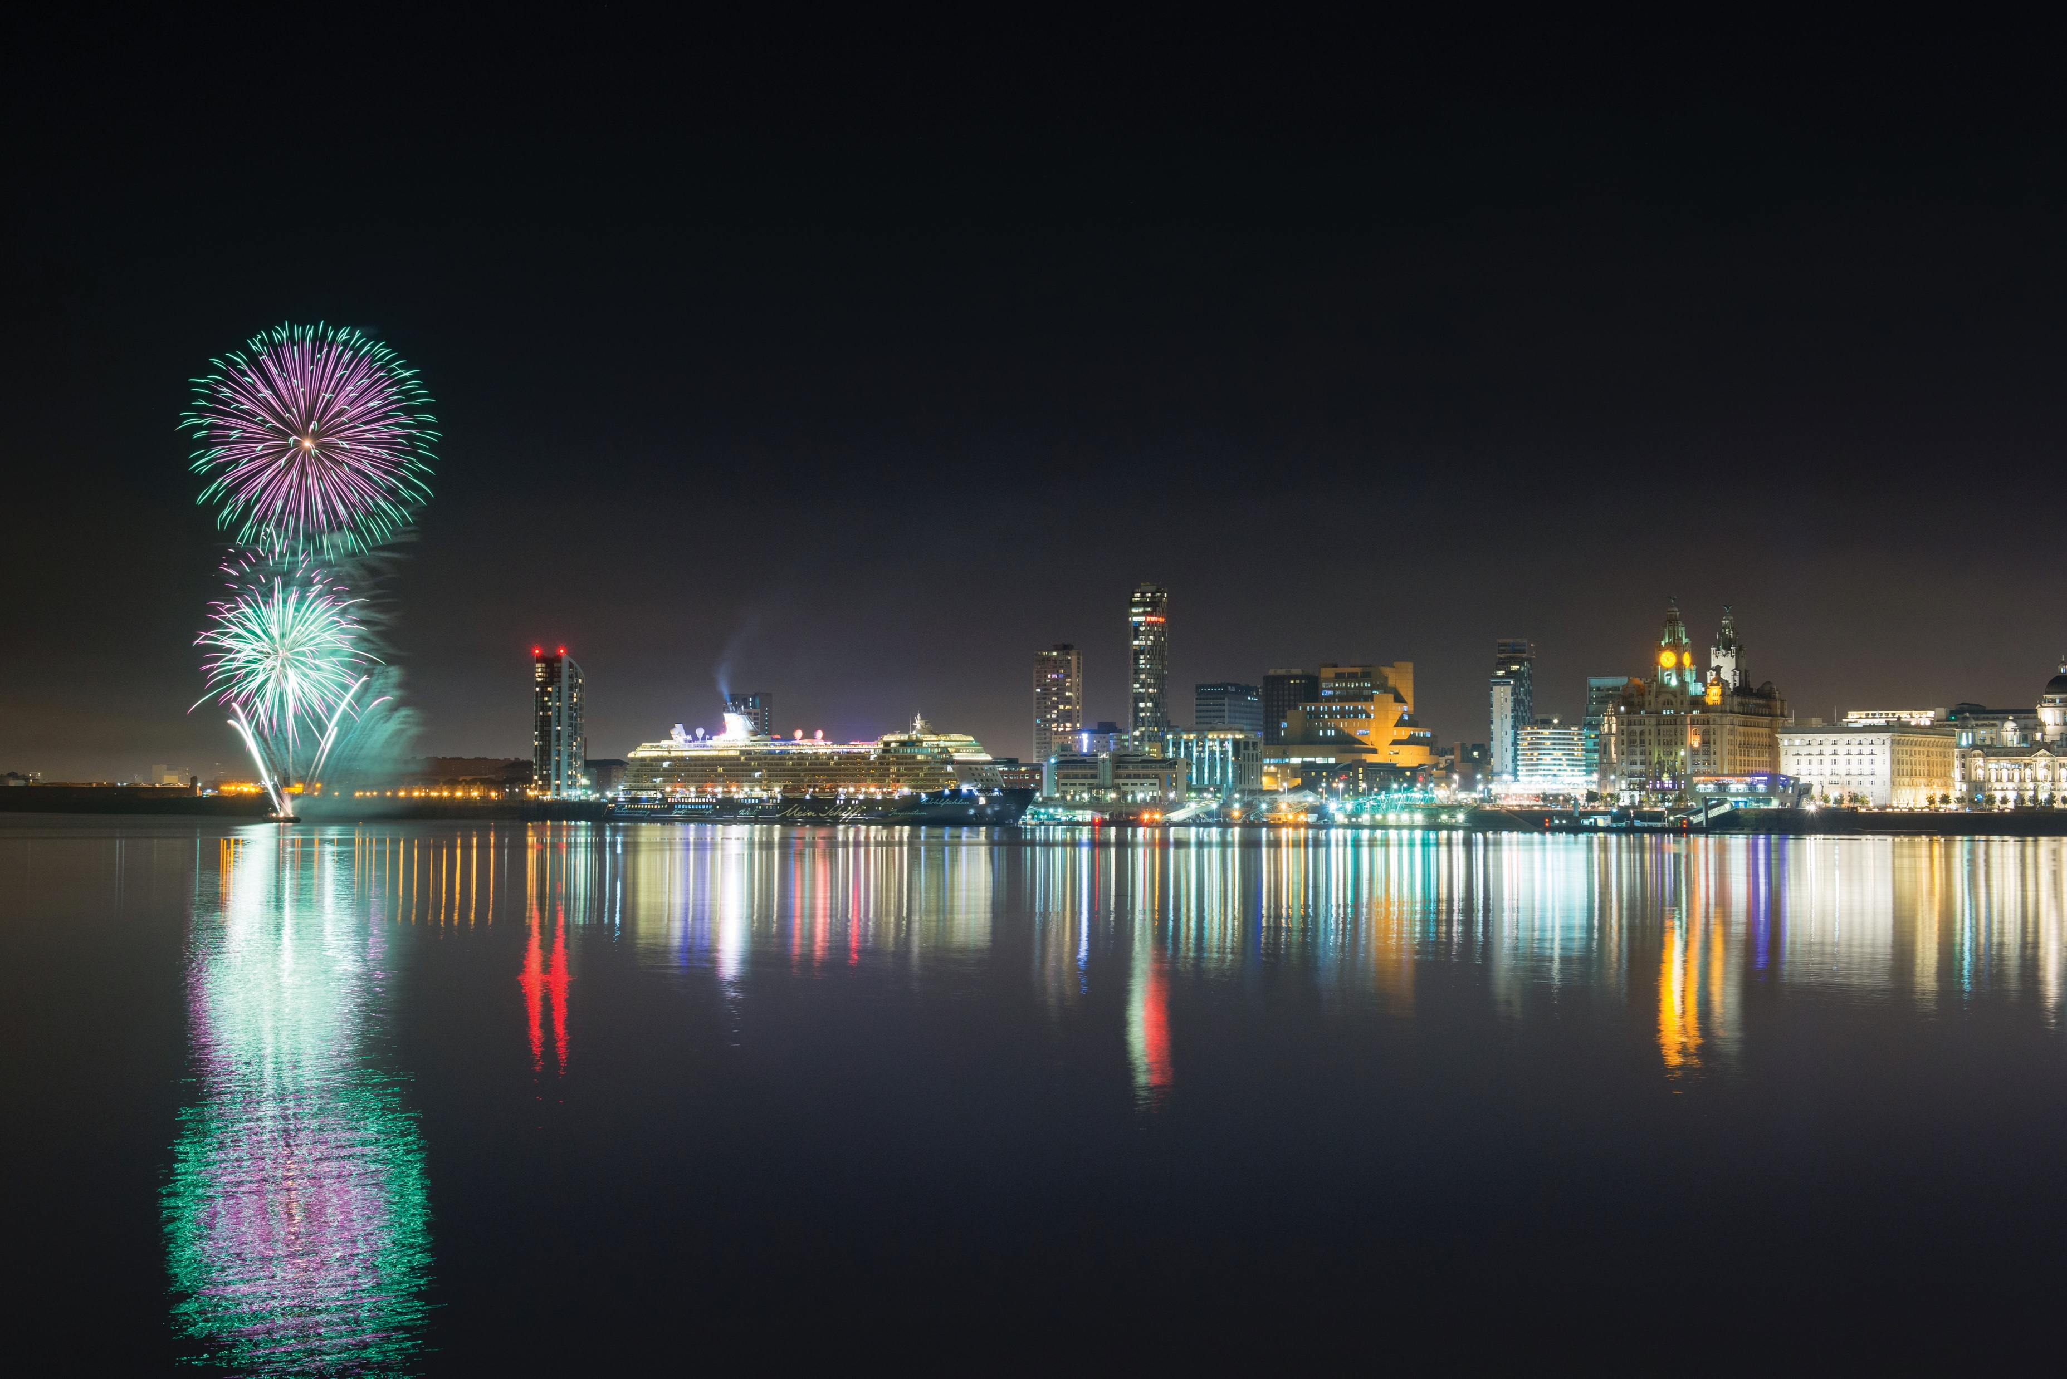
[Title]
[Name]
[Date]

Slide 4
[Title]
[Name]
[Date]

Slide 5
Self-introduction and timeline –
Director of Tate Liverpool 1990 - 2000
SuperLambanana for Artranspennine98
Founding Trustee of Liverpool Biennial 1998
First Liverpool Biennial 1999
Resigned from Tate to lead Liverpool Biennial 2000
Consultants appointed to write Culture Capital Bid Nov 2000
Second Biennial 2002 – ECoC judges present
Liverpool’s ECoC Bid succeeded 2003
[Title]
[Name]
[Date]
Notes:
Tate illustrated
SLB illustrated

Slide 6
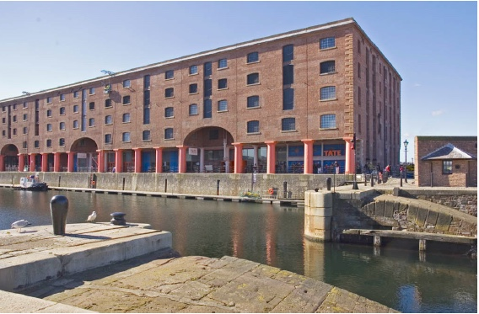
[Title]
[Name]
[Date]

Slide 7
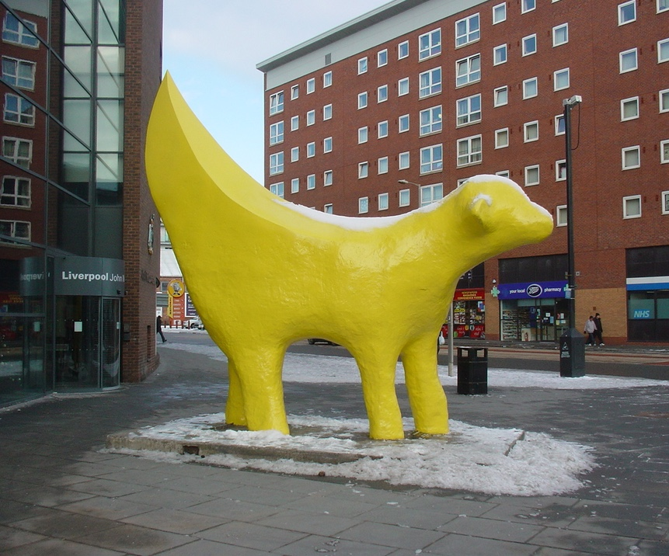
[Title]
[Name]
[Date]

Slide 8
David Wade Smith – Entrepreneur
Mike Storey – Leader of LCC
David Henshaw – CEO of LCC
Sir Bob Scott – Leader of ECoC bid
A challenge not a reward –
‘don’t ask what 2008 can do for you,
ask what you can do for 2008’
[Title]
[Name]
[Date]
Notes:
David Wade Smith – interested in the Biennial because there was no other CONTEMPORARY culture. You can’t sell fashion unless people are interested in culture.
Mike Storey – Head Maser in a local school. Understood the value of culture. Present at First Biennial Opening and met his own hairdresser.
David Henshaw. Picture of SuperLambanana appeared in his office in 2000. Understood the need to change perceptions of Liverpool as a place to visit and a place to do business.

Slide 9
Liverpool Biennial
of Contemporary Art
– a partnership between
contemporary visual arts organisations
Why?
‘to make Liverpool a better place for artists to live and work’
[Title]
[Name]
[Date]

Slide 10
Liverpool Biennial – a partnership
Partnership =
Shared vision
Shared resources
Shared audiences
Shared civic responsibilities
[Title]
[Name]
[Date]
Notes:
Civic responsibility = making the city a better place to live. Biennial was about a better place for artists to live, but artists are no different from anyone else, so making it a better place for everyone to live.

Slide 11
Before 2008 - How did we prepare?
Marketing
Higher Education alliance
Stakeholder / Funding advocacy
Audience development
Organisational development
[Title]
[Name]
[Date]

Slide 12
VAIL – Visual Arts In Liverpool
An umbrella marketing initiative
Partnership and the problem of brands
[Title]
[Name]
[Date]

Slide 13
Liverpool Culture Campus founded 2003
The opportunity for Higher Education
[Title]
[Name]
[Date]
Notes:
CEO of Liverpool University also Chair of FACT (Foundation for Art and Creative Technology)

Slide 14
Culture Campus
Three Liverpool Universities
The ‘cultural’ opportunity of 2008
Inter-university collaboration
Connecting ‘town and gown’
Realise local assets / archives etc
Liverpool as a HE brand / student experience
[Title]
[Name]
[Date]
Notes:
Most important was the understanding that the city brand was the best way to attract students.

Slide 15
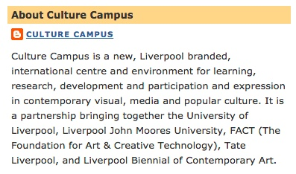
[Title]
[Name]
[Date]
Notes:
Liverpool branded

Slide 16
LARC founded 2004
Liverpool Arts Regeneration Consortium / Campaign
Political and business advocacy for funding.
Programme and audience development.
Organisational development.
[Title]
[Name]
[Date]
Notes:
Mutual, collaborative advocacy.
Sharing programmes and audiences
Professional training and updating for staff, shared services eg accountancy, ticketing, security.

Slide 17
LARC
8 most prominent cultural organisations receiving public money
National Museums Liverpool (NML)
Tate Liverpool
Everyman and Playhouse Theatres Trust
Royal Liverpool Philharmonic Orchestra (RLPO)
Unity Theatre
The Bluecoat
Liverpool Biennial
Foundation for Art and Creative Technology (FACT)
[Title]
[Name]
[Date]
Notes:
Two Nationally funded organisations – central govt recognized the requirement for national arts organsiations to reach people around the country not just in the capital.

Slide 18
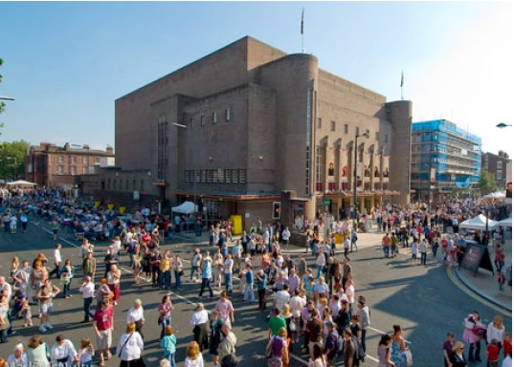
[Title]
[Name]
[Date]

Slide 19
SMAC
Small and Medium Arts Collective
50+ organisations – festival and long term
Collaborating to develop audiences
Networking to develop themselves organisationally and in relation to funders and sponsors.
[Title]
[Name]
[Date]

Slide 20
The Culture Company’s
CREATIVE COMMUNITIES programme
Quality cultural interventions
Neighbourhoods outside the city centre
Addressing health, heritage, community safety, sport, environment.
Intergenerational
Inclusive
Promoting Connectivity and Community Cohesion.
Europe’s biggest programme of its kind.
[Title]
[Name]
[Date]
Notes:
City’s links to schools etc meant that this programme created pathways for cultural organisations to follow.

Slide 21
After 2008
What Difference Did It Make?
[Title]
[Name]
[Date]

Slide 22
Culture Campus - outcomes
Liverpool as a city recognised as a major attractor for students
PhD Students and Lecturers hosted between Universities and Arts Organisations.
John Lennon Academy of Art & Design construction started 2005, opened 2008
[Title]
[Name]
[Date]

Slide 23
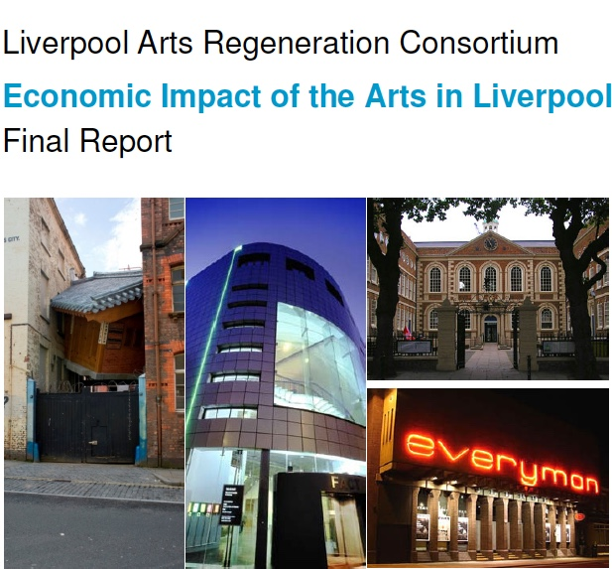
[Title]
[Name]
[Date]

Slide 24
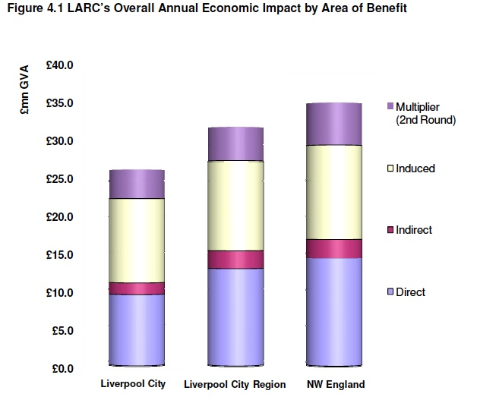
[Title]
[Name]
[Date]

Slide 25
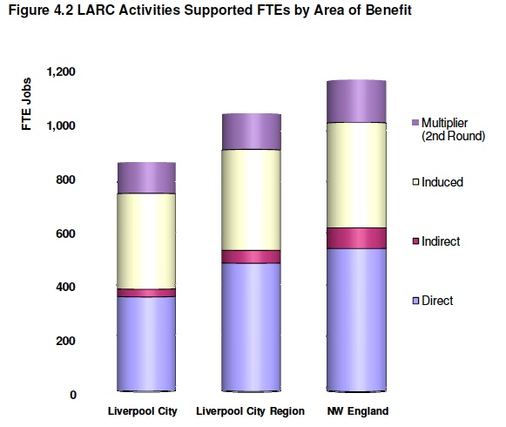
[Title]
[Name]
[Date]

Slide 26
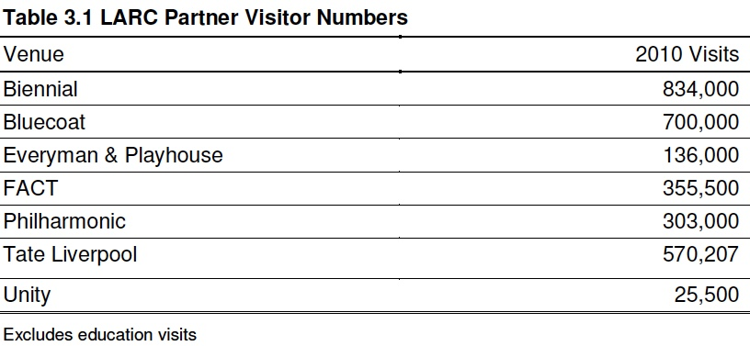
[Title]
[Name]
[Date]

Slide 27
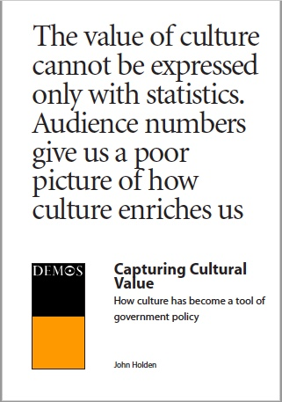
[Title]
[Name]
[Date]

Slide 28
POLITICS
Revitalised <Liverpool City> brand allows
Unified <Liverpool City Region> created - five Boroughs working together
Mayor / Mayor’s office established in leadership
[Title]
[Name]
[Date]

Slide 29
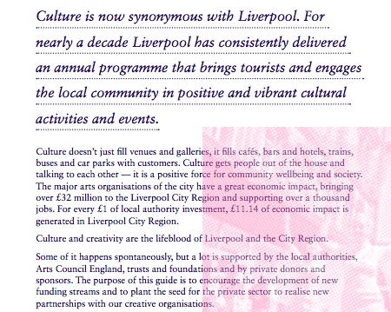
[Title]
[Name]
[Date]

Slide 30

[Title]
[Name]
[Date]

Slide 31
Business
Revitalised economy and new facilities
Liverpool One city centre retail district
Cruise Terminal
World Heritage Site designation
Establishment of annual Business Conference
[Title]
[Name]
[Date]

Slide 32
[Title]
[Name]
[Date]

Slide 33
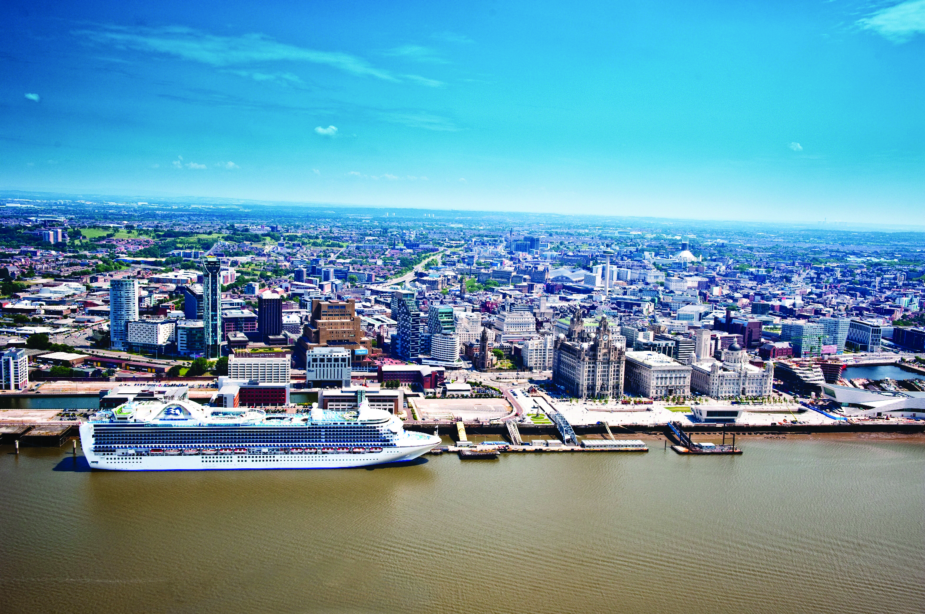
[Title]
[Name]
[Date]

Slide 34
What Did We Learn?
Ten Years On…
[Title]
[Name]
[Date]

Slide 35
Values from Liverpool, vision for Kaunas!
Local (start with this!)
Inclusion / connection
Variety / diversity
Entrepreneurship / sustainability
[Title]
[Name]
[Date]

