Slide 1
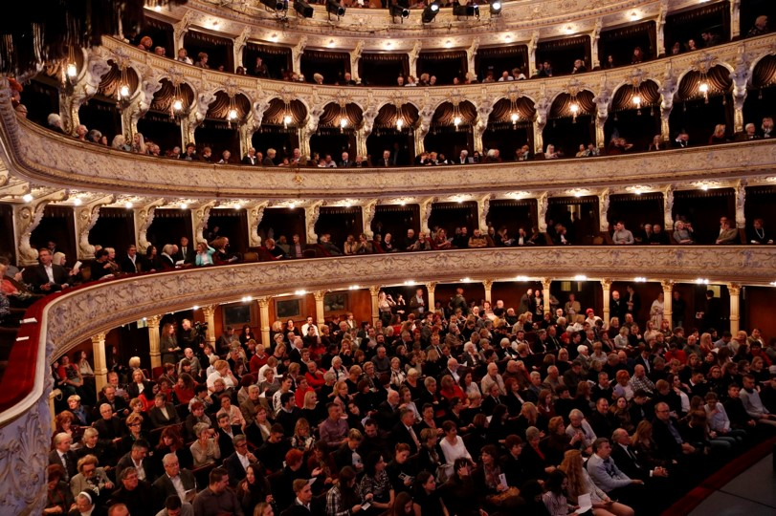
Croatian National Theatre Ivan pl. Zajc,
Rijeka,
Croatia

Slide 2
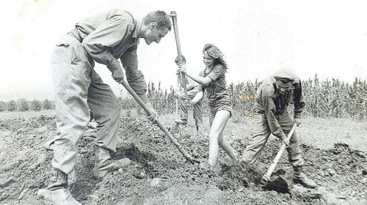
We develop audience, audience develops
We develop the audience, the audience develops us
(We build the railroad, the railroad builds us!)

Slide 3
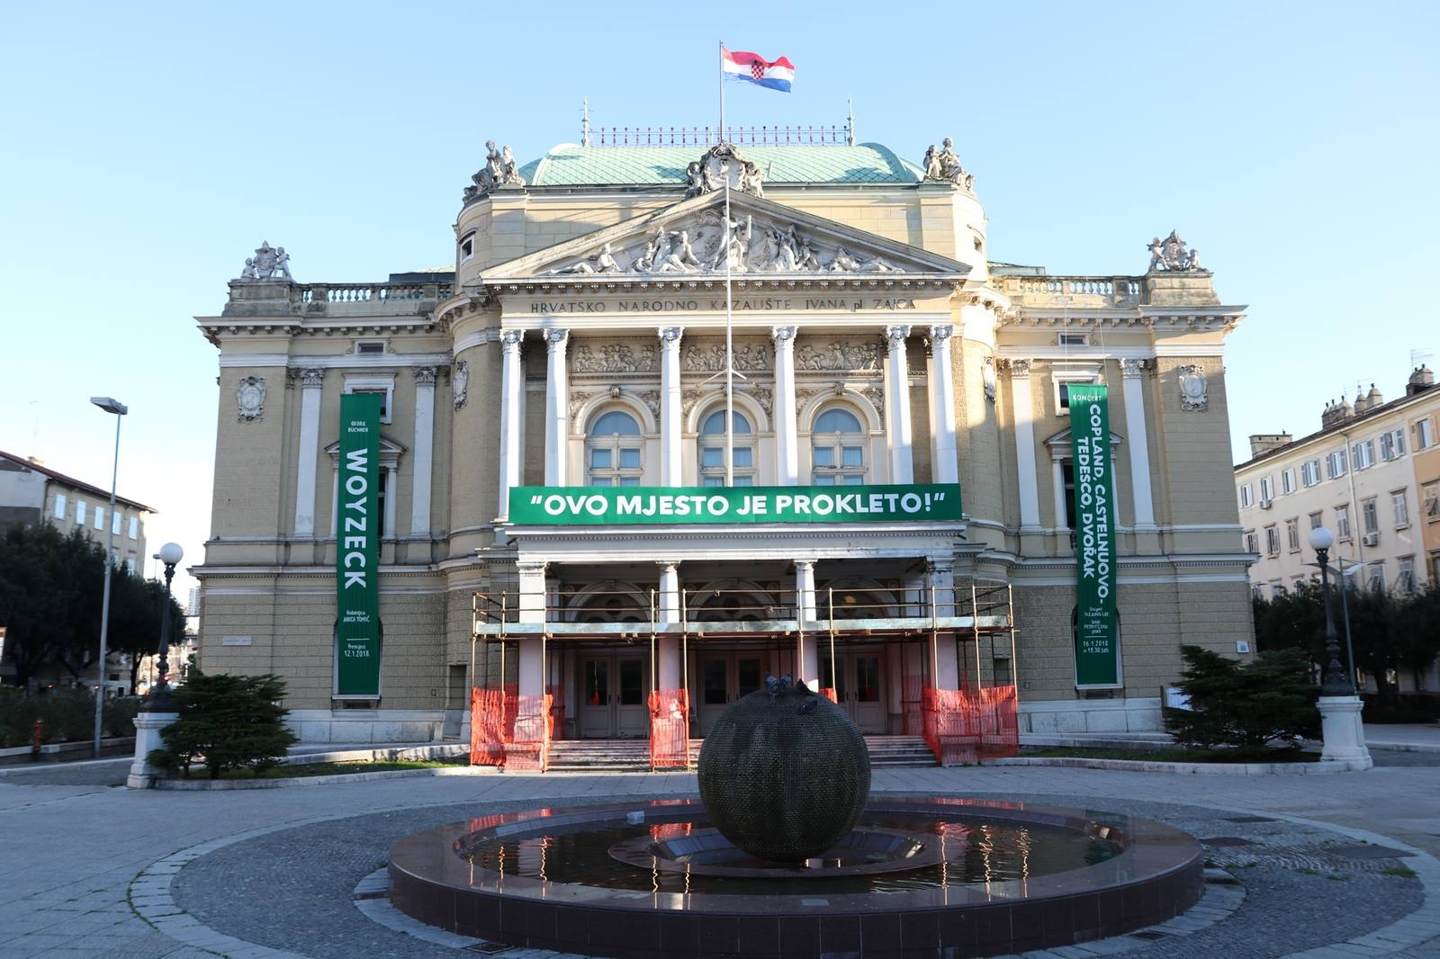
One of four national theatres in Croatia
The largest cultural venue in the county
300 employees
Long tradition that starts back in the 19th century
- Consists of the Croatian company as well as the Italian one, also The Opera and Ballet Company
- Three departments that cooperate in Audience Developmant projects:
Sales, Marketing and Propaganda

Slide 4
Making the arts widely accessible
Audience development opportunities in two opposed cultural sectors
Infrastructure
Staff - enthusiasm
Finances
Time
Contacts with stakeholders
Contact with the local community
AD Plan: analysis and goals
Reaction speed
Present audience involvement
Networking
Public institutions
Private sector

Slide 5
Expecting-ECOC-Rijeka 2020
Large expectations?
Everyday irony (from piles of garbage on the street to naked artists)?
RIJEKA 2020: EUROPEAN CAPITAL OF CULTURE
Intense public attention?
Capacity Building?
More media attention?
Citizens involvement?
Partnerships?
Learning programme?

Slide 6
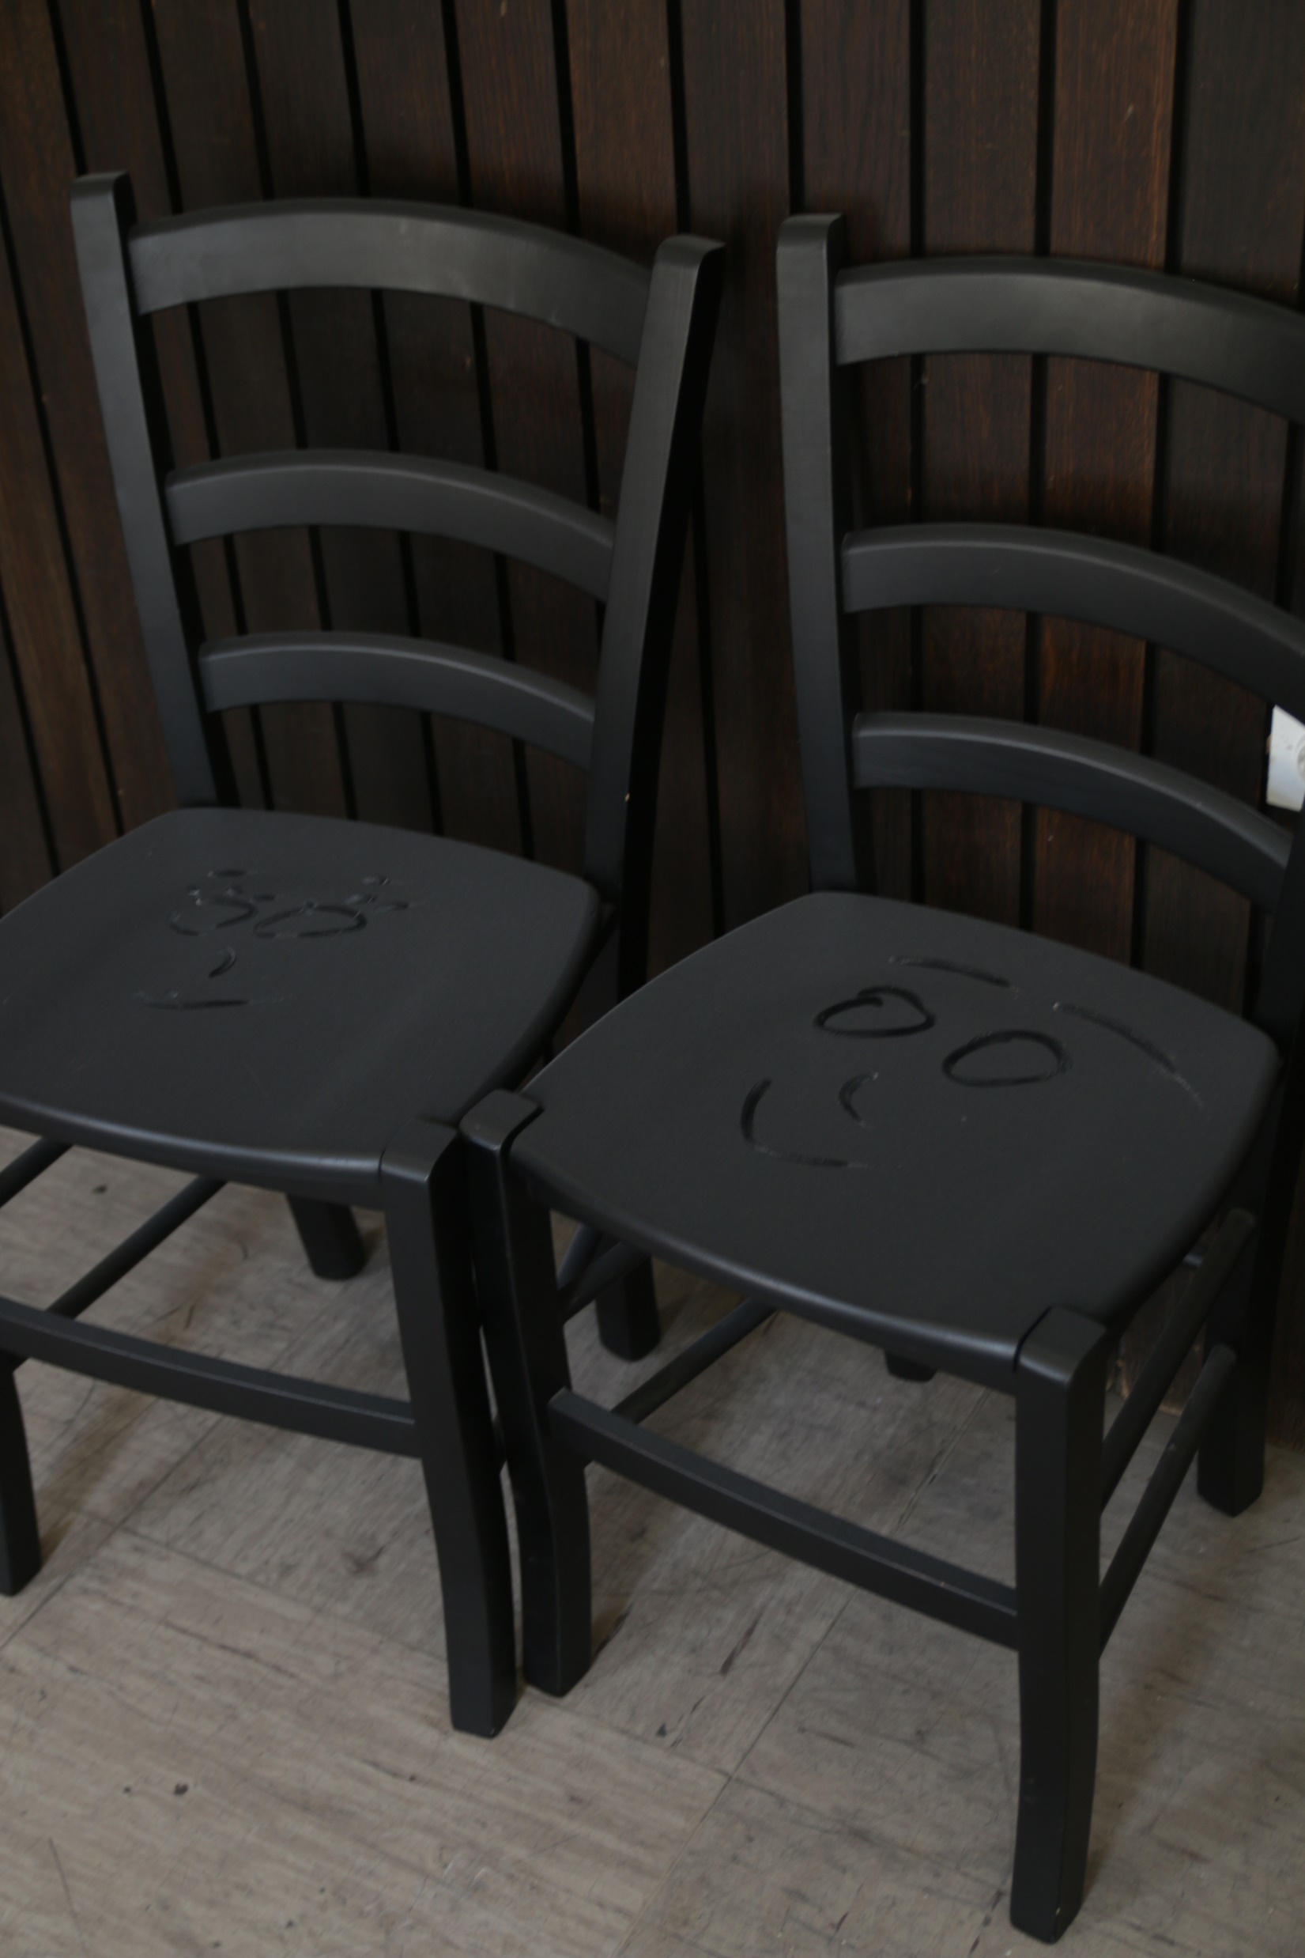
Audience Development in CNT
Theatre Parliament
Talks After the Performance
Musical Salon
Rijeka's Youth Theatre Kamov
Working ballet matinee
Ballet workshops (free of charge): for kids; for passionate dancers, 50+
Lectures
Video-clips (behind the scenes)
Educational concerts
Theatre and Film: cooperation with Art-cinema
Vulnerable Social Groups
Balcony is for the Gang
The rule of 30

Slide 7
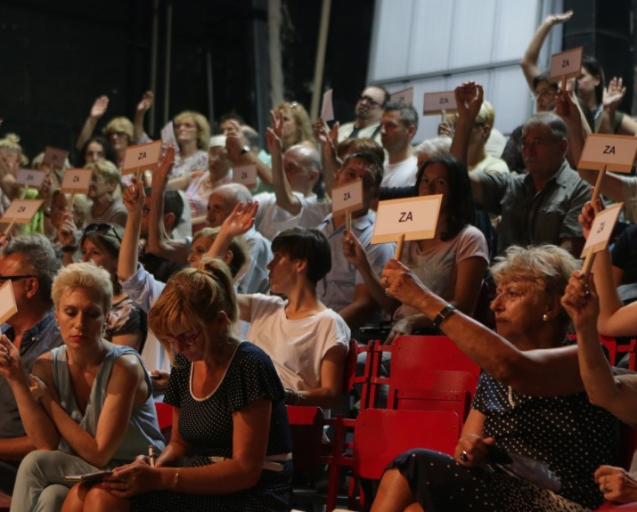
Theatre parliament:
What is it that you dislike about your theatre
Is there a future for the Rijeka Summer Nights Festival
Financial and Programme transparency
Audience Season Awards…

Slide 8
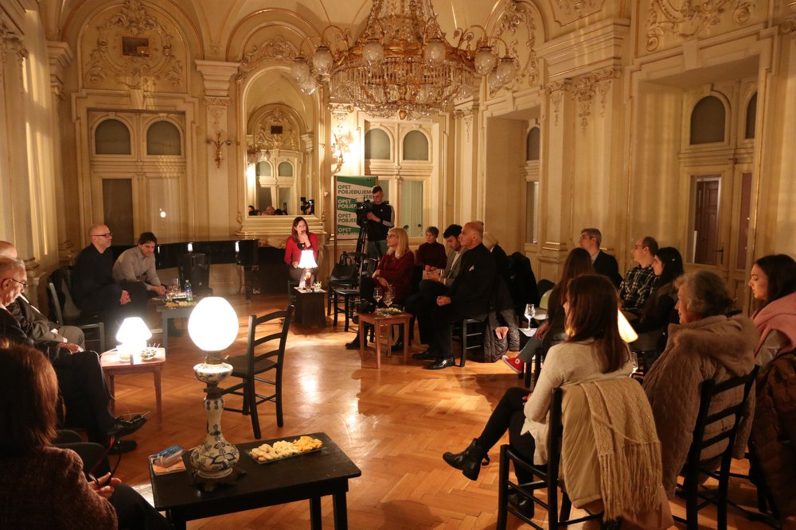
Musical-salon: What about the third
Musical Salon:
What about the Third one?

Slide 9
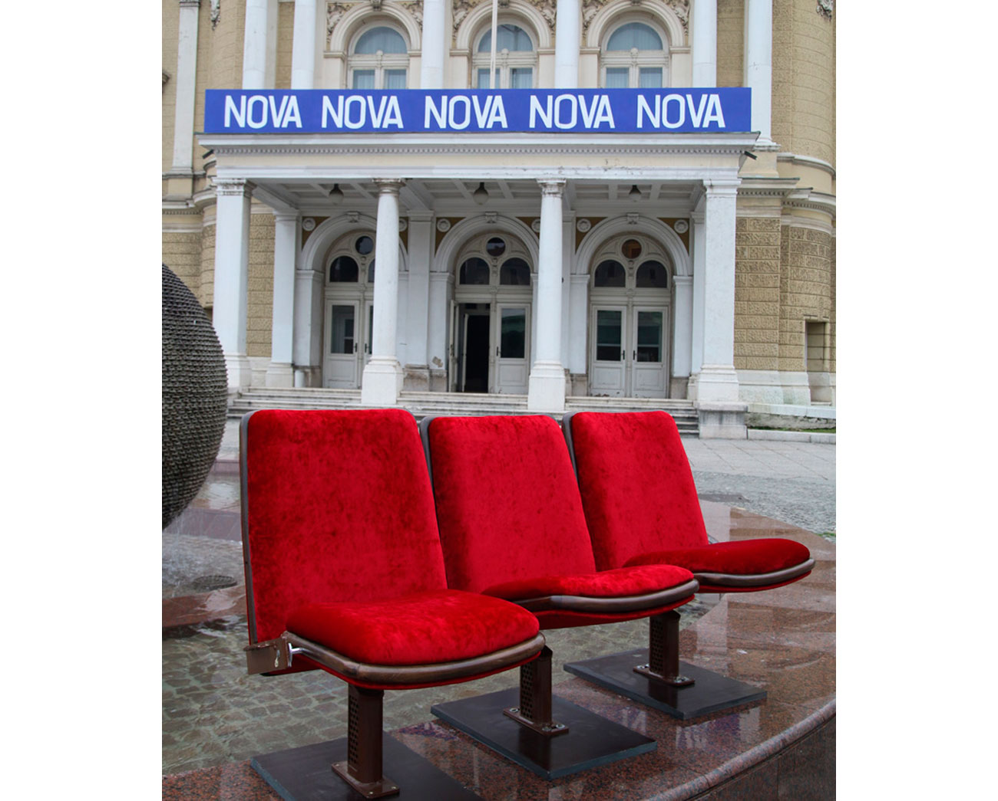
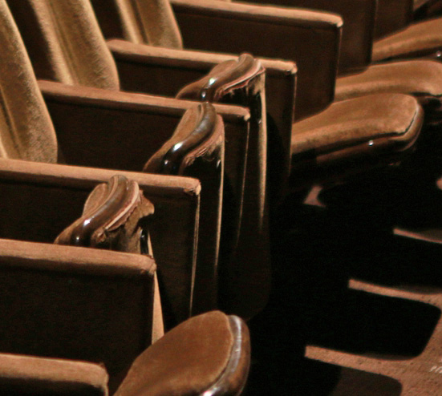
Let’s renew the theatre

Slide 10
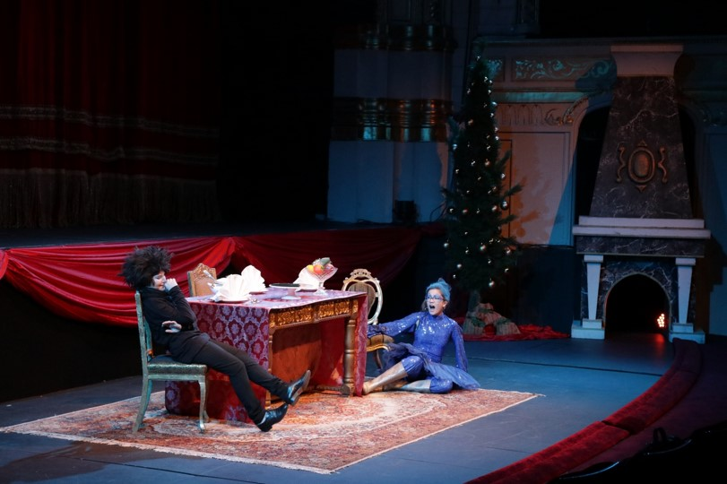
Youth Theatre:
Workshops
Production
Educational concerts
Coproduction with The Youth Home, City institution.

Slide 11
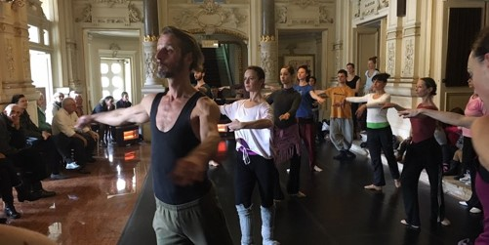
Ballet matinees and open rehearsals

Slide 12
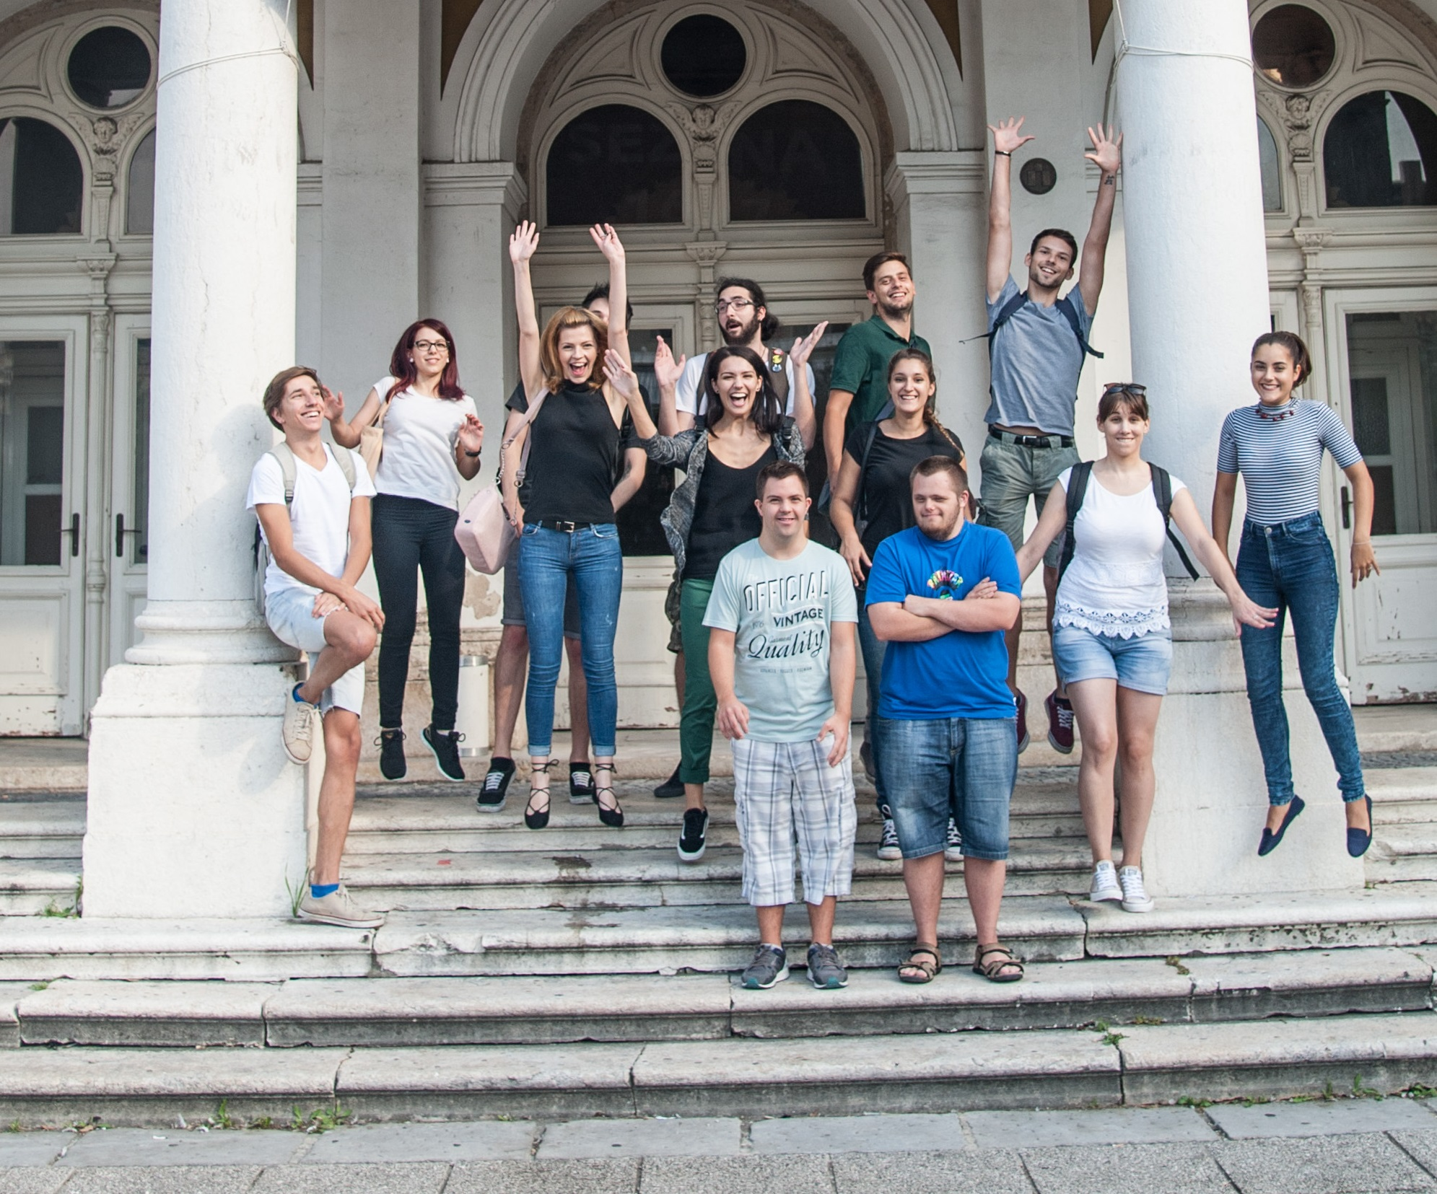
Inclusion: 5th ensemble

Slide 13
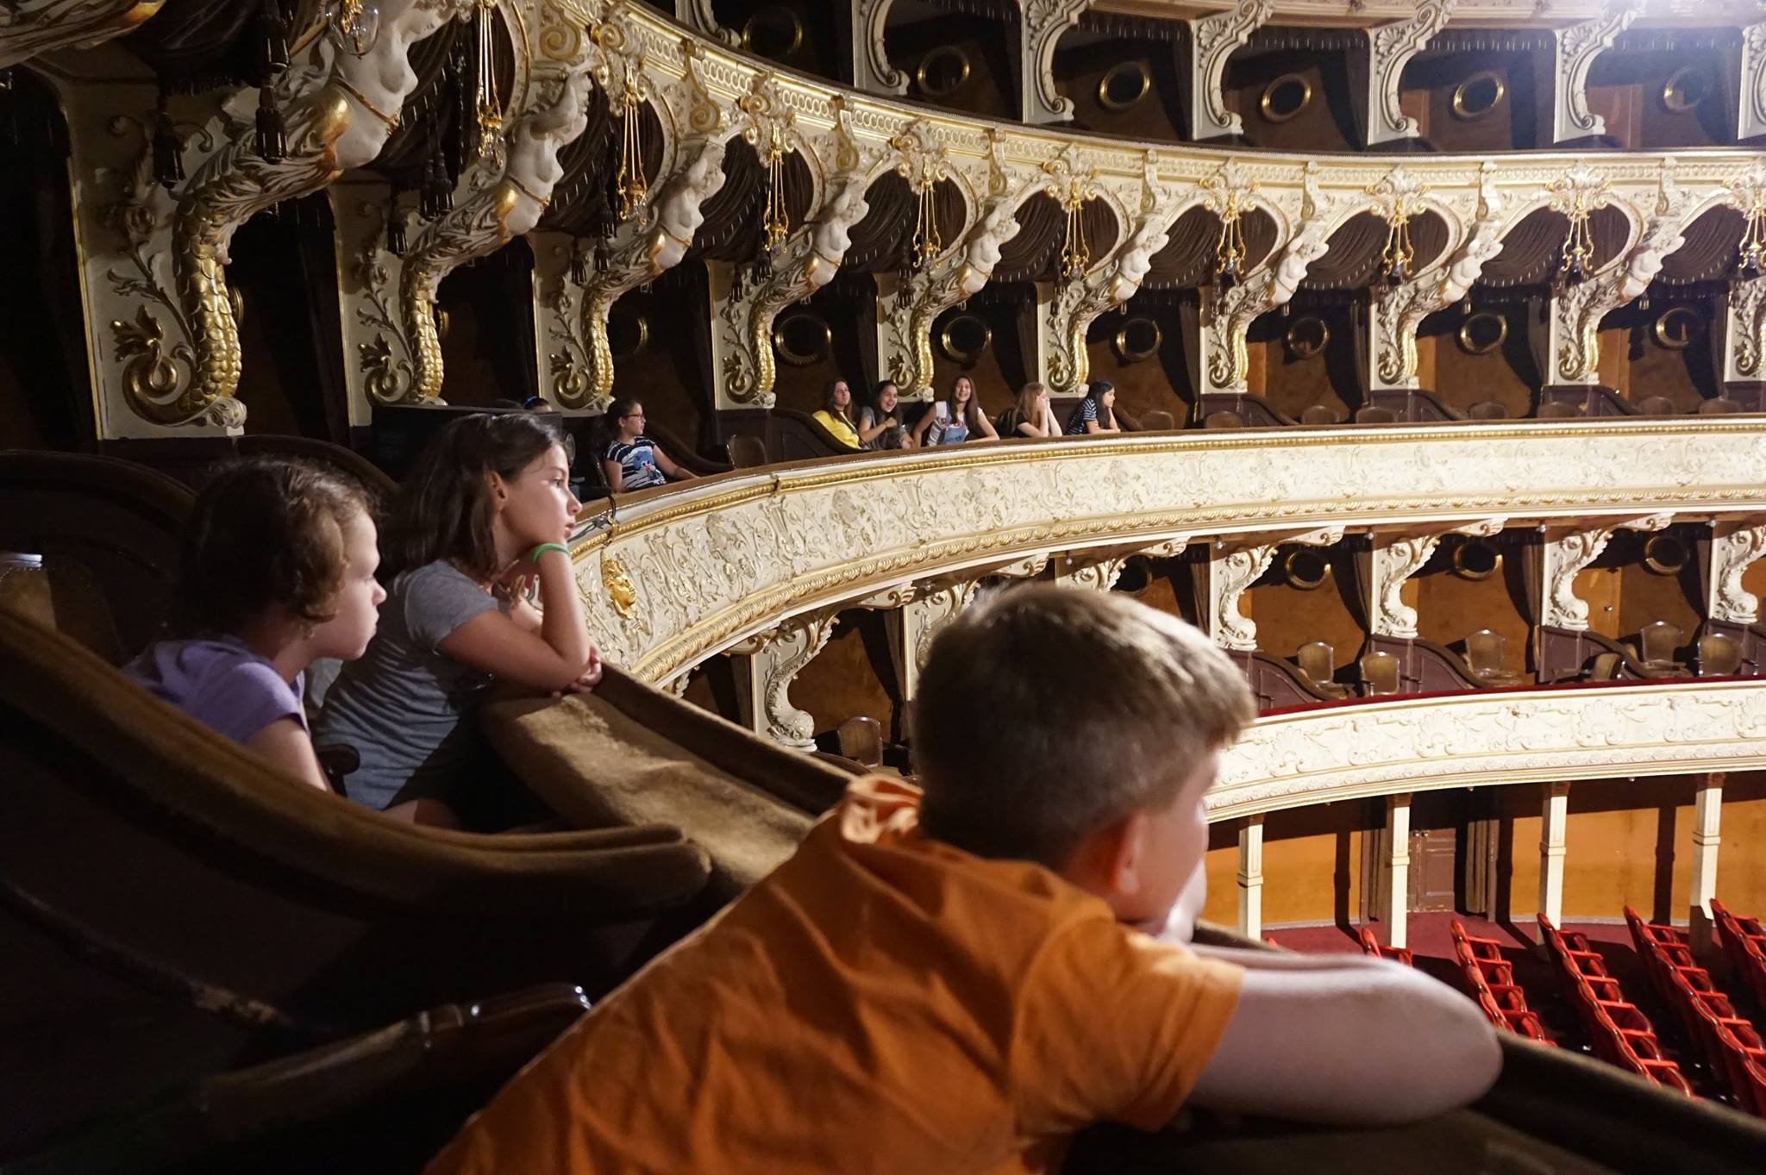
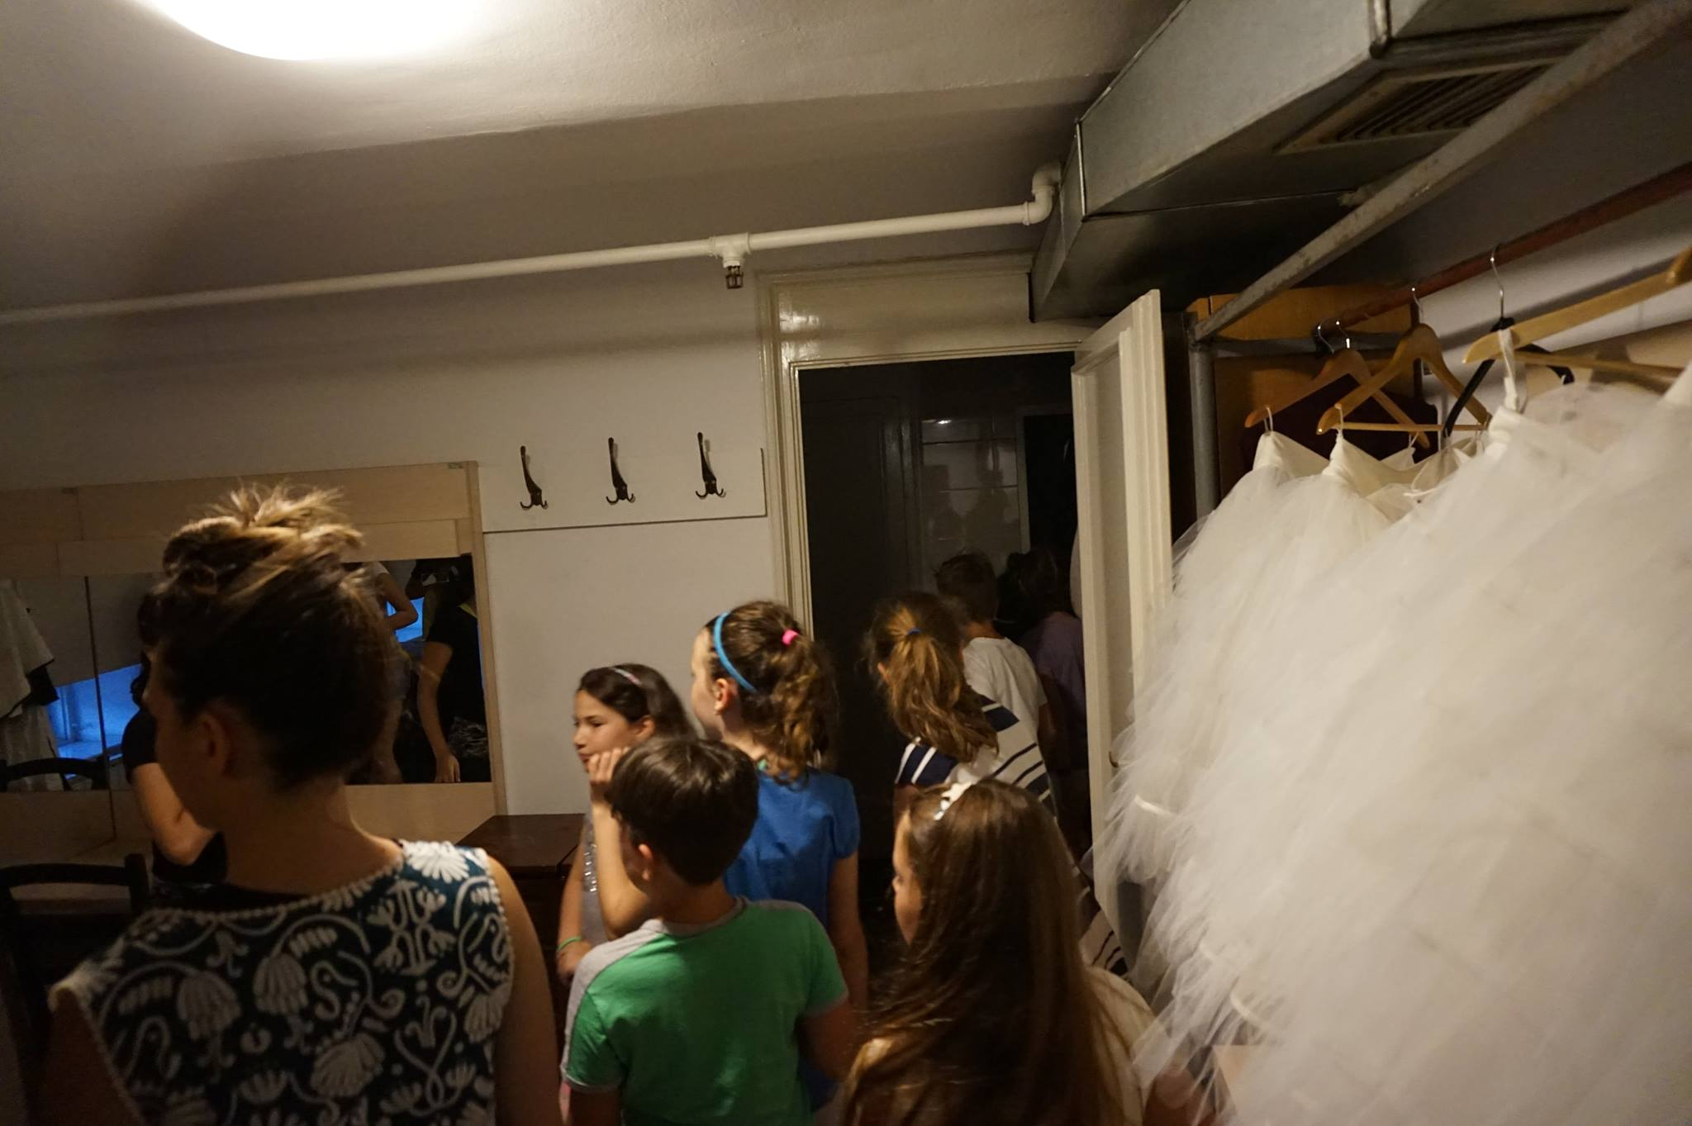
My Theatre

Slide 14
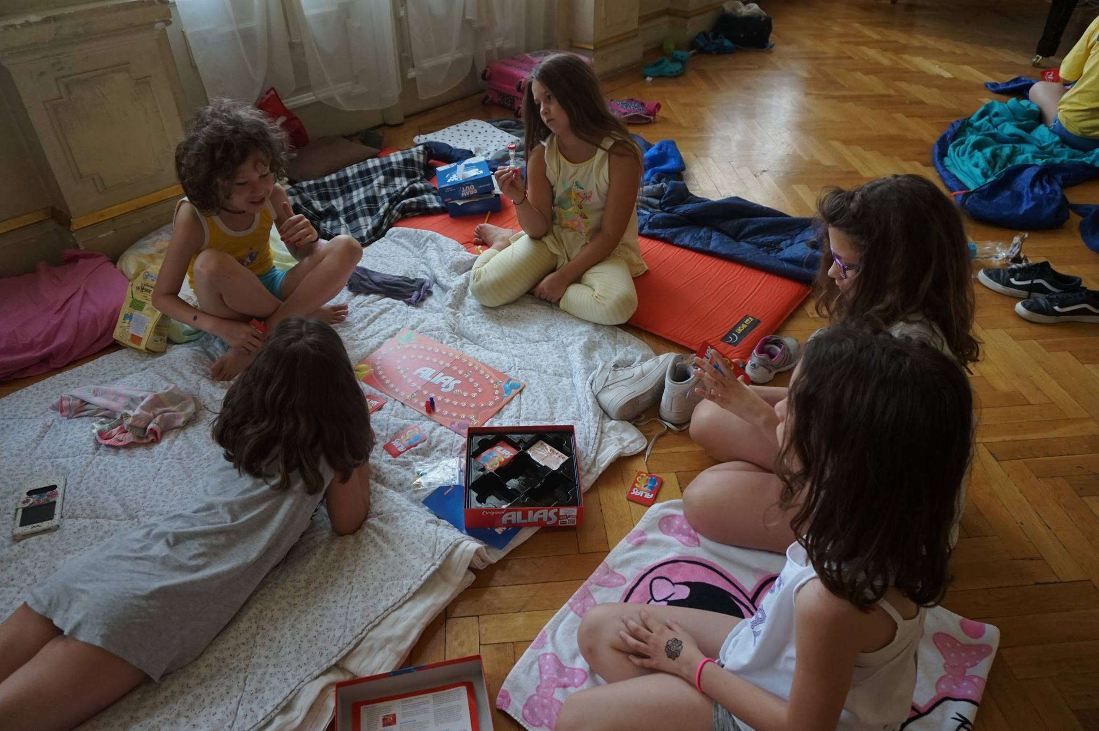
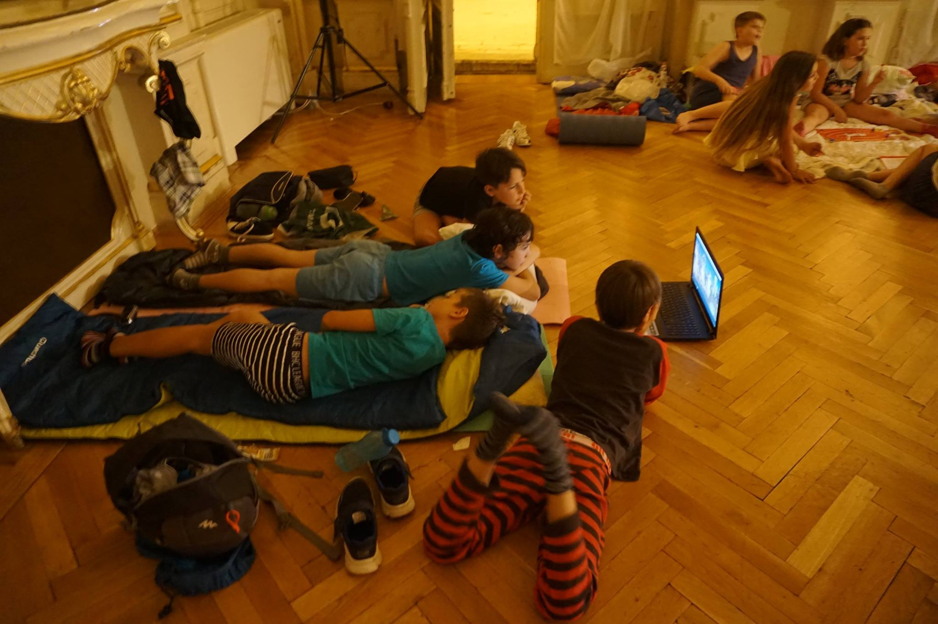
Sleepover

Slide 15
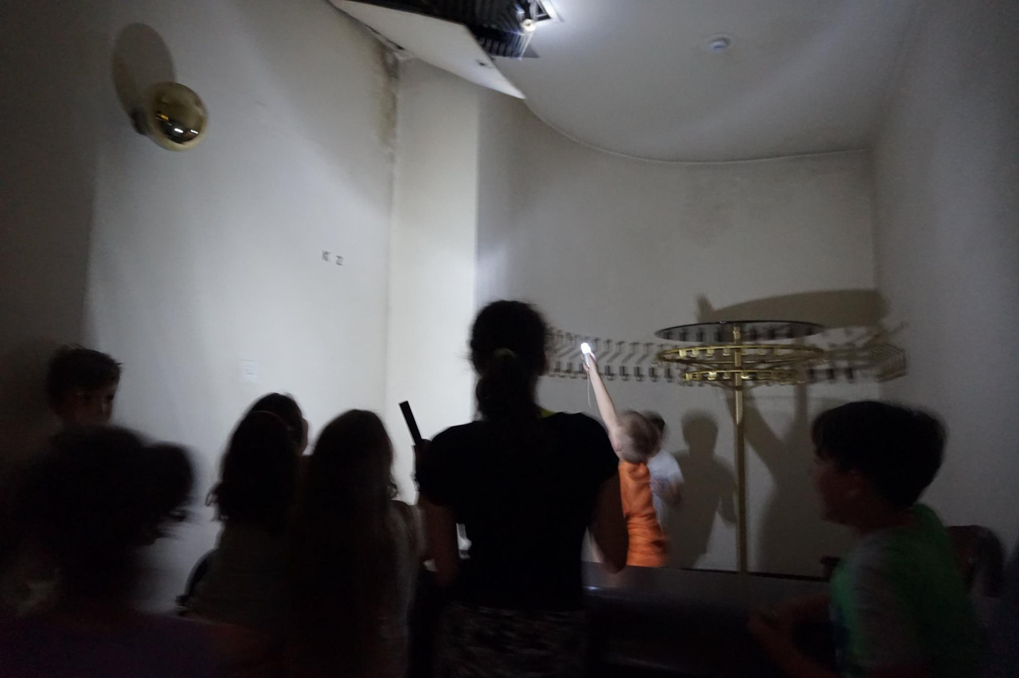
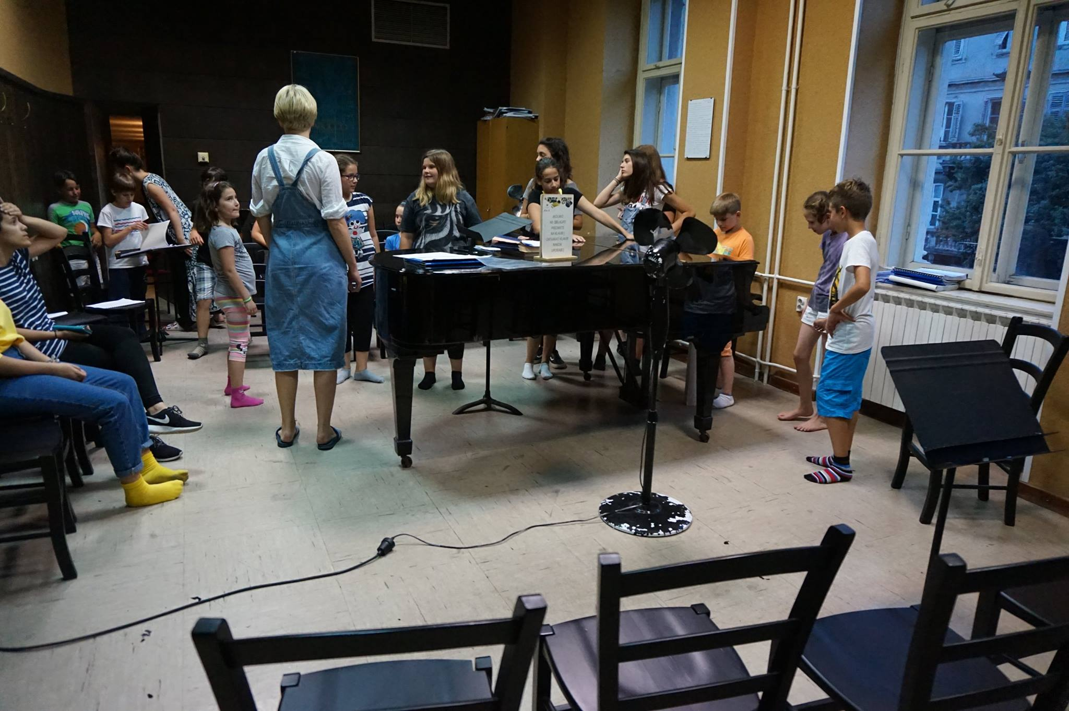
17 Ten-year olds
Evening:
- Balet rehearsal Swan’s lake
- Talks with actors and dancers
- Visiting wardrobes, sound-studio, drama-studio…
- Camping in the theatre foyer, social games and sleep
Morning:
- Stage, behind the stage and audience

Slide 16
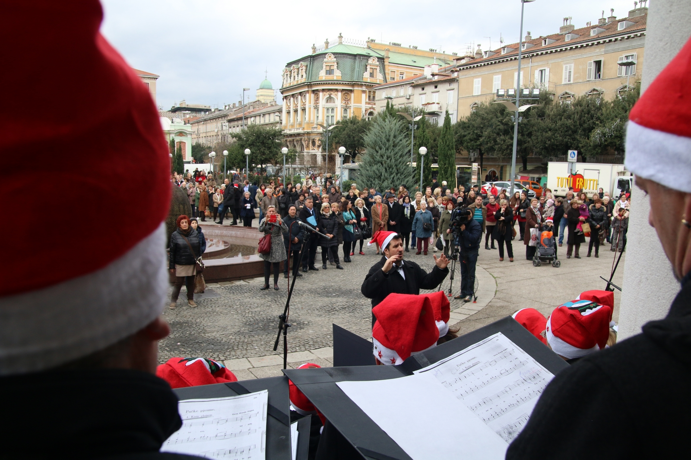
Theatre widely accessible to the audience:
Process of work as an artwork itself
Social relevance
Cocreation
Prioritizing/selection

Slide 17
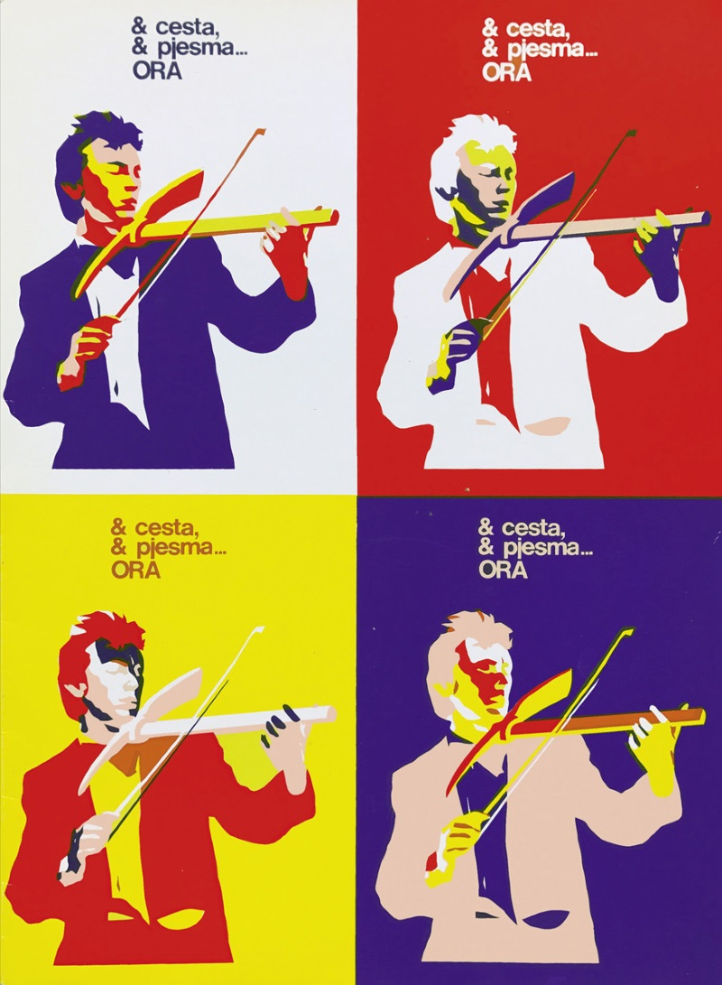
Katarina Mažuran Jurešić
Audience Development Director
Croatian National Theatre Ivan pl. Zajc
Rijeka
Croatia
www.hnk-zajc.hr

